Slide 1
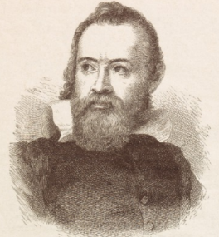
You Would Not Have Stood With Galileo The surprising (and forgotten) strength of the science against Copernicus in Galileo’s time
Christopher M. Graney
Jefferson Community & Technical College
Louisville, Kentucky (USA)
christopher.graney@kctcs.edu

Slide 2
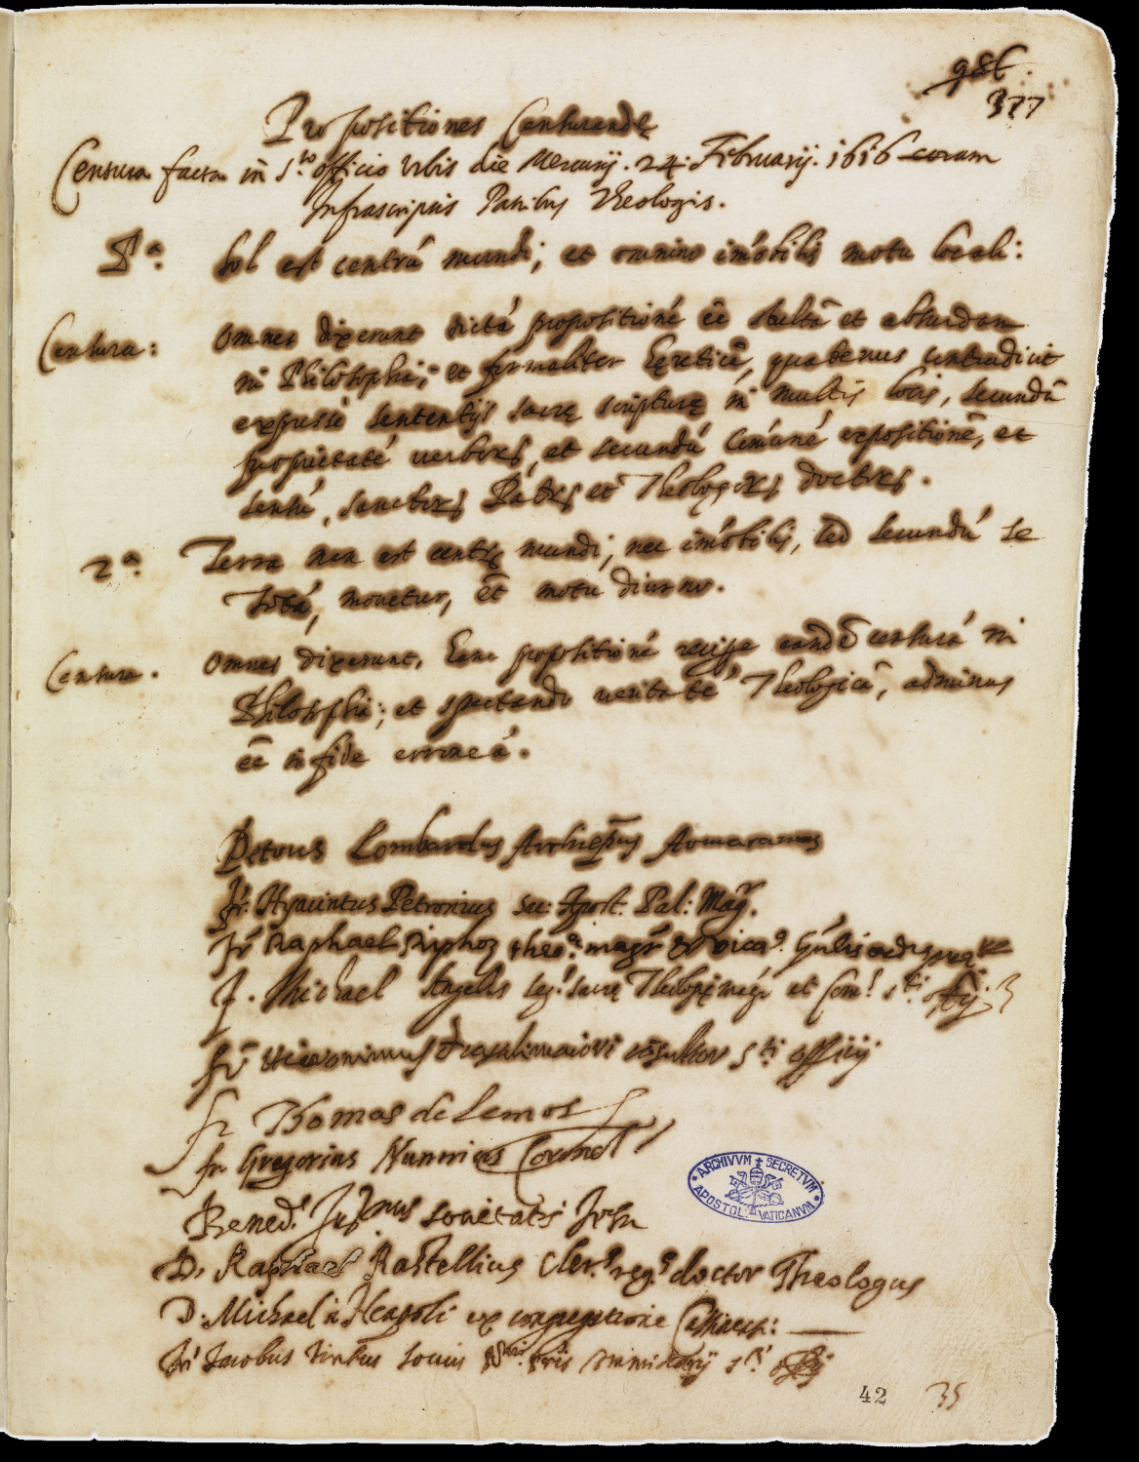
400 years ago,
24 February 1616
“foolish and absurd in philosophy”
“scientifically untenable”

Slide 3
“All have said the stated proposition to be foolish and absurd in Philosophy;
and formally heretical, since it expressly contradicts the sense of sacred scripture in many places, according to the quality of the words, and according to the common exposition, and understanding, of the Holy Fathers and the learned Theologians.”

Slide 4
“Heliocentrism is scientifically untenable;
and, since it contradicts the literal sense of scripture, it is theologically heretical.”

Slide 5
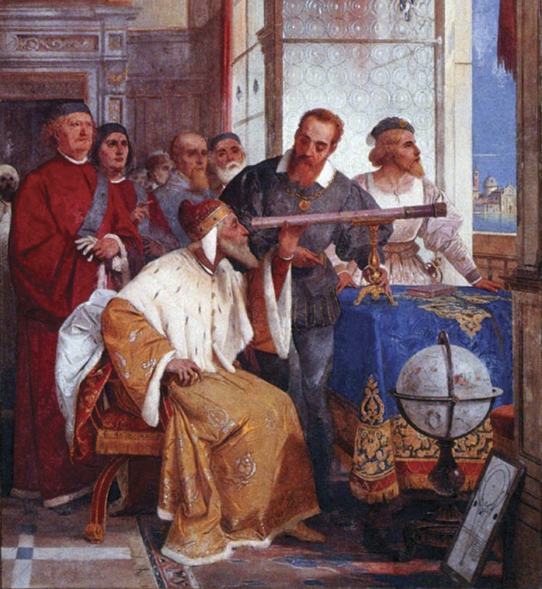

Slide 6
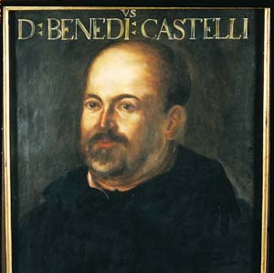
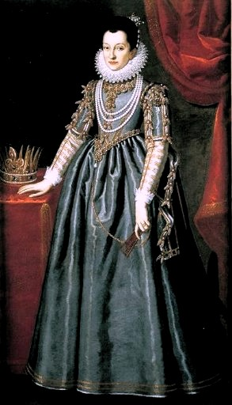

Slide 8
Ingoli’s Arguments:
Galileo attributed the rejection of Copernicus to these arguments
#1) Triangulated distances to the sun and moon wrong.
#2 & #3) Two different effects on the appearance of the stars that should be caused by Earth’s orbital motion are not observed.
#4) Copernicus was wrong regarding certain technical details of Mercury’s and Venus’s orbits.
#5) Heavier materials move down, lighter materials up. Earth is heavy.
#6) In a circularly agitated sieve, the heavier bits of material collect at the center. Earth is a heavy thing surrounded by lighter bodies in circular motion.

Slide 9
Ingoli’s Arguments:
Galileo attributed the rejection of Copernicus to these arguments
#7) Scripture—the sun and moon being equally described in Genesis as lights in the firmament.
#8) Where is hell?
#9) On a rotating Earth, a falling ball should deflect from the vertical.
#10) On a rotating Earth, launched projectiles should behave differently at different latitudes.
#11 & #12) Two more not observed effects of Earth’s motion on the appearance of stars.

Slide 10
Ingoli’s Arguments:
Galileo attributed the rejection of Copernicus to these arguments
#13) Earth’s motion should have an observable effect on daylight.
#14) The observed motions of comets are inconsistent with a moving Earth.
#15- #17) Three issues regarding how Copernicus keeps Earth’s axis aimed at the North star while Earth circles the sun.
#18) Earth is heavy -- hard to make move.
#19) Heavy stuff moves naturally toward the center of Earth. Earth, being composed of heavy stuff, cannot move naturally around the sun.

Slide 11
Ingoli’s Arguments:
Galileo attributed the rejection of Copernicus to these arguments
#20) Copernicus lacked consistency in what he put into motion -- both a dark body like Earth and bright bodies like the planets.
#21) Scripture—Joshua commanding the sun to stand still.
#22) Traditional hymns.
Skip the religious ones, Galileo!
--Ingoli

Slide 12
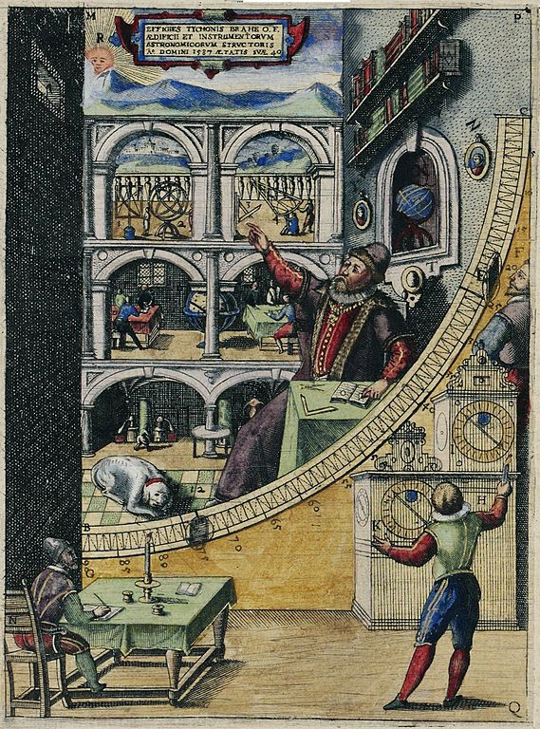
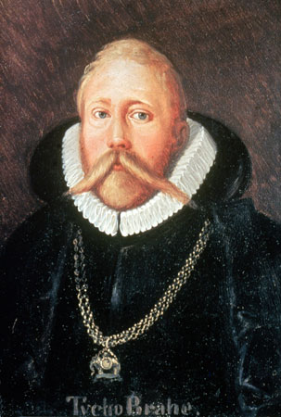

Slide 13
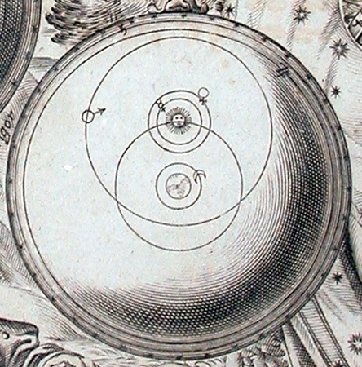

Slide 14
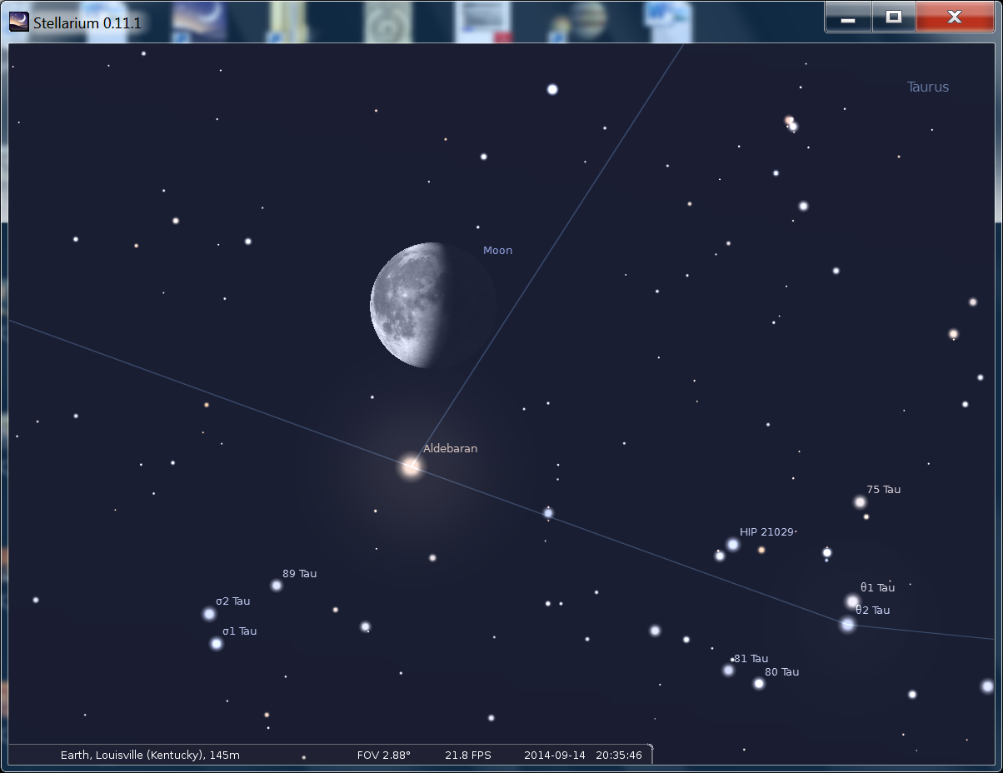

Slide 15
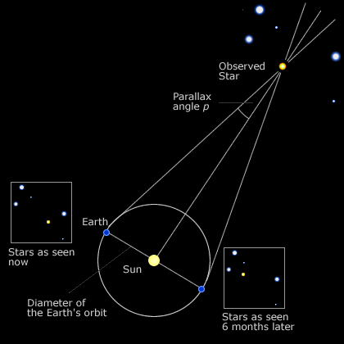
Under the heliocentric system, the annual motion of the Earth should be reflected in the stars—
annual parallax—one of those “observable effects”

Slide 16
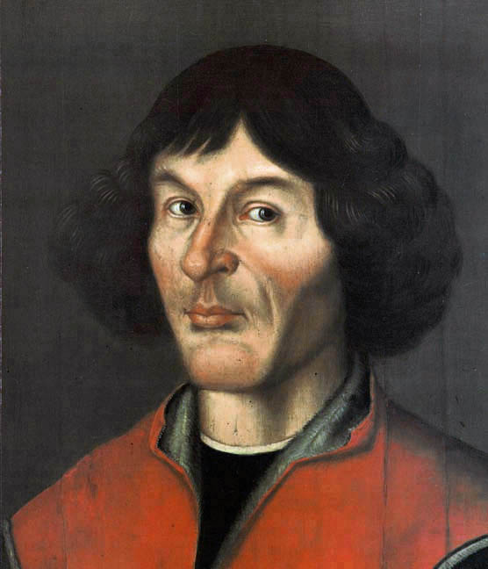
“This proves their [the stars] immense height.... every visible object has some measure of distance beyond which it is no longer seen, as is demonstrated in optics..”
—Copernicus, De Revolutionibus

Slide 17
EYE

Slide 18
EYE

Slide 20
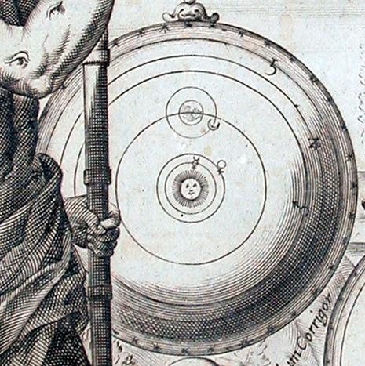

Slide 21
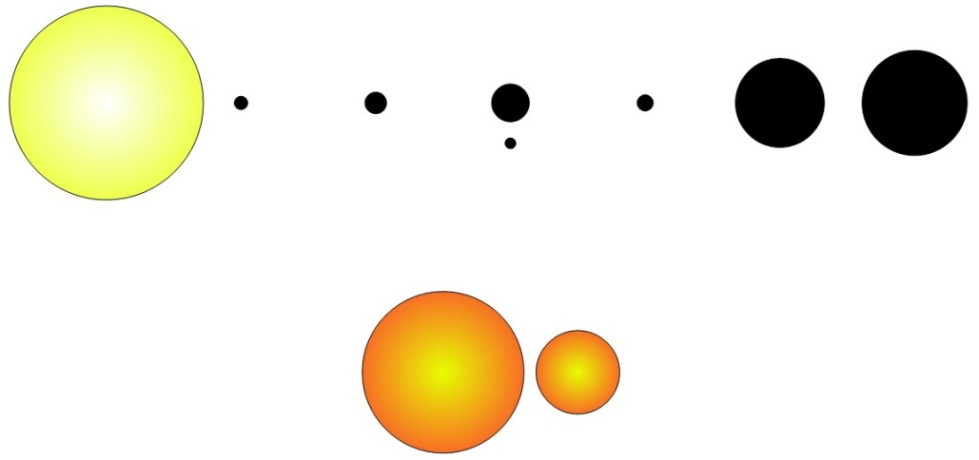

Slide 22
?

Slide 23
You Would Not Have Stood With Galileo

Slide 24
. . . .

Slide 25
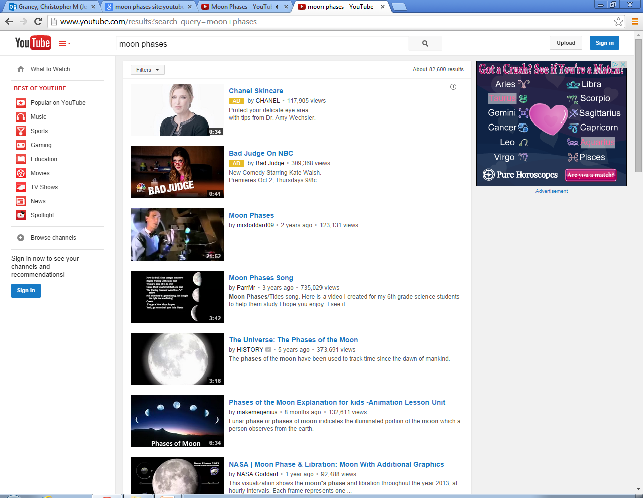

Slide 26
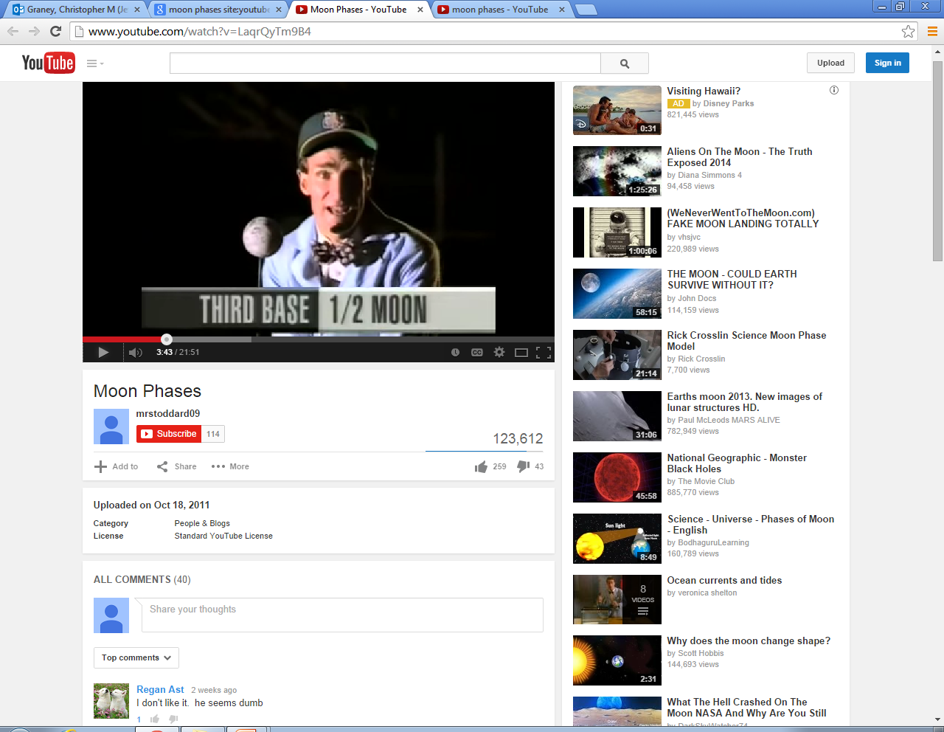

Slide 27
My OPINION…
History of science myths are central to science denial.

Slide 28
My OPINION…
Science deniers see themselves as Copernicans, standing up against those who refuse to acknowledge the truth.

Slide 29
My OPINION…
Good history is essential to science.

Slide 30
QUESTIONS?

