Slide 1
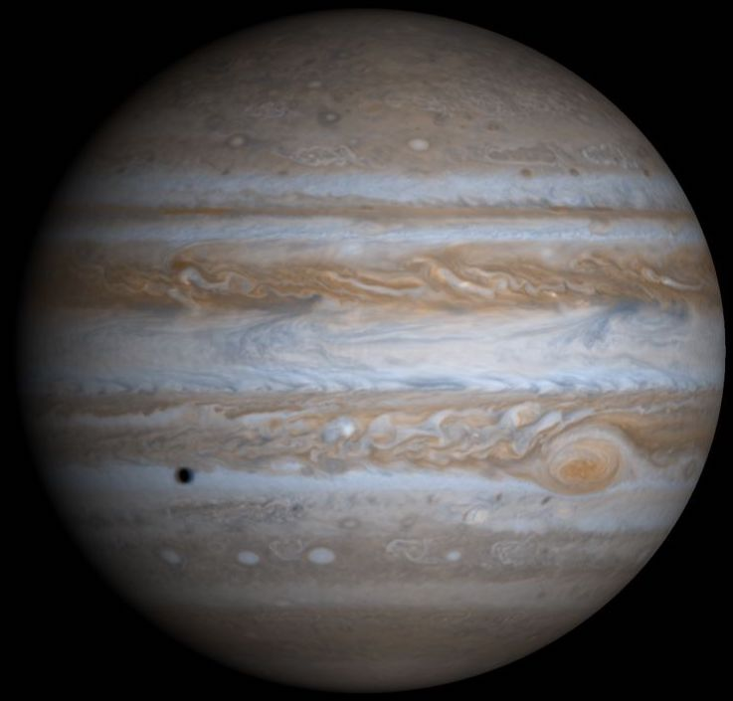
The Real Reason Jupiter has
Cloudy Zones and Clear Belts
Tim Dowling
Physics & Astronomy
University of Louisville

Slide 2
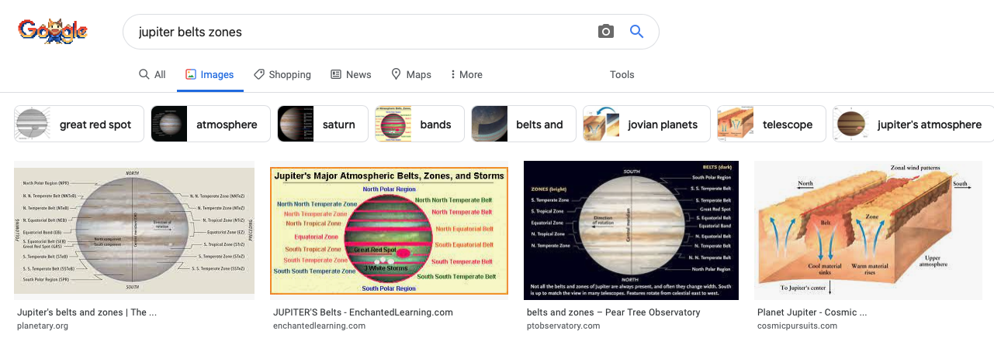
Do a Google search / Images: Get the detailed nomenclature of Jupiter’s belts and zones, plus a bevy of cartoons:
The nomenclature is 100% fine
The cartoons are 100% rubbish

Slide 3
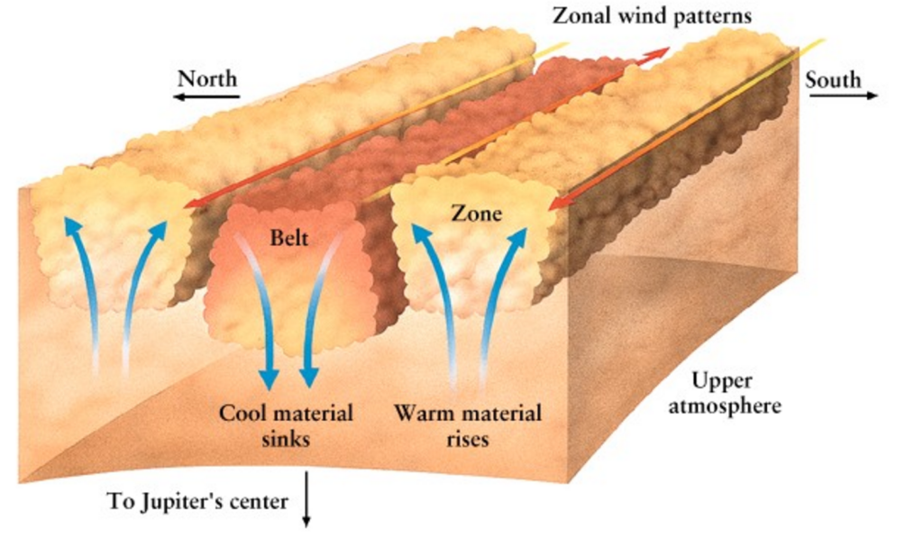
The notion that clouds imply upwelling
and clearings imply downwelling is a
widespread fallacy in planetary science
Busting an entrenched cartoon myth is not easy…
We must fight fire with fire
1. A training session using clouds that are not from upwelling, but have cartoon up arrows drawn on them
Surface friction is needed to drive
such secondary circulations on Earth.
Where do these cartoons
locate this friction on Jupiter?
2. Emoticons that show the real reason Jupiter’s zones are cloudy and its belts are clear
These cartoons are made up out of whole cloth

Slide 4

Training Session: Case 1 of 3
    Downwelling
Upwelling

Slide 5
Training Session: Case 1 of 3
    Downwelling
Upwelling

Slide 6
Training Session: Case 1 of 3
What is the real reason we see our breath in winter?

Slide 7
Training Session: Case 1 of 3
What is the real reason we see our breath in winter?
A: We add moisture to chilly air.

Slide 8

Training Session: Case 2 of 3
Downwelling
Upwelling

Slide 9
Training Session: Case 2 of 3
Downwelling
Upwelling

Slide 10
Training Session: Case 2 of 3
What is the real reason dry ice makes fog?

Slide 11
Training Session: Case 2 of 3
What is the real reason dry ice makes fog?
A: It chills moist air.

Slide 12
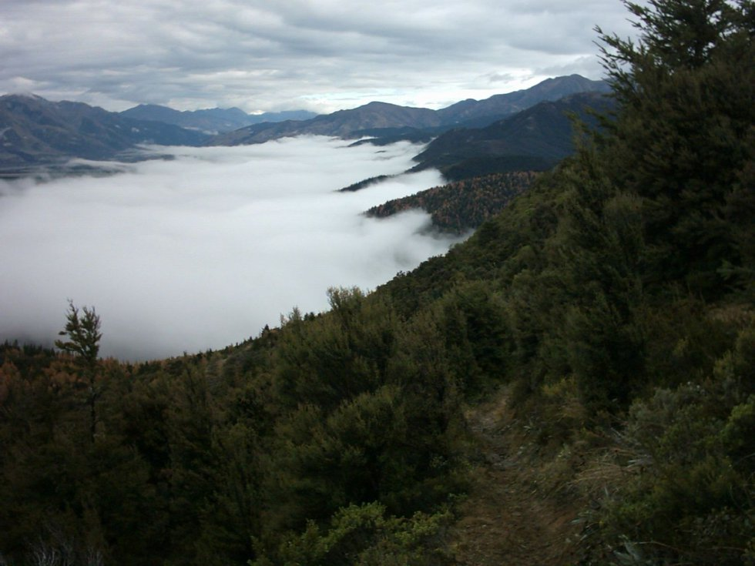
Training Session: Case 3 of 3
Downwelling
Upwelling

Slide 13
Training Session: Case 3 of 3
Downwelling
Upwelling

Slide 14
Training Session: Case 3 of 3
What is the real reason for valley fog?

Slide 15
Training Session: Case 3 of 3
What is the real reason for valley fog?
A: Chilled moist air.

Slide 16
What do clouds imply?
What do clearings imply?
A: The air is moist and chilly.
A: The air is dry or warm, or both.
not upwelling
not downwelling
not up arrows
not down arrows

Slide 19
What is the real reason for Jupiter’s cloudy zones and clear belts?
A: The zones are chilly and the belts are warm.

Slide 20
Why are Jupiter’s zones chilly?
1. Zones have anticyclonic shear
The air in zones is chilly
so that it fits
under the tropopause
2. Anticyclones are high pressure
3. Jupiter’s jet streams are deep
4. The tropopause is flat
5. Thickness between pressure surfaces . is proportional to temperature
Jupiter’s cloudy zones are a side effect of the
processes that keep the tropopause flat and the jets strong

Slide 21
Why are Jupiter’s belts warm?
1. Belts have cyclonic shear
The air in belts is warm
so that it fits
under the tropopause
2. Cyclones are low pressure
3. Jupiter’s jet streams are deep
4. The tropopause is flat
5. Thickness between pressure surfaces . is proportional to temperature
Jupiter’s clear belts are a side effect of the
processes that keep the tropopause flat and the jets strong

Slide 22
A tropopause is stratified, it is stubbornly flat
(“flat” like the surface of the ocean)
Voyager: East and west jet streams on Jupiter run deep
Juno: The jets are about as deep as they are wide
Jupiter’s cloudy zones and clear belts (first seen in the 1600s)
are indirect visual evidence that the planet has strong, deep jets!

Slide 23


Emoticons for Jupiter’s Zones and Belts
Tropopause
High pressure
Zone
Belt
Low pressure

Slide 25
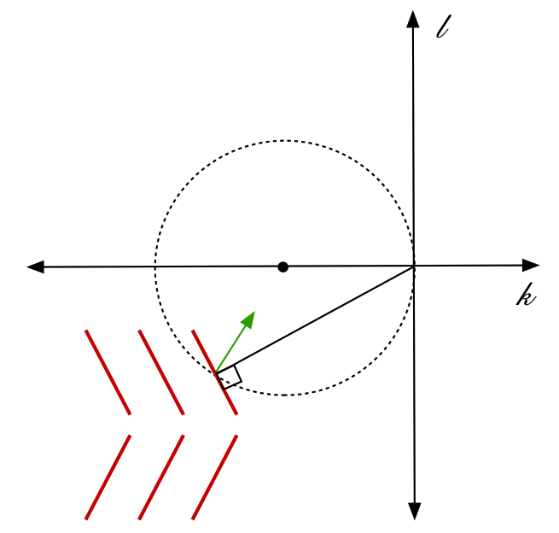
Jet streams come from Reynolds stresses:
turbulent eddies that drive currents like cilia
Jupiter has deep and strong Reynolds stresses
The conflict between Jupiter’s wiggly deep jets and its flat tropopause is primary;
no secondary circulations are involved

Slide 26

But, do the pressure ridges and troughs associated with the deep jets
require continuous upwelling and downwelling?
Downwelling
Upwelling

Slide 27
But, do the pressure ridges and troughs associated with the deep jets
require continuous upwelling and downwelling?
Downwelling
Upwelling

Slide 28
But, do the pressure ridges and troughs associated with the deep jets
require continuous upwelling and downwelling?
No. Just as your knuckles do not require continuous upwelling and downwelling to keep their shape
The Coriolis force tirelessly balances
the pressure wiggles with the prevailing jets

Slide 29
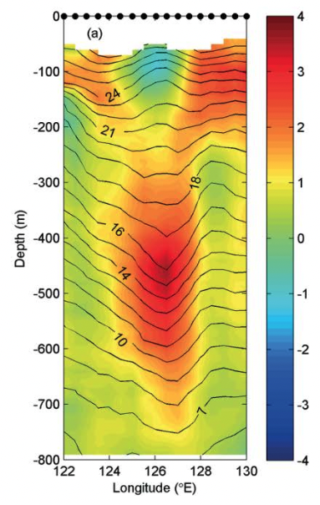
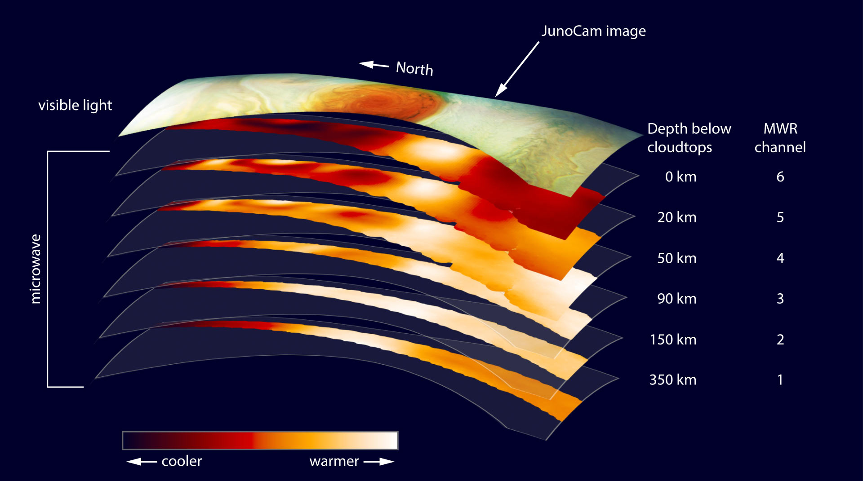
Temperature of an
anticyclonic lens in the
Northwestern Pacific
Juno’s Microwave Radiometer (MWR)
found the Great Red Spot is warm at depth
cold core
cold core (Voyager IRIS)
warm core (Juno MWR)
warm core
|(|
|(|
cold core
Anticyclonic lenses are pedestrian for physical oceanographers
warm core
(Juno does not have a physical
oceanographer on its science team)
Emoticon for an anticyclonic lens
Nan et al. (2017, J Marine Sci Res Dev 7:4)

Slide 30
Conclusions
• Jupiter has no surface friction to generate upwelling and downwelling
• Jupiter’s zones must be chilly to fit under the tropopause: |*( ( (
• Jupiter’s belts must be warm to fit under the tropopause: | ) ) )
• These temperature differences are maintained by the
. processes that keep the tropopause flat and the jets strong
• Cloudy zones and clear belts are centuries-old evidence of deep jets
• The Great Red Spot is an anticyclonic lens: | ( |
. just like in oceanography
• Be wary of cartoon physics (and of “new discovery” claims)

