Slide 1
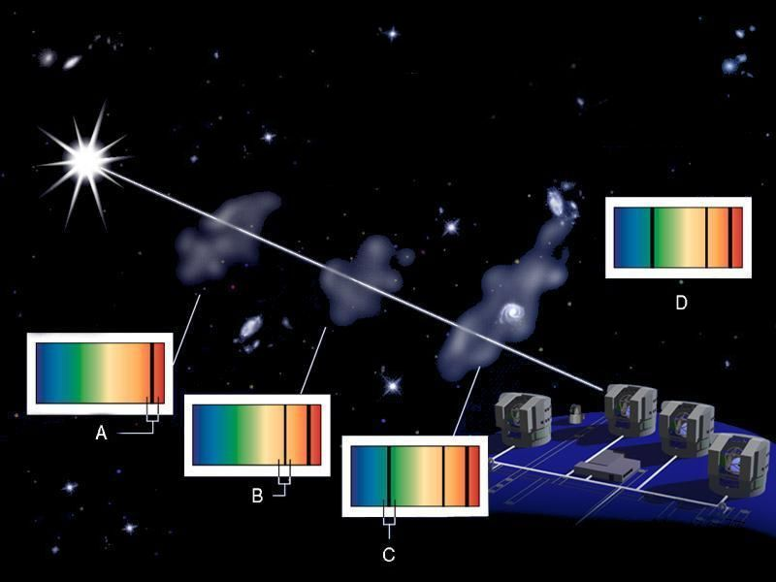
Quasars and Large Scale Structures
``Lighthouses of the Universe” and what they Illuminate
``Shadows” from foreground galaxy haloes
Quasar

Slide 2
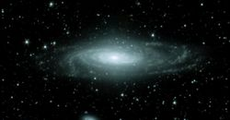
Stars -- ``cells” of the Universe – in Galaxies
But – also see GAS → turns into stars
100 billion stars + gas → galaxy (like our Milky Way)

Slide 3
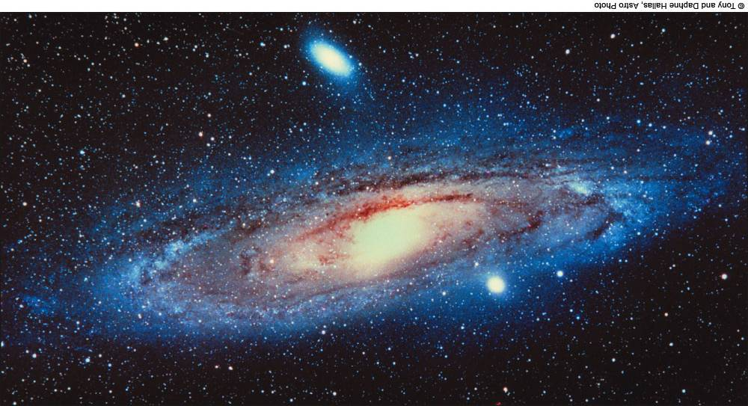
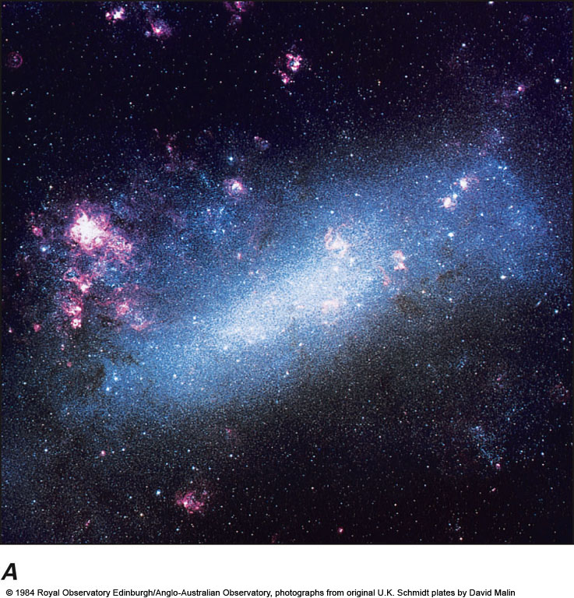
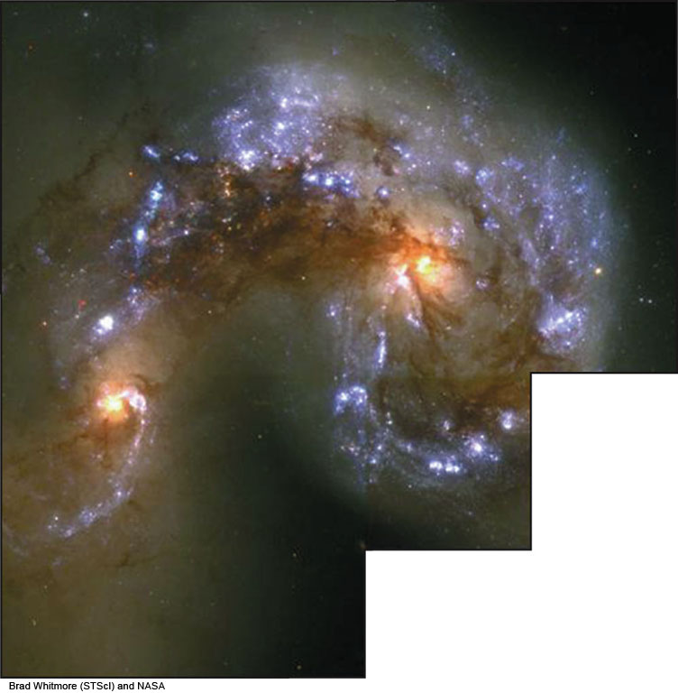
Galaxies: Many types, sizes, masses!
Spirals: ~0.1-10 x Milky Way size/mass can have lots-o-gas
Ellipticals: ~0.0001-10000 Milky Ways
less gas
Irregulars: ~0.0001-0.01 Milky Ways
lots-o-gas
Smash-ups: galaxy mergers
can have lots-o-gas

Slide 4
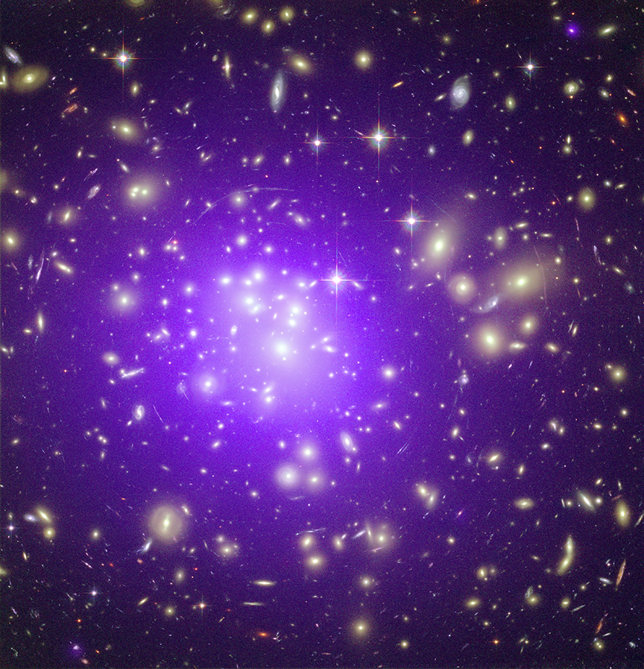
Clusters of Galaxies
MOST galaxies found in pairs, small groups (<50 of Milky Way size or bigger), clusters (>50) or big clusters (>>50)
Isolated ``Field galaxies” exist, too
LOTS of HOT GAS in clusters!
Cluster Abell 1689, 2 billion light years away
Purple: Chandra (hot X-ray gas,
Temperature > 100 million K).
White: Hubble Space Telescope (optical light). Credit: NASA, ESA; E. Jullo et al.

Slide 5
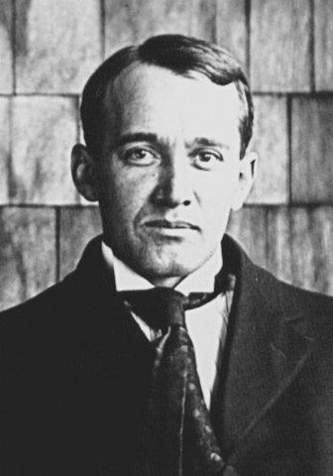
Expanding Universe: Galaxy velocities
1912, Vesto Slipher (from IU and NW IN [Mulberry]) – measured first galaxy velocity
Andromeda galaxy, moving 300 km/s toward us
V. Slipher 1875-1969

Slide 6
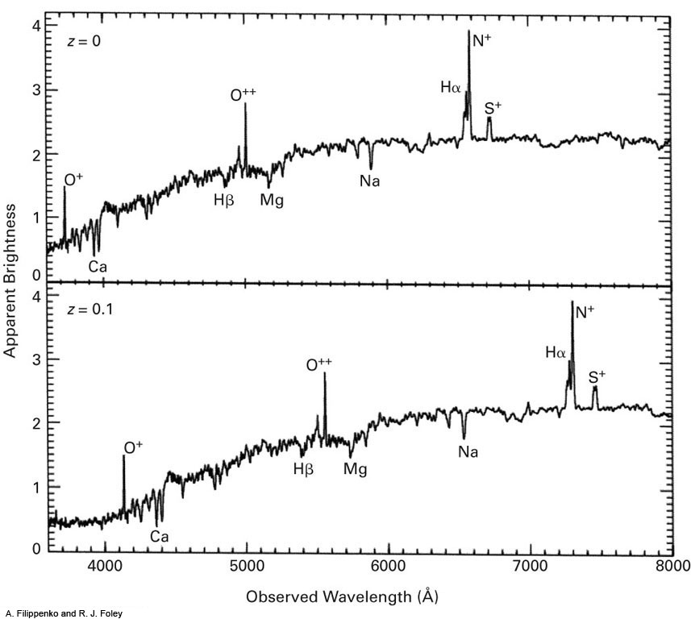
HOW to measure motion toward/away from us (blueshift/redshift)?
SPECTRAL LINES
Emission lines
Each element’s atoms in GAS ``resonates” (like a tuning fork) at different frequencies/wavelengths of light.
Emission (“UP”) lines or Absorption (“DOWN”) lines
Redshifted Galaxies
Absorption lines
Motion away from us shifts lines to longer wavelengths (RED) by a factor (1+z), where z is REDSHIFT
REDSHIFT z=0.1
Fig. 16-30, p. 384
Notes:
Figure 16.30: (top) The optical spectrum of a very nearby galaxy, having essentially zero redshift. Various emission and absorption lines are marked. (bottom) The spectrum of the same galaxy, if it were at a redshift z = 0.1 (in other words, a recession speed of about 30,000 km/sec; see Figure It Out 16.2: Redshifts and Hubble’s Law). The same patterns of emission and absorption lines are visible, but their wavelengths are shifted toward the red by 10 per cent.
A. Filippenko and R. J. Foley

Slide 7
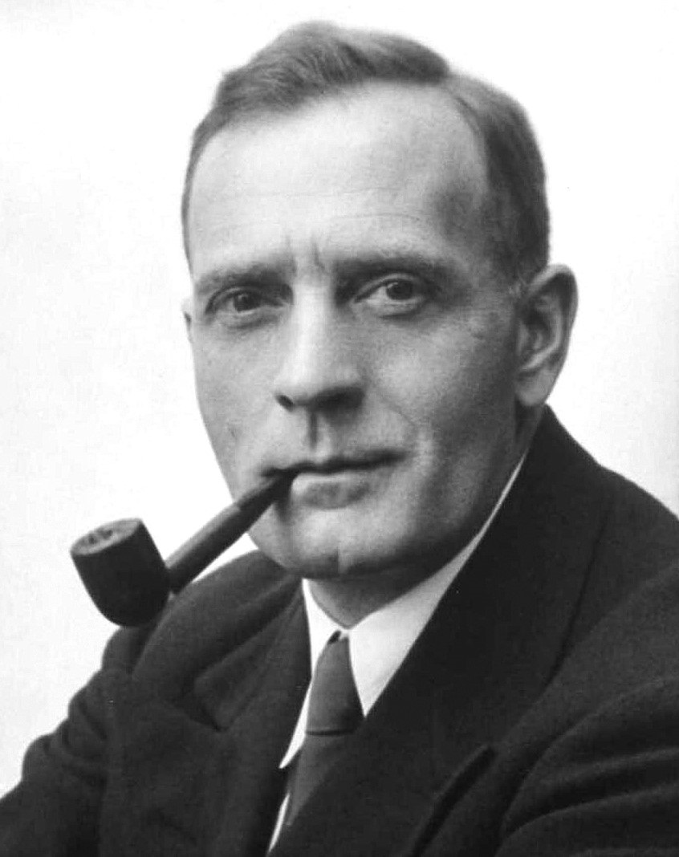
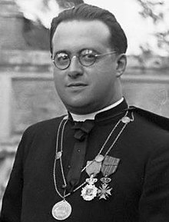
EXPANDING UNIVERSE
Edwin Hubble, c.1925, showed `galaxies VERY FAR + BIG
Used relatively new Mt Wilson 2.5m scope
1927 Based on Einstein’s equations and Hubble’s early observations, Fr. Georges Lemaître proposed galaxies moving away from us → expanding Universe – published in French, 177 citations
1929 Based on data, Edwin Hubble proposed similarly – published in English, 718 citations
E. Hubble
Both nominated for Nobel Prize (Hubble 1953, Lemaître 1954)
Fr. G. Lemaître

Slide 8
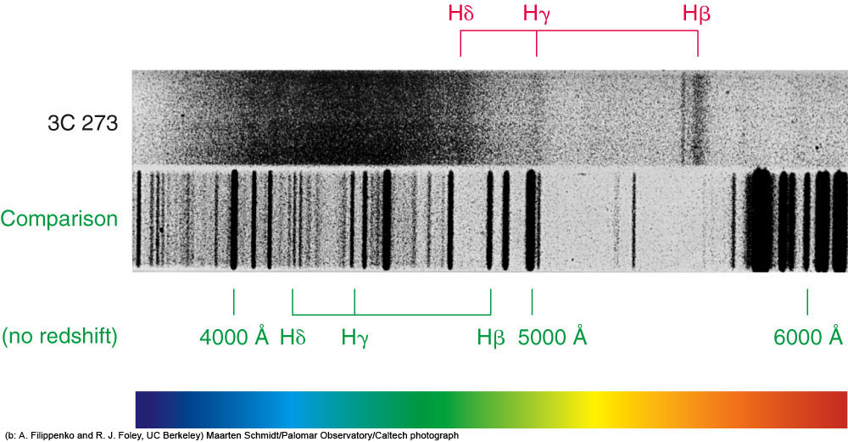
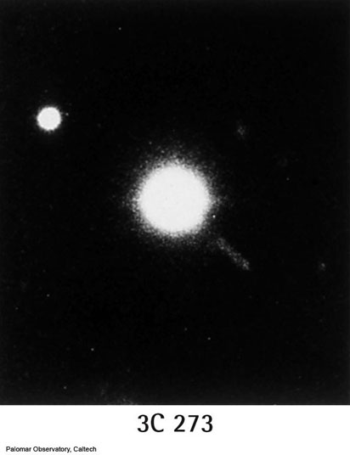
1963 -- Discovery of Quasars
"star" has jet!
spectrum
Photographic plate
Optical image (Mt. Palomar)
Weird ``stars”: emission lines (unusual), HUGE redshifts!
Plot of spectral brightness
Redshift z=0.16
Fig. 17-9a
Notes:
Figure 17.9: (a) The upper spectrum is a photographic optical spectrum of the quasar 3C 273. Dark lines represent emission, not absorption. The hydrogen Balmer emission lines (Hβ, Hγ, and Hδ) appear as fuzzy (broad) bands. When properly scanned, the spectrum would look much like the modern, well-calibrated spectrum of 3C 273 shown in (b).
The comparison spectrum in (a) is of a hot lamp in the telescope dome; it consists of hydrogen, helium, neon, and other elements that emit lines at known wavelengths. This “comparison spectrum” establishes the wavelength scale. A color bar shows the colors of the different wavelengths of the comparison spectrum.
The hydrogen Balmer lines (Hβ, Hγ, and Hδ) in the quasar (upper) spectrum in (a) are at longer wavelengths (labels in red) than in the comparison spectrum (labels in green). Similarly, in (b), the observed hydrogen emission lines appear redshifted to wavelengths longer than their laboratory values (indicated at the top). The redshift of 16% corresponds, according to Hubble’s law (with H₀ = 71 km/sec/Mpc), to a distance of 2.2 billion light-years. (b: A. Filippenko and R. J. Foley, UC Berkeley)
Maarten Schmidt/Palomar Observatory/Caltech photograph

Slide 9
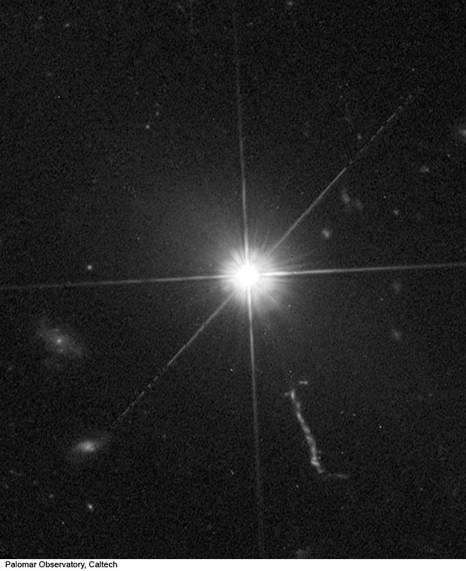
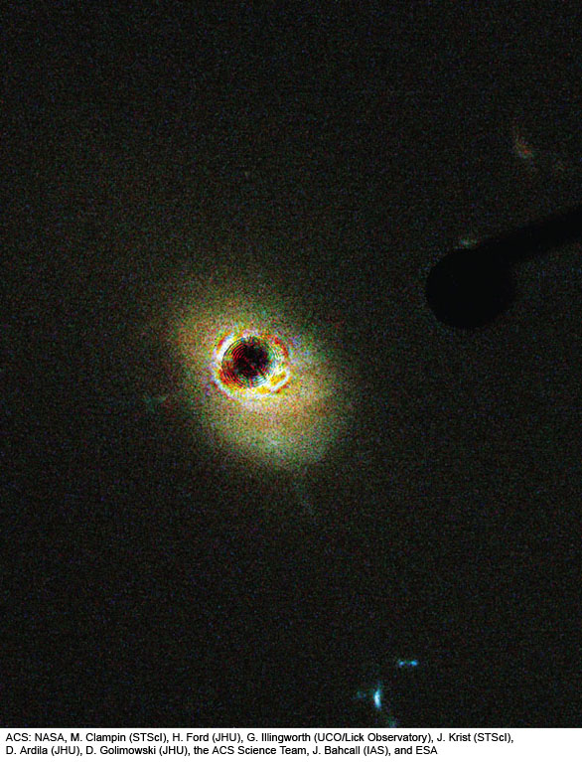
How to see host galaxies?
Need to block out light from central bright spot!
Coronagraph
High resolution images
Hubble Space Telescope
Adaptive optics + ground-based telescope
Images of Quasars
Optical, from HST, nucleus blocked out (coronagraph)
Optical, from HST
Optical, from Mt. Palomar (no adaptive optics)
Host galaxy
Jet
Various views of Quasar 3C 273 with Host Galaxy
Fig. 17-6c
Notes:
Figure 17.6: Original optical photographs of four of the first known quasars, from the photographic era before the current era of making electronic images. The objects appear star-like, but measurements with radio telescopes show that they are much brighter than normal stars at radio wavelengths.
Palomar Observatory, Caltech

Slide 10
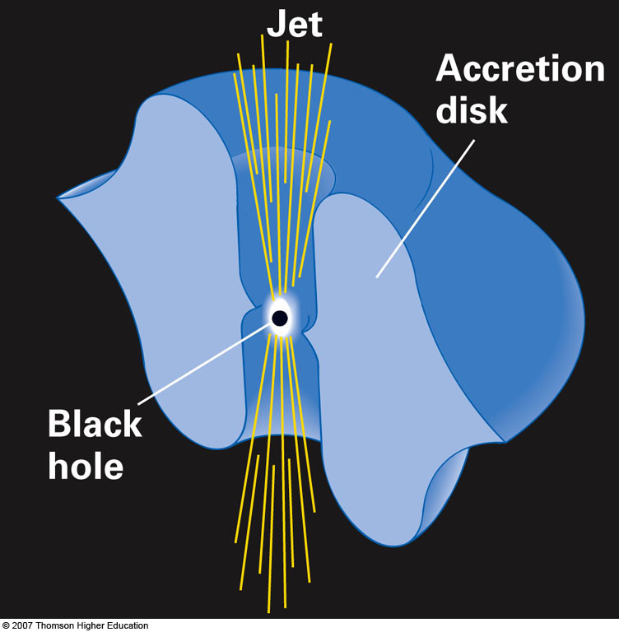
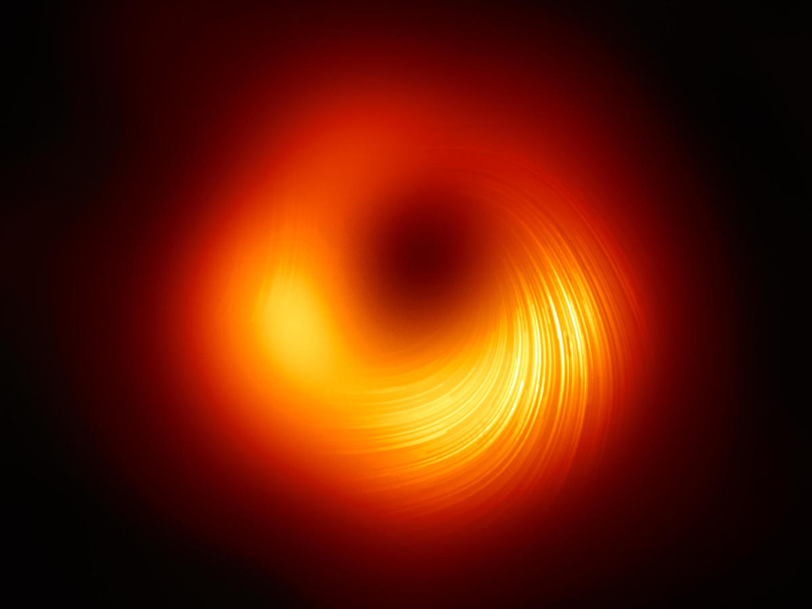
Quasars: Accretion Disks around Giant Black Hole
Gas spirals onto supermassive black hole (SMBH, millions to billions of solar masses)
More material accretes → brighter
Black hole: solar system-sized
Accretion disk: 100-1000x bigger
As matter (gas) spirals in:
Compressed+Moves faster and faster → heats by friction
Gas is so hot: emits X-rays
Jets can form, held in by magnetic fields
RARE – in maybe 0.1-1% of galaxies
Fig. 17-14
SMBH in M87, polarized light, Event Horizon Telescope, Astronomy, 2021.03.24

Slide 11
Trip to an Active Galactic Nucleus

Slide 12
Quasars = bright ``Lighthouses”
``Shadows” from foreground galaxy haloes
Path length can be BILLIONS of light years!
Quasar

Slide 13
Back to Galaxies…
Galaxies have REALLY complex structure
Milky Way more complicated than meets the eye!
How Milky Way looks in optical light (stars, some glowing gas)

Slide 14
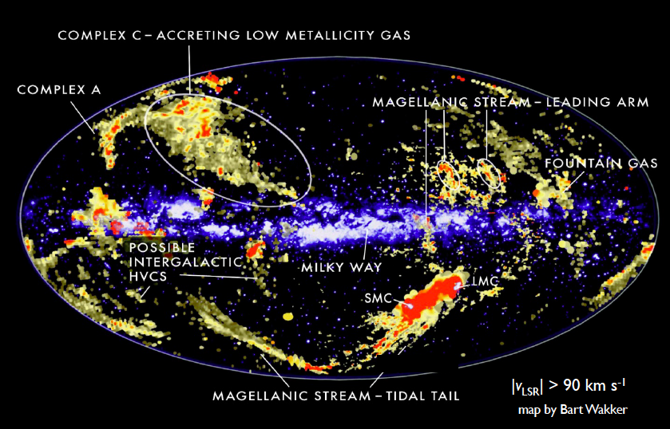
Milky Way Gas: Halo Complexity

Slide 15
Superimpose on one line of sight
Quasar

Slide 16
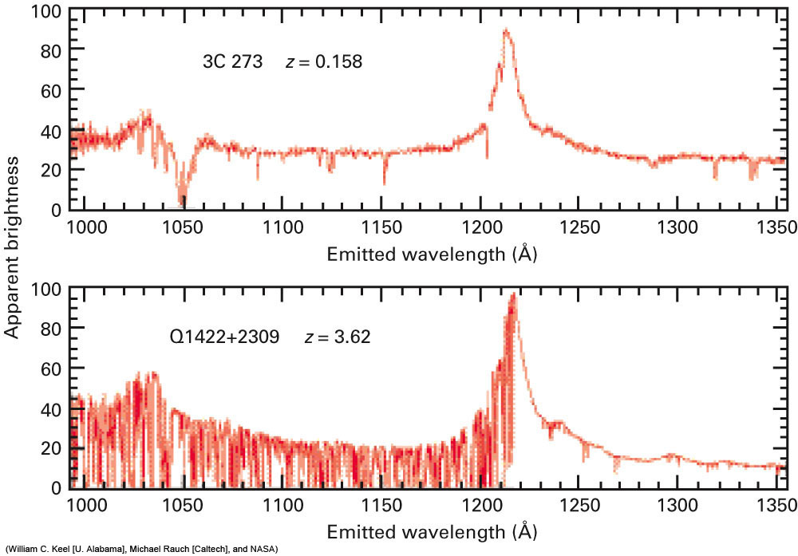
H emission from QSO
oxygen, Milky Way
Lyα, Milky Way
H, z=0.07
Carbon, Milky Way
H, z=0.05
hydrogen from Quasar
Light skewer: MANY absorption lines toward a quasar!
Cosmological redshifts help separate each transition
Hydrogen, carbon, magnesium make strong lines
Lookback: 11.9 Gyr (de-redshifted)
Lyβ from IGM
z~3.60
C, Si, Fe etc. from all redshifts 0<z<3.62
z~3.10
Lyα ``forest” from IGM
Fig. 17-32, p. 418
Notes:
Figure 17.32: Spectra of two quasars, plotted with the redshift removed (so that we see light at the emitted wavelengths rather than the observed, redshifted wavelengths). A high-redshift quasar (bottom) shows a large number of absorption lines produced by clouds of gas and galaxies along our line of sight to the quasar. Most of these lines, especially the ones in the blue (left) part of the spectrum, correspond to the hydrogen Lyman-α transition produced by intergalactic clouds at many different (and generally large) distances from us. We see the lines at many different wavelengths because of the different redshifts of the clouds. The spectrum of 3C 273 (top), a low-redshift quasar, has far fewer absorption lines, indicating that intergalactic clouds of gas are scarce at the present time in the Universe. (William C. Keel [U. Alabama], Michael Rauch [Caltech], and NASA)

Slide 17
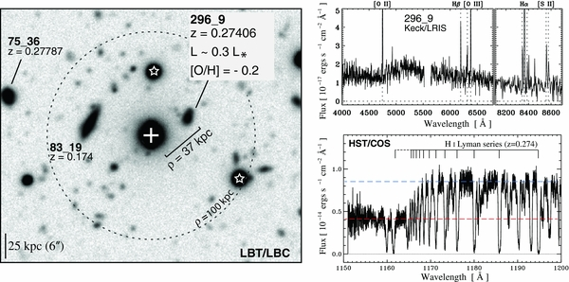
Quasar Absorbers: Progenitor Galaxies
Often small, faint, GAS-RICH systems
Sometimes interacting = galaxy mergers
Absorber (galaxy halo) at z=0.27406 –
Strong hydrogen;
also singly ionized magnesium, also carbon, silicon, oxygen etc.
galaxy
Quasar
Ribaudo+ 2011, ApJ

Slide 18
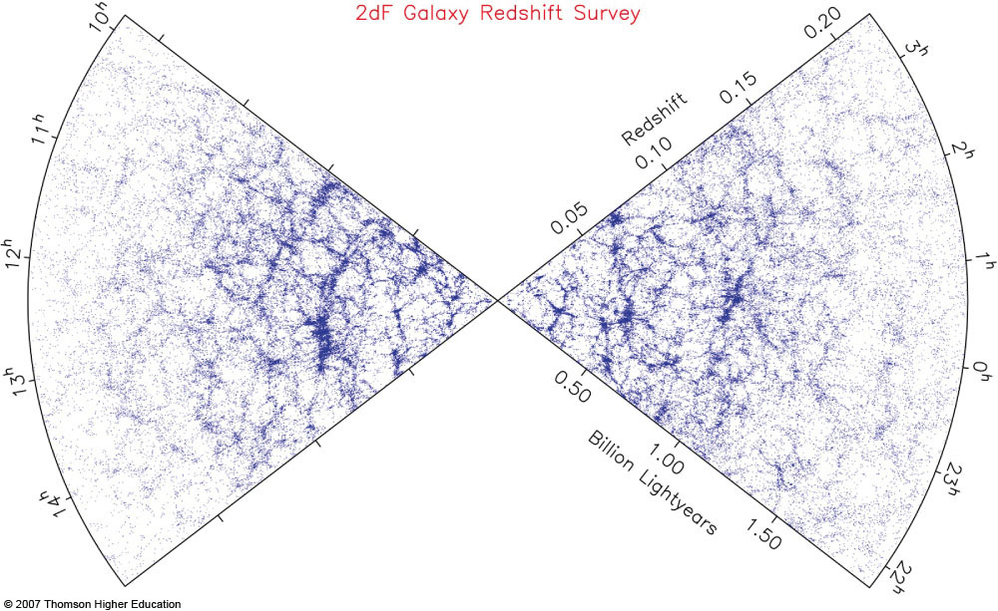
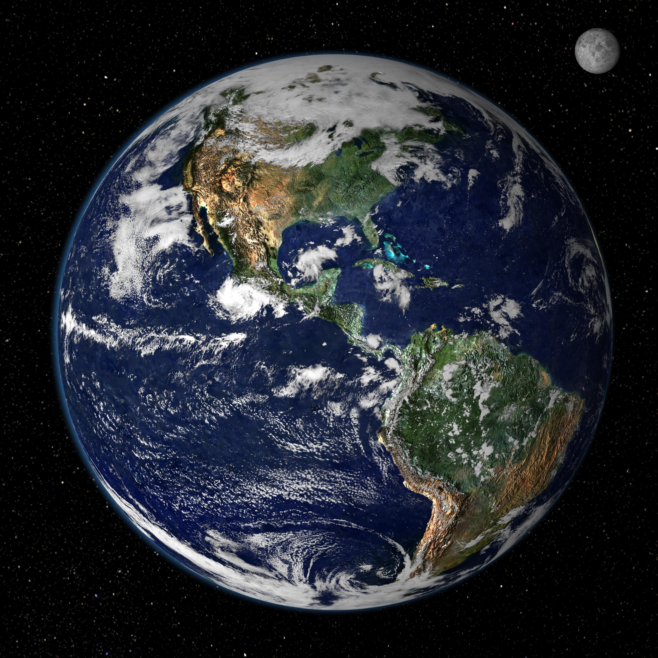
Galaxy Surveys: reveal Agglomerations of Clusters or ``structures”
“Wall” of galaxies
Earth
Remember: Redshift = distance
Galaxy surveys → “foamy/bubbly/spongy” structure
Fig. 16-43
Notes:
Figure 16.43: A map of space, made by the Two Degree Field Galaxy Redshift Survey (2dF GRS), showing a slice whose vertex is at the Earth, as in Figures 16–23 and 16–42. The distances come from the measured redshifts. We see over two hundred thousand galaxies and the structure they reveal in the Universe. Many clusters of galaxies, superclusters, filaments, and voids can be traced. This plot shows the completed survey.

Slide 19
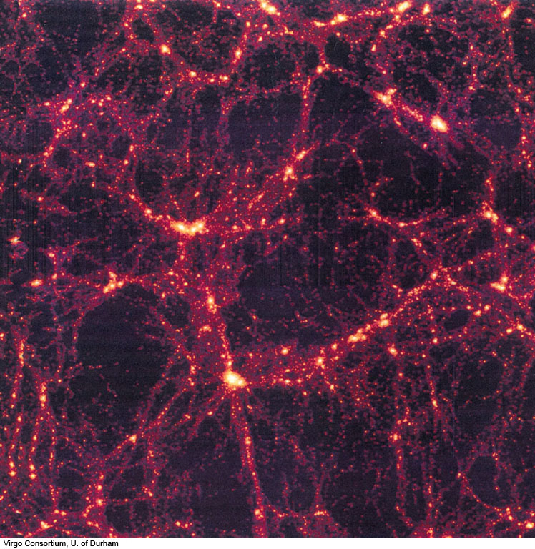
Bubbly/Sponge-like structure EXPECTED.
Large-scale structure from N-body simulation output. Note network of nodes, sheets/walls and filaments, similar to what is observed.
Sheet
Filament
Node
Fig. 16-44
Notes:
Figure 16.44: This supercomputer calculation of the formation of clusters of galaxies shows the existence of filaments and voids. The details of the results depend on whether cold dark matter, hot dark matter, or a mixture of the two fills the Universe. The ability of astrophysicists to model the formation of galaxies in the Universe increases as computing power increases.
Virgo Consortium, U. of Durham

Slide 20
Simulated Evolution of Large Scale Structure
z Gyr
ago
-------------
∞ 13.8
7 12.9
4 12.1
3 11.5
2 10.3
1 7.7
0.5 5.0
0.3 3.4
0.1 1.3

Slide 21
Quasars – can use to REVEAL Structures!!
Earth
Remember: Redshift = distance
Galaxy surveys → “foamy/bubbly/spongy” structure
Fig. 16-43
Notes:
Figure 16.43: A map of space, made by the Two Degree Field Galaxy Redshift Survey (2dF GRS), showing a slice whose vertex is at the Earth, as in Figures 16–23 and 16–42. The distances come from the measured redshifts. We see over two hundred thousand galaxies and the structure they reveal in the Universe. Many clusters of galaxies, superclusters, filaments, and voids can be traced. This plot shows the completed survey.

Slide 22
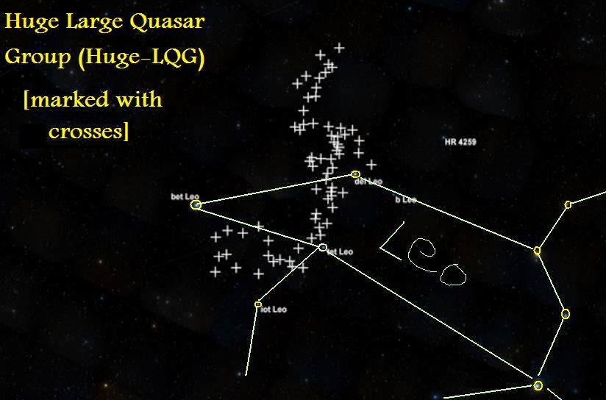
Quasars, too, make Groups – BIGGER than galaxy clusters, more like ``Walls”!
“Huge” Large Quasar Group (LQG) found in Leo, 2013 (by Roger Clowes and collaborators, U. Central Lancashire, England)
Redshift z=1.27, or 8.6 billion light years away
Seen 4.8 billion years after Big Bang
Long axis ~4 billion light years
Similar to “walls” of galaxies
Dozens of LQGs known
Even bigger: Hercules-Corona Borealis “Great Wall”, found in 2014
7 degrees on sky
Full moon: 0.5 degrees across

Slide 23
Challenge of Giant Structures
``Cosmological Principle”
Universe is same density – on big enough scales (light years)
Universe looks same in all directions – on big enough scales (angles)
WHAT is “big enough”?
Use Models of Structure Formation
SIZE -- about 1 billion light years
ANGLE – maybe 5-10 degrees (out of 360 degrees around the sky)
BUT “Huge” LQG is about 25-30 degrees, 4 billion light years across!
A few other structures: similar size or bigger!!

Slide 24
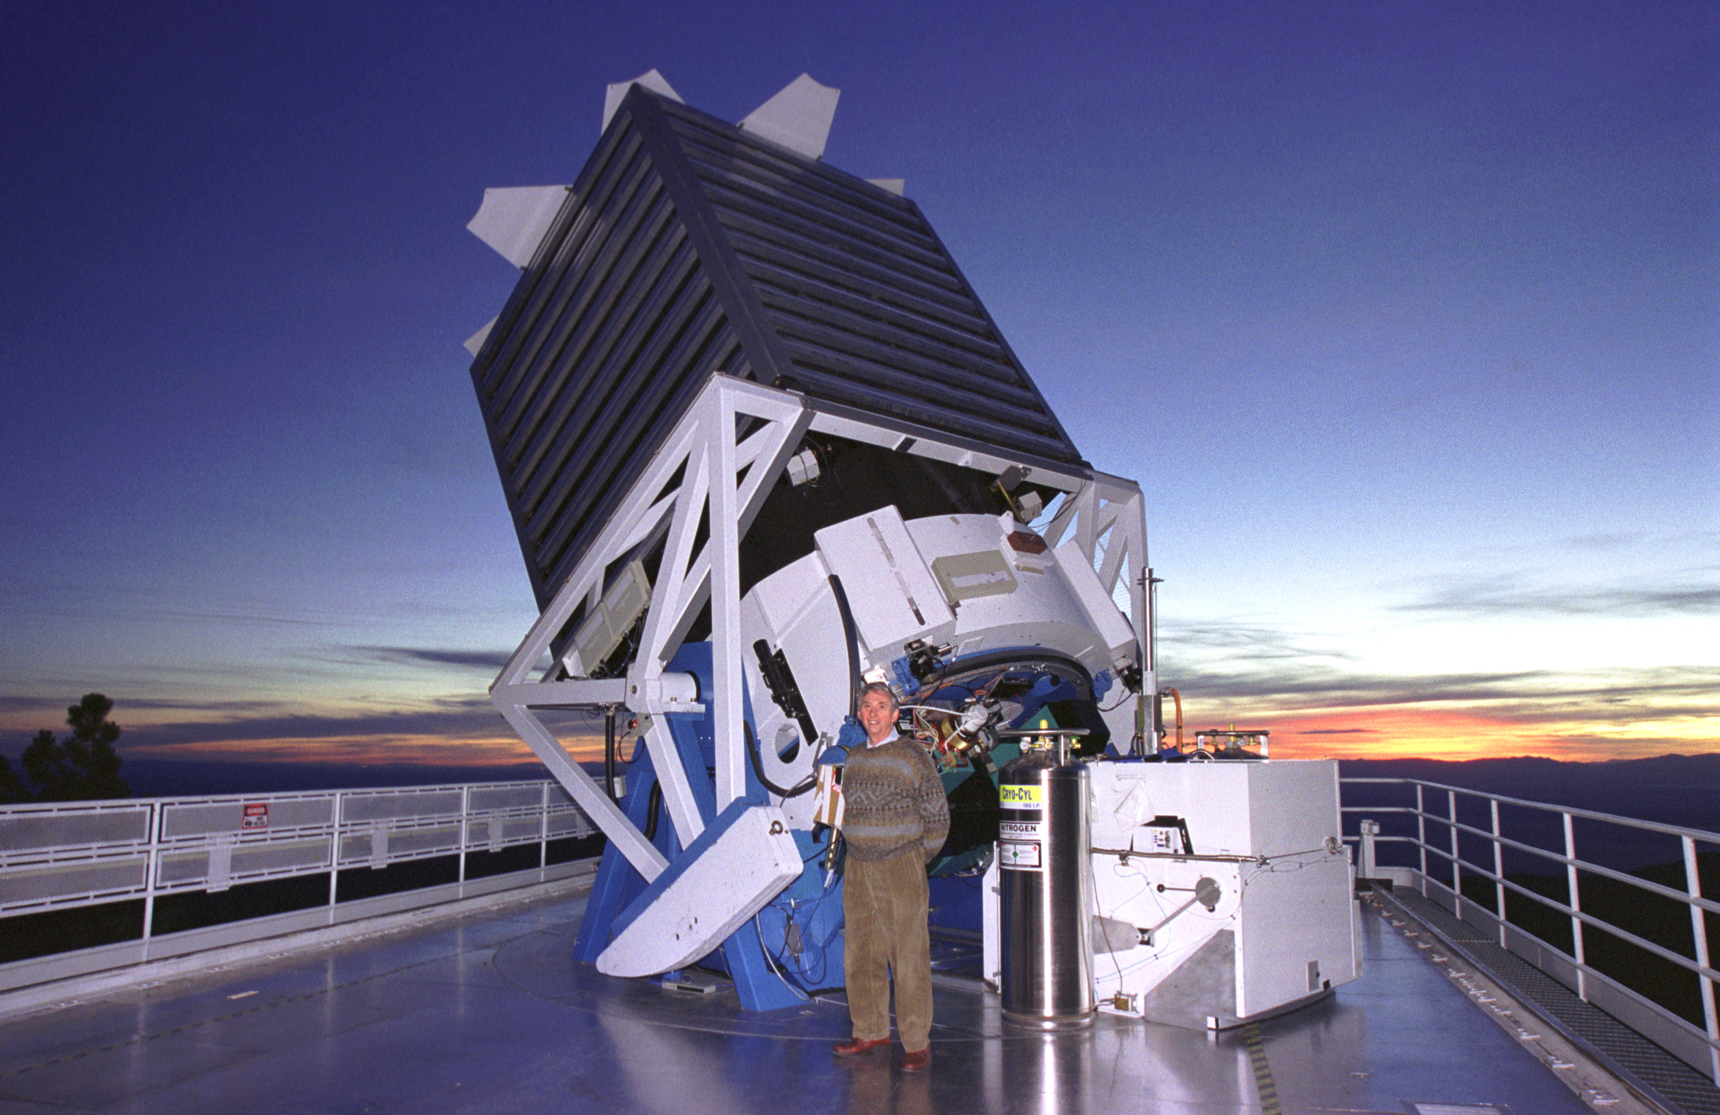
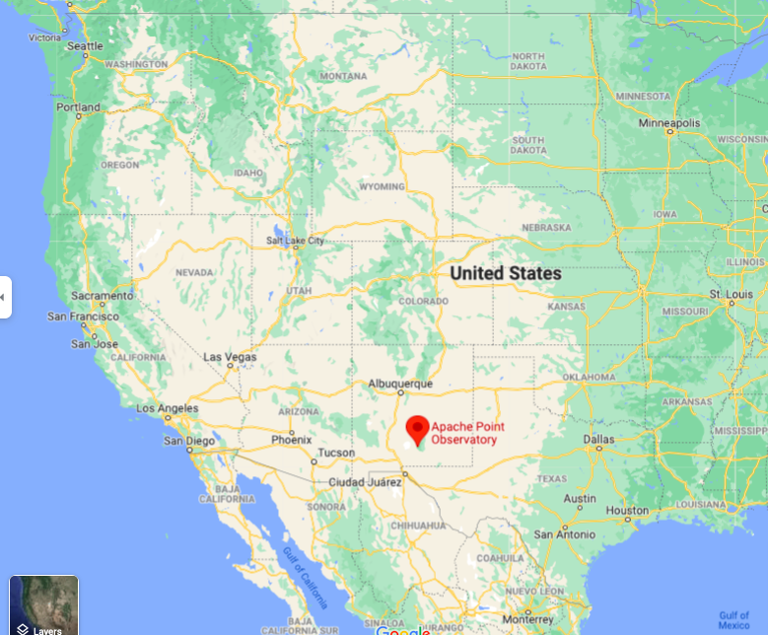
Recent Discovery: The ``Giant Arc”
Project by graduate student Alexia Lopez, advisor Roger Clowes (U Central Lancashire)
Look in catalogue of 250,000 quasar absorption systems from quasar spectra
Singly ionized magnesium – from galaxy haloes
Assembled over 10 years from 2.5m diameter telescope, Apache Point, New Mexico
Funded by Sloan Digital Sky Survey + consortium of universities
Covers about 20% of sky, mostly in Northern Hemisphere

Slide 25
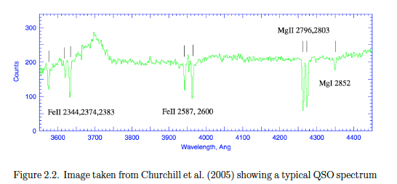
Finding Magnesium Absorbers
Quasars
Telescope!
iron
iron
magnesium

Slide 26
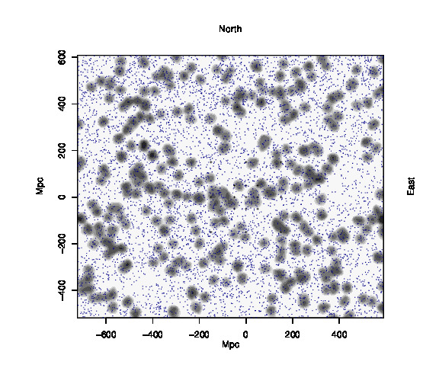
Large Structure Found – Outlined by magnesium absorbers (galaxy haloes)
Found “serendipitously” (= by luck!), by visual exam
Often happens in science!
Roughly 35 degrees across (70 full moon diameters)
Roughly 4 billion light years across
At redshift z=0.8
6.8 billion light years away
seen 6.6 billion years after the Big Bang)
7.4 degrees on sky
Blue dots: background quasars in this patch of sky
Grey splotches: foreground groups of magnesium absorbers (galaxy haloes), in clumps of 35 million light years
1 Megaparsec = 3.26 million light years

Slide 27
Giant Arc on Sky
Distance: 6.8 billion light years
30-35 degrees

Slide 28
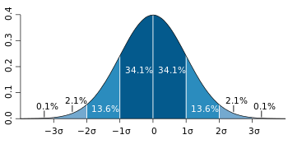
Stats: Testing the Giant Arc
the +/- 1 standard deviation (“ERROR/UNCERTAINTY”, which covers 68% of the possibilities) in that rate is 𝞂=√N.
Scientists prefer a deviation from random chance of
4-5𝜎 (<1/10000 to <1/10 million chance) before saying that a result is NOT due to chance
average
1𝝈
2𝝈
3𝝈
68.2% of time
95.4% of time
99.6% of time

Slide 29
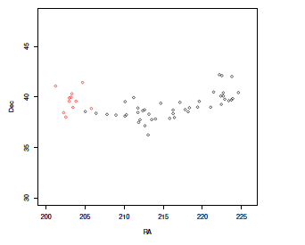
Test 1: Connectedness
``Minimal Spanning Tree” – what groups of points exist when connecting them to minimize the total length of the connections?
Giant Arc – Minimal Spanning Tree result
Black: main group
Red: secondary group;
BOTH: 4𝜎 compared to randomized data

Slide 30
Test 2: Resampling Quasar Spectra
Test adapted from archaeology drill-hole results (Cuzick & Edwards test)
Looks for ``clusters” against an uneven background, used for epidemiology studies
Relevant because we ONLY know about magnesium if there is a quasar in the background
Involves simulated re-sampling of quasar directions for magnesium absorbers

Slide 31
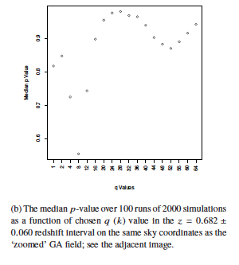
Test 2: Clustering – Giant Arc
Giant Arc field, redshift z=0.80+/- 0.05
Probability p=0.7% by chance (about 3𝜎)
Control field,same direction, different redshift (distance) -- redshift z=0.68+/- 0.06

Slide 32
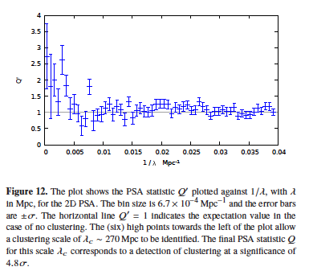
Test 3: Different Clustering – Giant Arc
``Power Spectrum Analysis” (PSA) – used for galaxy clustering statistics
Based on frequency of close pairs, triplets, quadruplets etc.
Similar mathematics to an MRI scan (``Fourier transform”)
Significant to 4.8𝜎

Slide 33
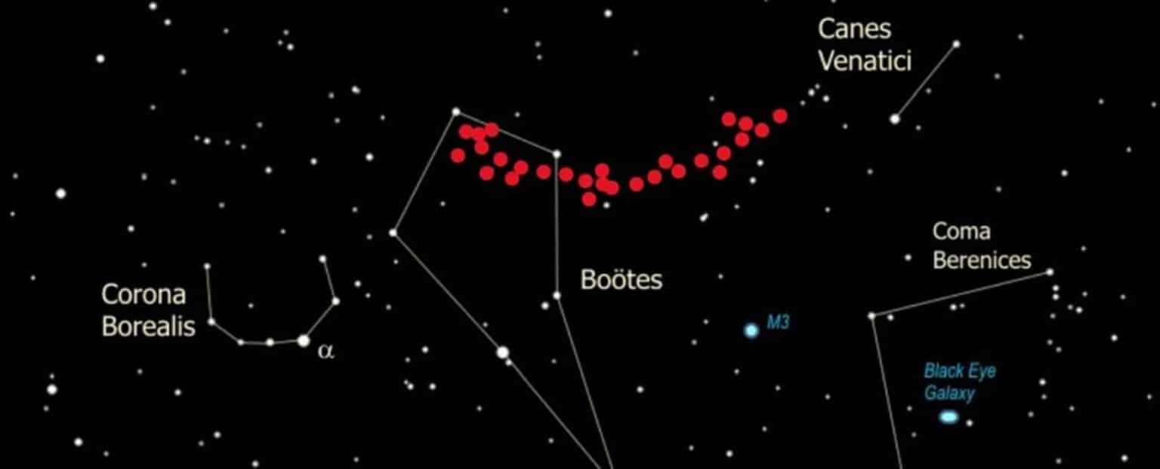
What does Giant Arc mean?
Giant Arc ONE MORE ``large structure” bigger than scale for cosmological principle
So big that it could not ``pull itself together” by gravity since the Big Bang
Probably a result of some earlier structures from Big Bang which were likely to form galaxies
Since first one was found by luck → might find more
Not enough to throw out standard cosmology model
but there should not be too many more structures this size otherwise hard to explain
Looking for more in the magnesium catalogue – stay tuned!

