Slide 1
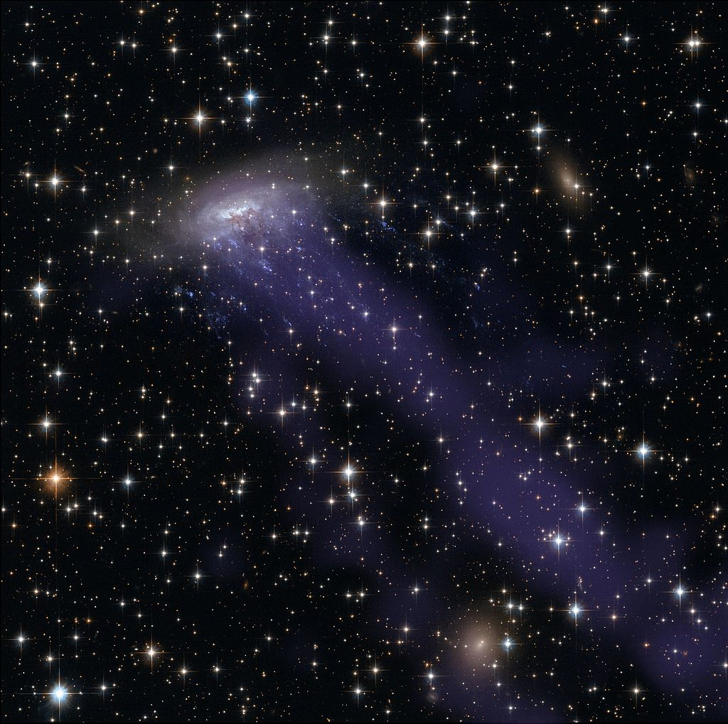
Ram Pressure in
Astronomy and Engineering
Tim Dowling
UofL Physics & Astronomy

Slide 2
Galaxy ESO 137-001
is moving in the upper-left direction through a dense medium
This jellyfish morphology is a dramatic example of ram pressure stripping

Slide 3
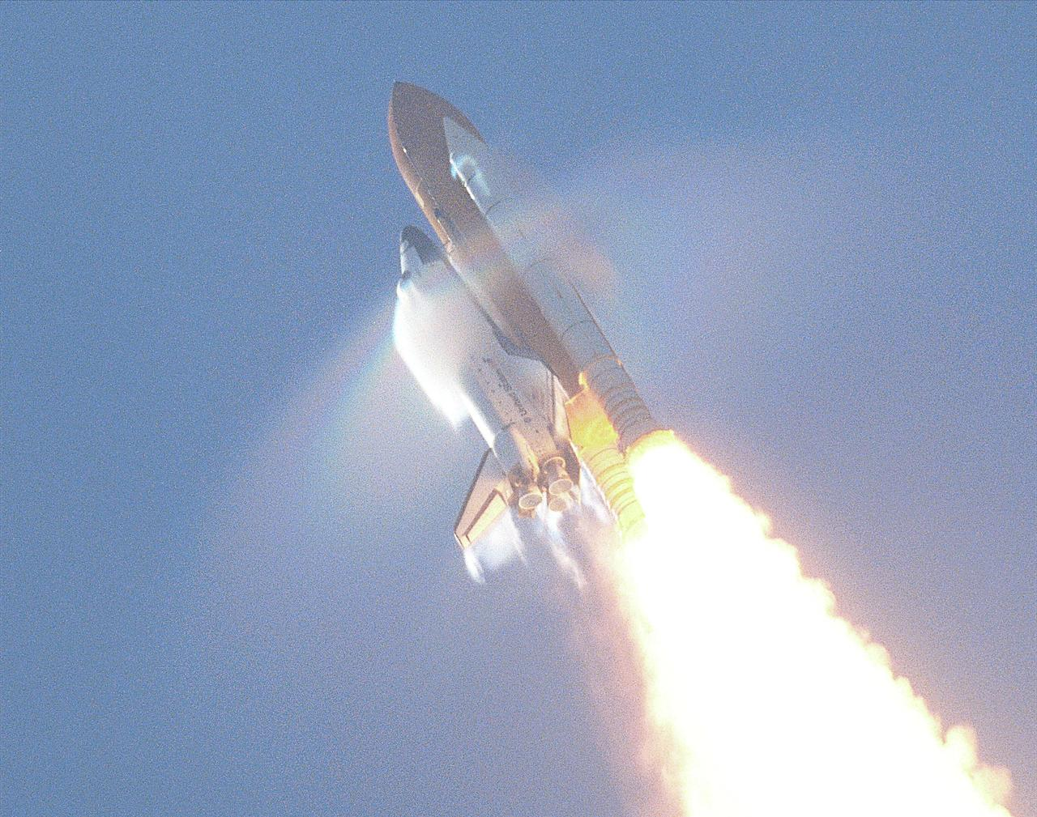
During a rocket launch you often hear “Max Q” followed by “Go at throttle up”

Slide 4
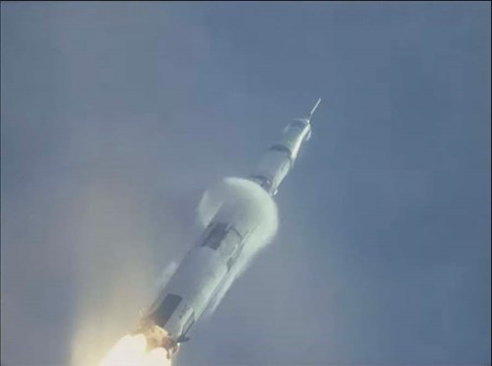
“Q” is the aeronautical symbol for ram pressure,
also known as dynamic pressure and impact pressure

Slide 5
Momentum $=mass × velocity$
$$=m × u$$
Momentum flux is momentum per area and per time
$\frac{m × u}{area × time}=$ $\frac{m × u }{area × time}$ $×$ $\frac{L}{L}$ $=$ $\frac{m}{area × L }× u ×\frac{L}{time}$

Slide 6
Momentum $=mass × velocity$
$$=m × u$$
Momentum flux is momentum per area and per time
$\frac{m × u}{area × time}=$ $\frac{m × u }{area × time}$ $×$ $\frac{L}{L}$ $=$ $\frac{m}{area × L }× u ×\frac{L}{time}$

Slide 7
Momentum $=mass × velocity$
$$=m × u$$
Momentum flux is momentum per area and per time
$\frac{m × u}{area × time}=$ $\frac{m × u }{area × time}$ $×$ $\frac{L}{L}$ $=$ $\frac{m}{area × L }× u ×\frac{L}{time}$
$$density velocity velocity$$
Momentum flux $is ρu^{2}$

Slide 8
$$Q = Sp ρu^{2}$$
/
/
ram pressure
momentum flux
Spreiter number,
$$Sp<100\%$$
The Spreiter number is the percentage
of the momentum flux that gets converted into ram pressure

Slide 9
Why is all the momentum flux not
converted into ram pressure? Why is $Sp<100\%$?
P.G. Wodehouse’s Aunt Dahlia said it best
in the Code of the Woosters:
It’s the old problem, of course –
the one that makes life so tough for murderers –
what to do with the body.
To get $Sp=100\%$ would require
100% of the moving gas to come to a dead stop.

Slide 10
In space, $ρ=0$,
so $Q= Sp ρu^{2} = 0$
Q has a maximum in between the launch pad and space
On the launch pad, $u$ = 0,
so $Q= Sp ρu^{2} = 0$

Slide 11
Max Q Saturn V
https://space.stackexchange.com/questions/15456/how-long-does-max-q-last

Slide 12
2022
1972
1966
1951
1913
1752
1738
1732

Slide 13
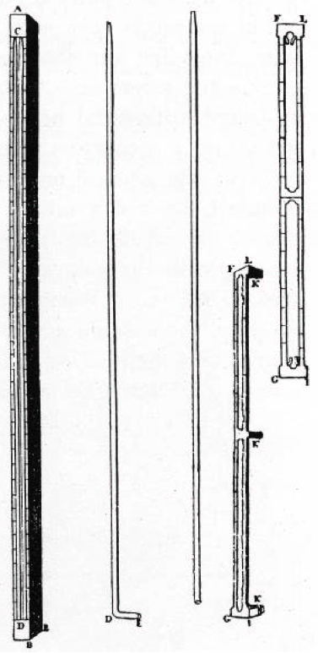
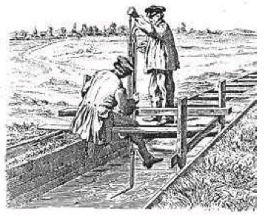
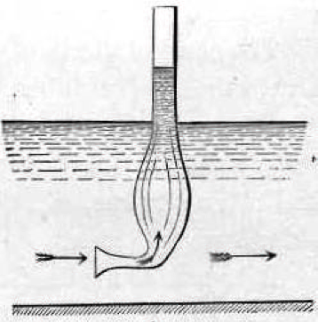
1732
February 22: George Washington was born
November 12: Henri Pitot introduced a device for
measuring local fluid flow speed to the
Royal Academy of Sciences in Paris
Brown (2003)

Slide 14
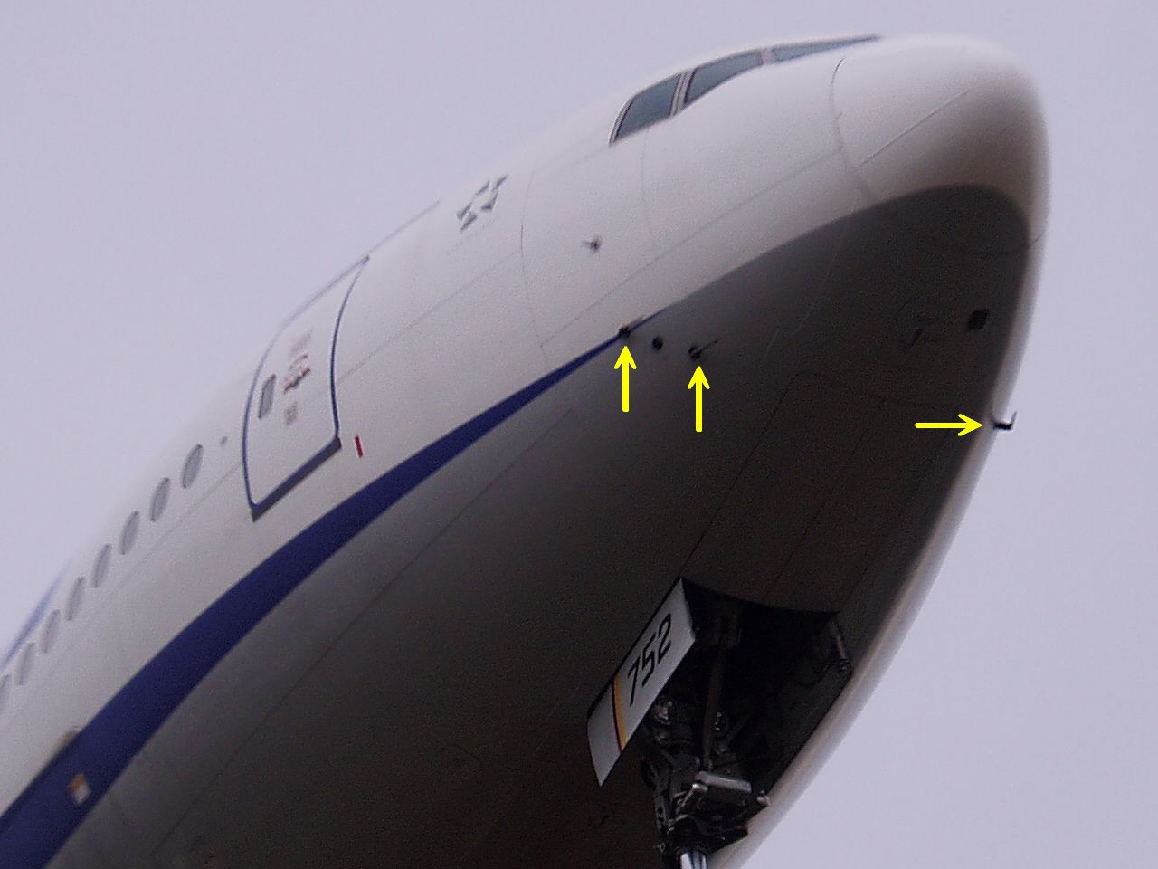
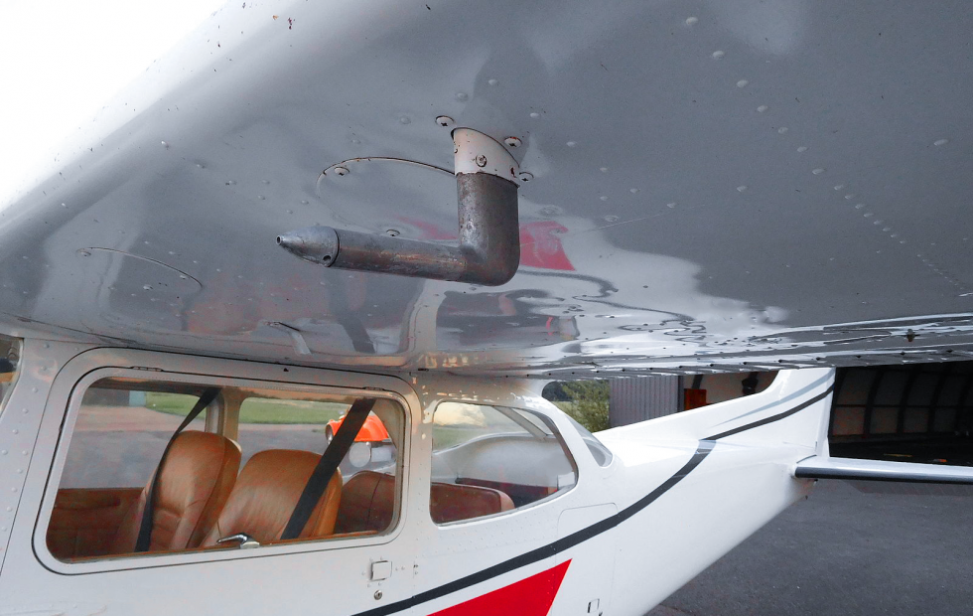
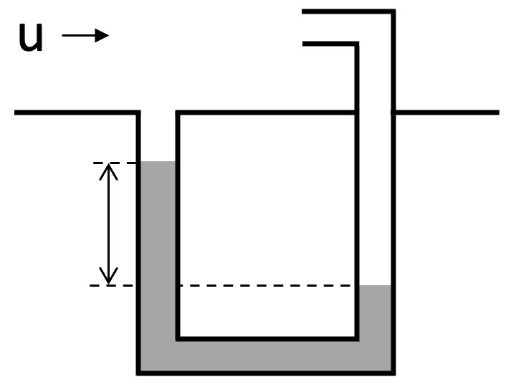
Wikipedia (2022)
Pitot-Static Tube
Ram pressure is this difference

Slide 15
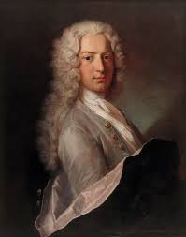
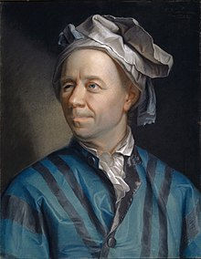
Early use of the pitot-static tube to determine
flow speed was empirical
1738: Daniel Bernoulli began the development of the
theory based on Newton’s mechanics, establishing that
pressure increases as velocity decreases
1752: Leonhard Euler derived what is today called the Bernoulli energy equation:
$p+\frac{1}{2}ρu^{2}=constant,$ along a streamline
This has been called the most famous equation in fluid dynamics

Slide 16
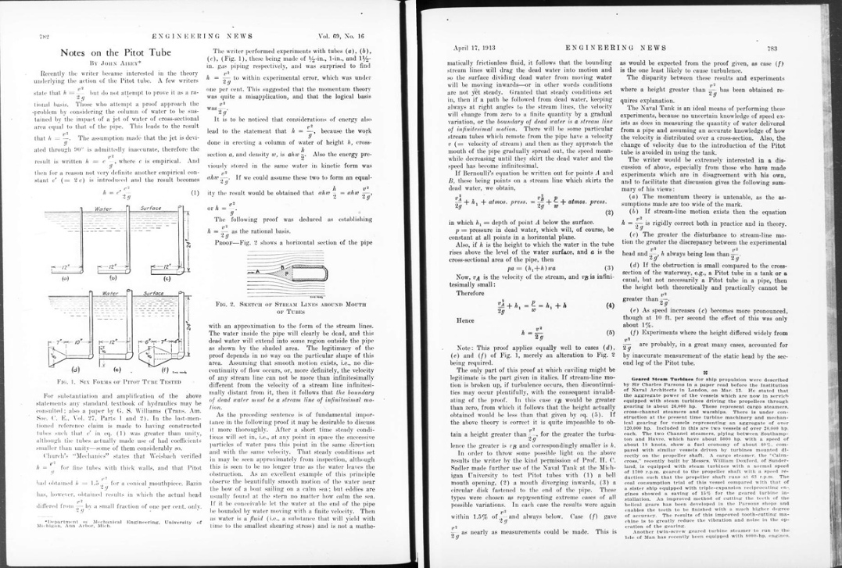
1913: John Airey (Univ. Michigan) established how to determine flow speed with a pitot-static tube using the Bernoulli energy equation
… 181 years after Pitot’s invention and 161 years after Euler
Airey’s key argument: “the boundary of dead water must be
a stream line of infinitesimal motion”

Slide 17
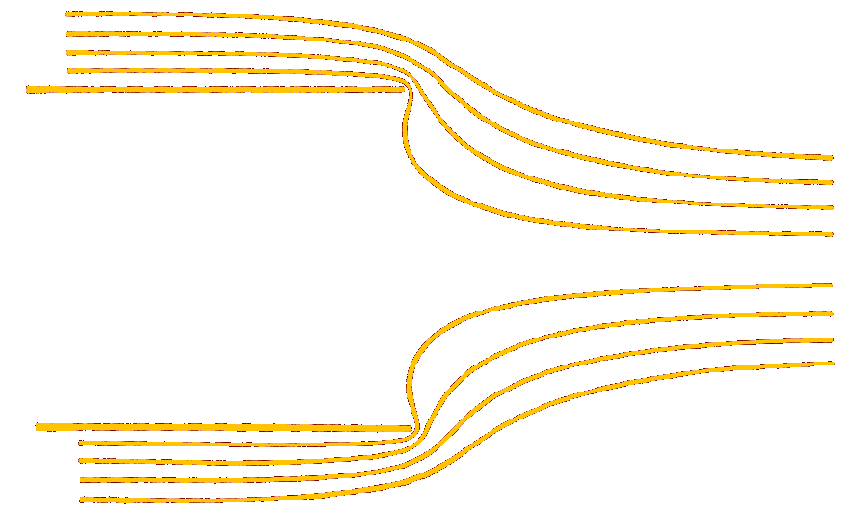
1948: Textbook pitot-tube streamlines
${= p}_{stag}+\frac{1}{2}ρ0^{2}$
${= p}_{stag}$
$$p+\frac{1}{2}ρu^{2}$$
/
$$Sp=50\%$$
Ram pressure,
Q $=Sp ρu^{2}$
Streeter (1948)

Slide 18
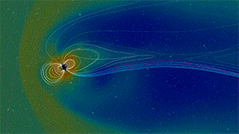
1951: D.F. Martyn (Solar Obs. Canberra) calculated the
standoff distance of Earth’s magnetic field in the solar wind
assuming $Sp=50\% , as in a pitot tube:$
“An estimate of the dimensions of the hollow may be obtained by the simple but justifiable approximation of equating the pressure exerted by the solar stream (that is, the energy density of the stream $\frac{1}{2 }N m u^{2}$, $N$ being the number density and $m$ the mean mass of the particles) to the pressure exerted by the lines of magnetic force”
NASA

Slide 19
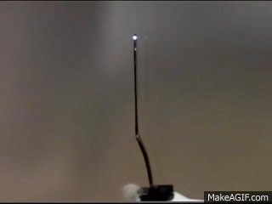
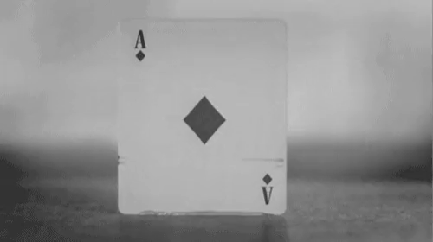
We will now segue to supersonic
with some gratuitous
slow motion bullets

Slide 20
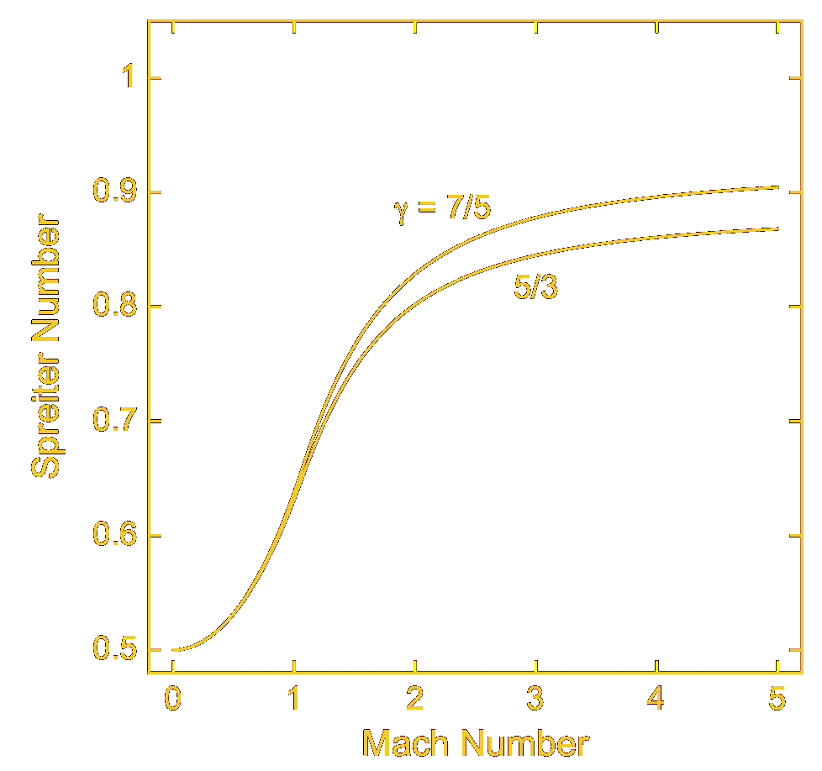
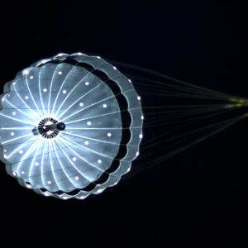
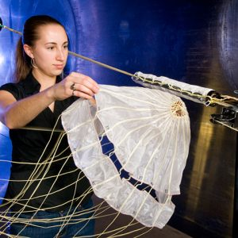
1922: First supersonic wind tunnel (England);
used to study projectiles
1945: NASA’s first supersonic wind tunnel (NASA Glenn)
diatomic
monatomic
4% scale MSL Parachute
1950s: How the Spreiter number varies with Mach number was in standard aerodynamic references
Cat 5 Hurricane: Ma = 0.2

Slide 21
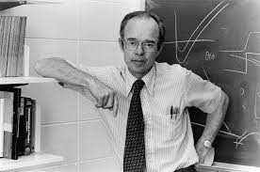
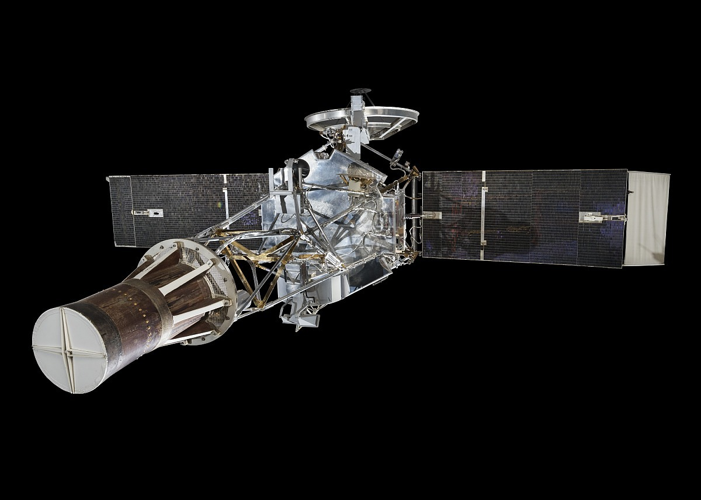
Late 1950s: Eugene Parker predicted
the solar wind is supersonic
1962: Mariner II confirmed
the solar wind is supersonic!

Slide 22
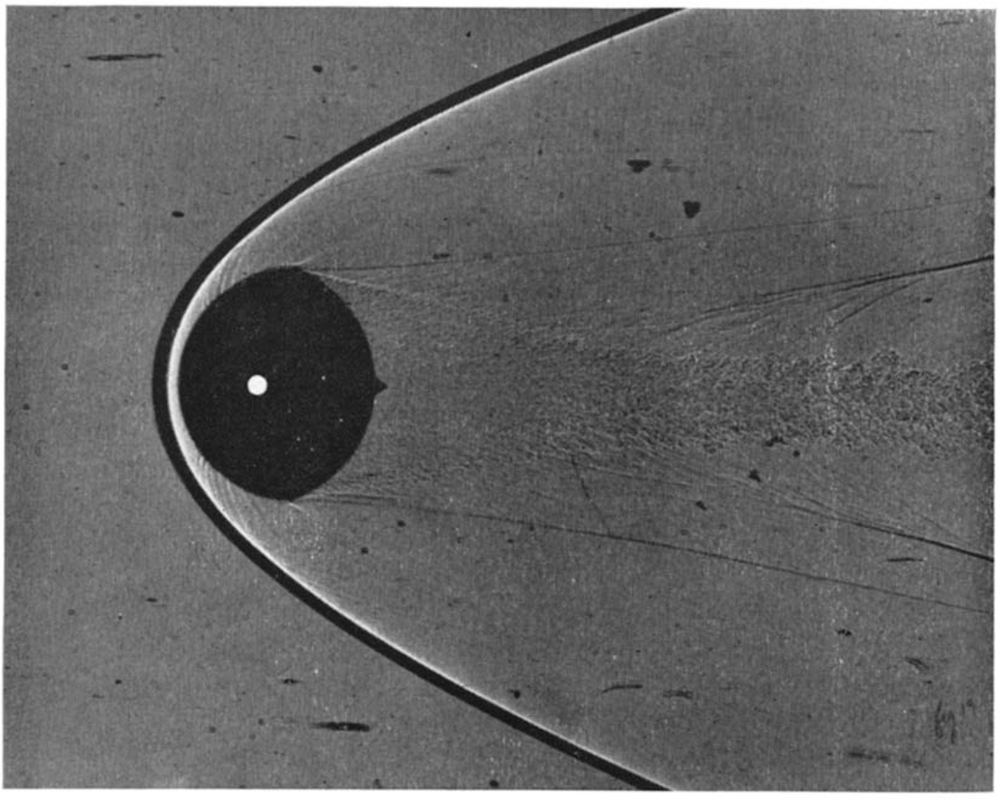
Mid 1960s: The apex of ram pressure treatment in astronomy
Axisymmetric metal projectile shaped
like Earth’s magnetosphere
Ma = 4.5, monatomic (Ar)
Sp = 86.5%
Black curve is shadow of bow shock
White curve is bow shock position calculated by John R. Spreiter et al. (1966)
NASA Ames Research Center
Supersonic Free-Flight Wind Tunnel

Slide 23
1972: In extragalactic astronomy, James Gunn & J. Richard Gott wrote:
“ram pressure is $[Q]≈ρ_{e}{[u]}^{2}$, where $ρ_{e}$ is the external (to the galaxy, i.e., the intracluster) density, and $[u]$ is the velocity of the galaxy”
They made this $Sp ≈100\%$ assertion without proof or reference.
They provided no plans for what to do with the body
Nevertheless, Gunn and Gott (1972) has been cited over 4600 times to date, pitot-static tubes have vanished from the astronomy curriculum, and $Sp$ has been set to unity and lost as a parameter

Slide 24
Examples of astronomy textbooks
that contain the $Sp=1$fallacy:
Physical Processes in the Interstellar Medium (Spitzer 1978)
The Physical Universe: An Introduction to Astronomy (Shu 1982)
Physics of Solar System Plasmas (Cravens 1997)
Principles of Astrophysical Fluid Dynamics (Clarke & Carswell 2007)
Ionospheres: Physics, Plasma Physics, and Chemistry (Schunk & Nagy 2009)
Understanding Space Weather and the Physics Behind It (Knipp 2015)

Slide 25
In textbooks, the fallacy generally takes the form:
Spitzer (1978), Physical Processes in the Interstellar Medium
The correct statement is:
$$p_{1}+{{Sp}_{1} ρ}_{1} u_{1}^{2}+\frac{B_{1}^{2}}{8π}=p_{2}+{{Sp}_{2} ρ}_{2 }u_{2}^{2}+\frac{B_{2}^{2}}{8π}$$
or if $Ma < 0.3$ ,
$$p_{1}+{\frac{1}{2}ρ}_{1} u_{1}^{2}+\frac{B_{1}^{2}}{8π}=p_{2}+{\frac{1}{2}ρ}_{2 }u_{2}^{2}+\frac{B_{2}^{2}}{8π}$$

Slide 26
In journal articles, including in Spreiter’s sub-discipline of space physics,
the fallacy generally takes the form:
Fatemi et al. (2018), “A modelling approach to infer the solar wind dynamic pressure from magnetic field observations inside Mercury’s magnetosphere”, Astron. & Astrophys. 614, A132.
$P_{dyn}= m_{i}n_{sw}u_{sw}^{2}$ should be $P_{dyn}={Sp}_{sw}m_{i}n_{sw}u_{sw}^{2}$

Slide 27
Today, the $Sp=1$fallacy has begun to spread outside of astronomy
The Wikipedia page for “Ram pressure” erroneously states:
But then its 1st example, for sea level ram air pressure, correctly states:
Fortunately, the Wikipedia pages for
“Dynamic pressure” and “Impact pressure” correctly state:
and

Slide 28
diatomic
Why do we need to treat ram pressure with precision?
monatomic
What’s a factor of 2
among friends?

Slide 29
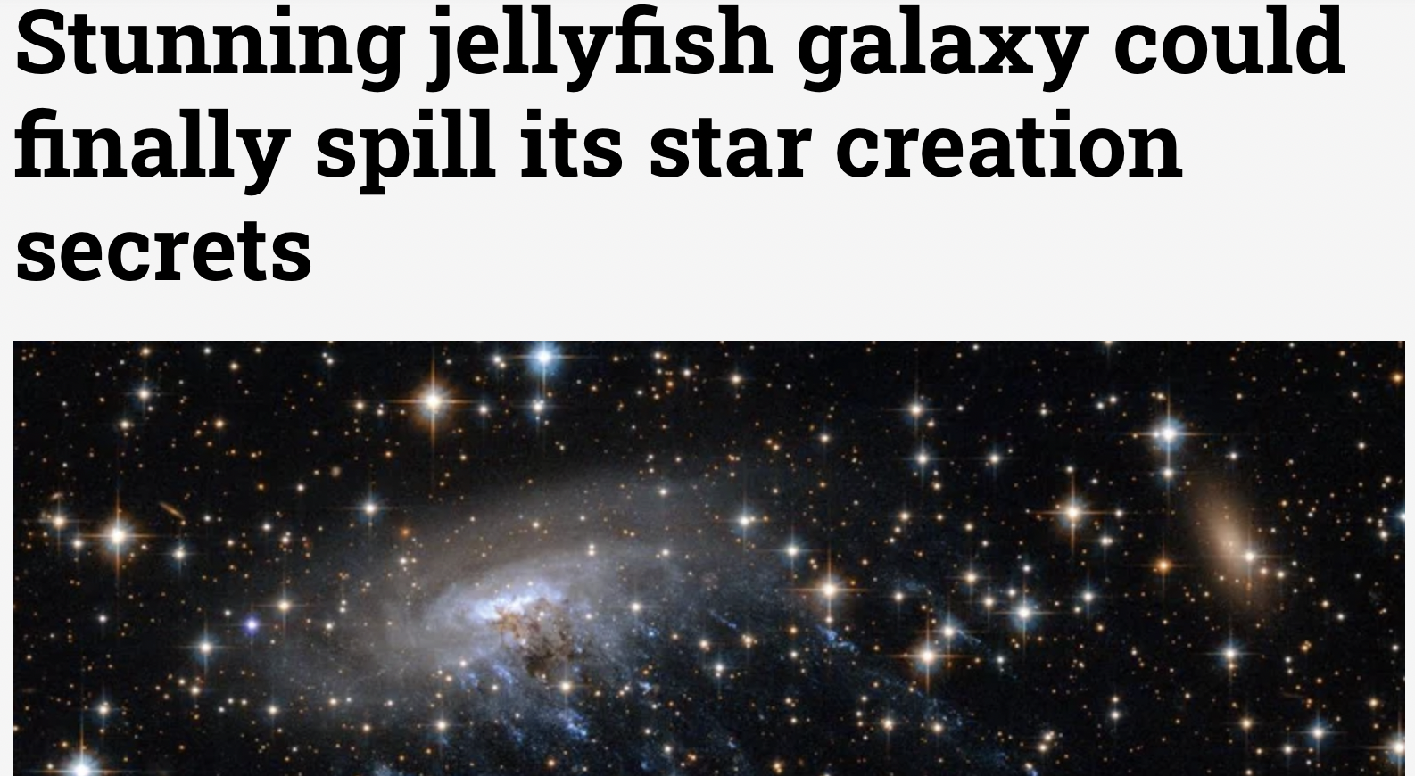

Slide 30
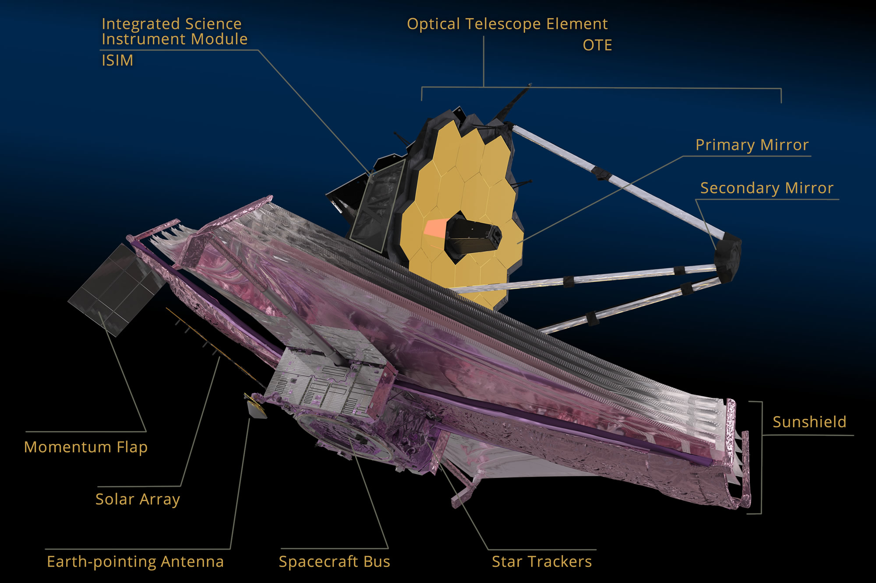
This precision
is why.

