Slide 1
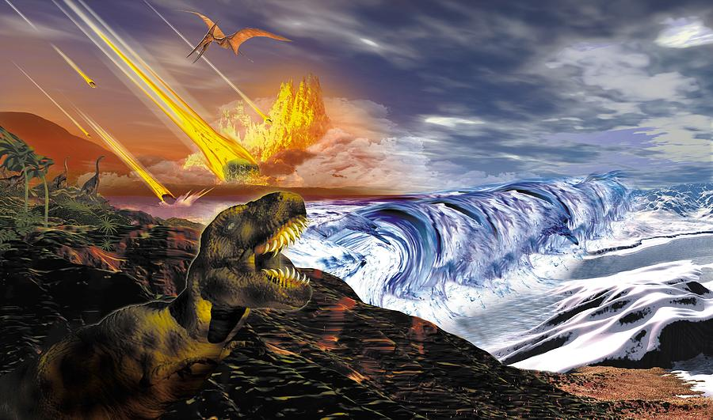
The Causes and Effects of Mass Extinctions
Dr. Kate Bulinski
Associate Professor of Geosciences

Slide 2
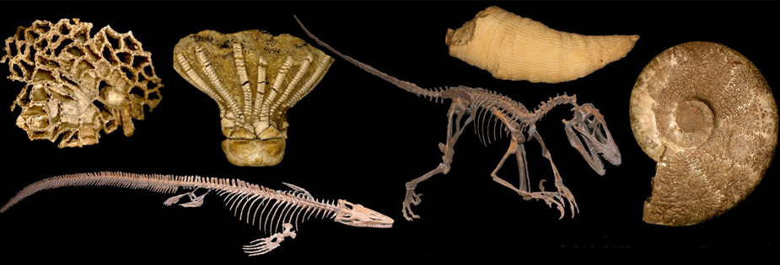
Outline
Definition and parameters of extinctions
Major causes of extinctions
Extinctions through Deep Time
The “Sixth Extinction”?

Slide 3
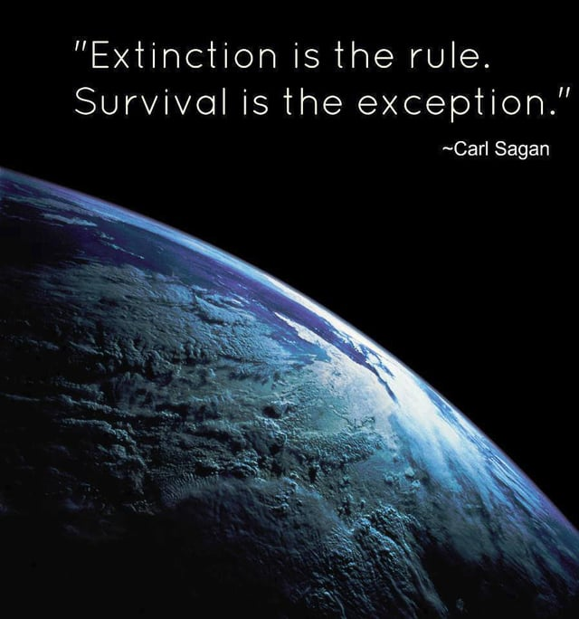
What is an extinction?
Whenever a species fails to reproduce the next generation and all members of that species dies.
95% (conservative estimate) of all species that have ever lived are extinct.
Extinction is the natural fate of all species.

Slide 4
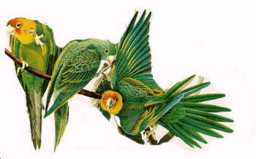
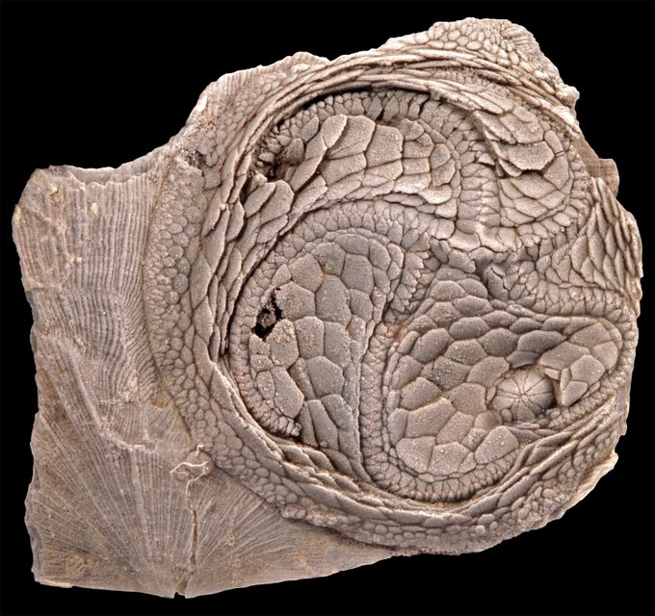
“Normal” Extinction
The average “life-span” of species with a fossil record is about 5 million years. It is longer for some groups (e.g., clams) and shorter for others (e.g., mammals).
It is frequently impossible to determine “why” a particular fossil species went extinct.
10% species extinction per million years is “normal” extinction
Carolina Parakeet
Edrioasteroid
Isorophus cincinnatiensis
http://www.delawaretribeofindians.nsn.us/extinct_birds.html

Slide 5
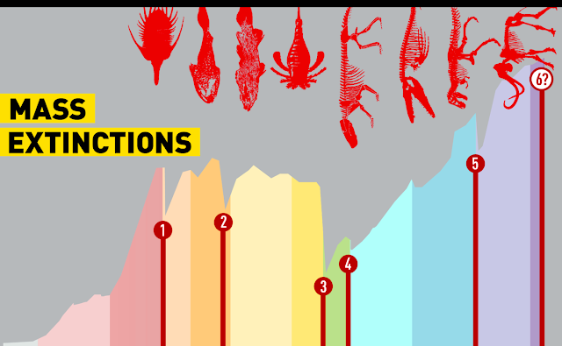
What are MASS Extinctions?
75% or more species lost to extinction=Mass Extinction
Mass extinctions are considered “events” as extinctions are concentrated in a relatively short period of (geologic) time <2 million years
Results in the extinctions higher taxonomic groups: genera, family, orders, classes and phyla.

Slide 6
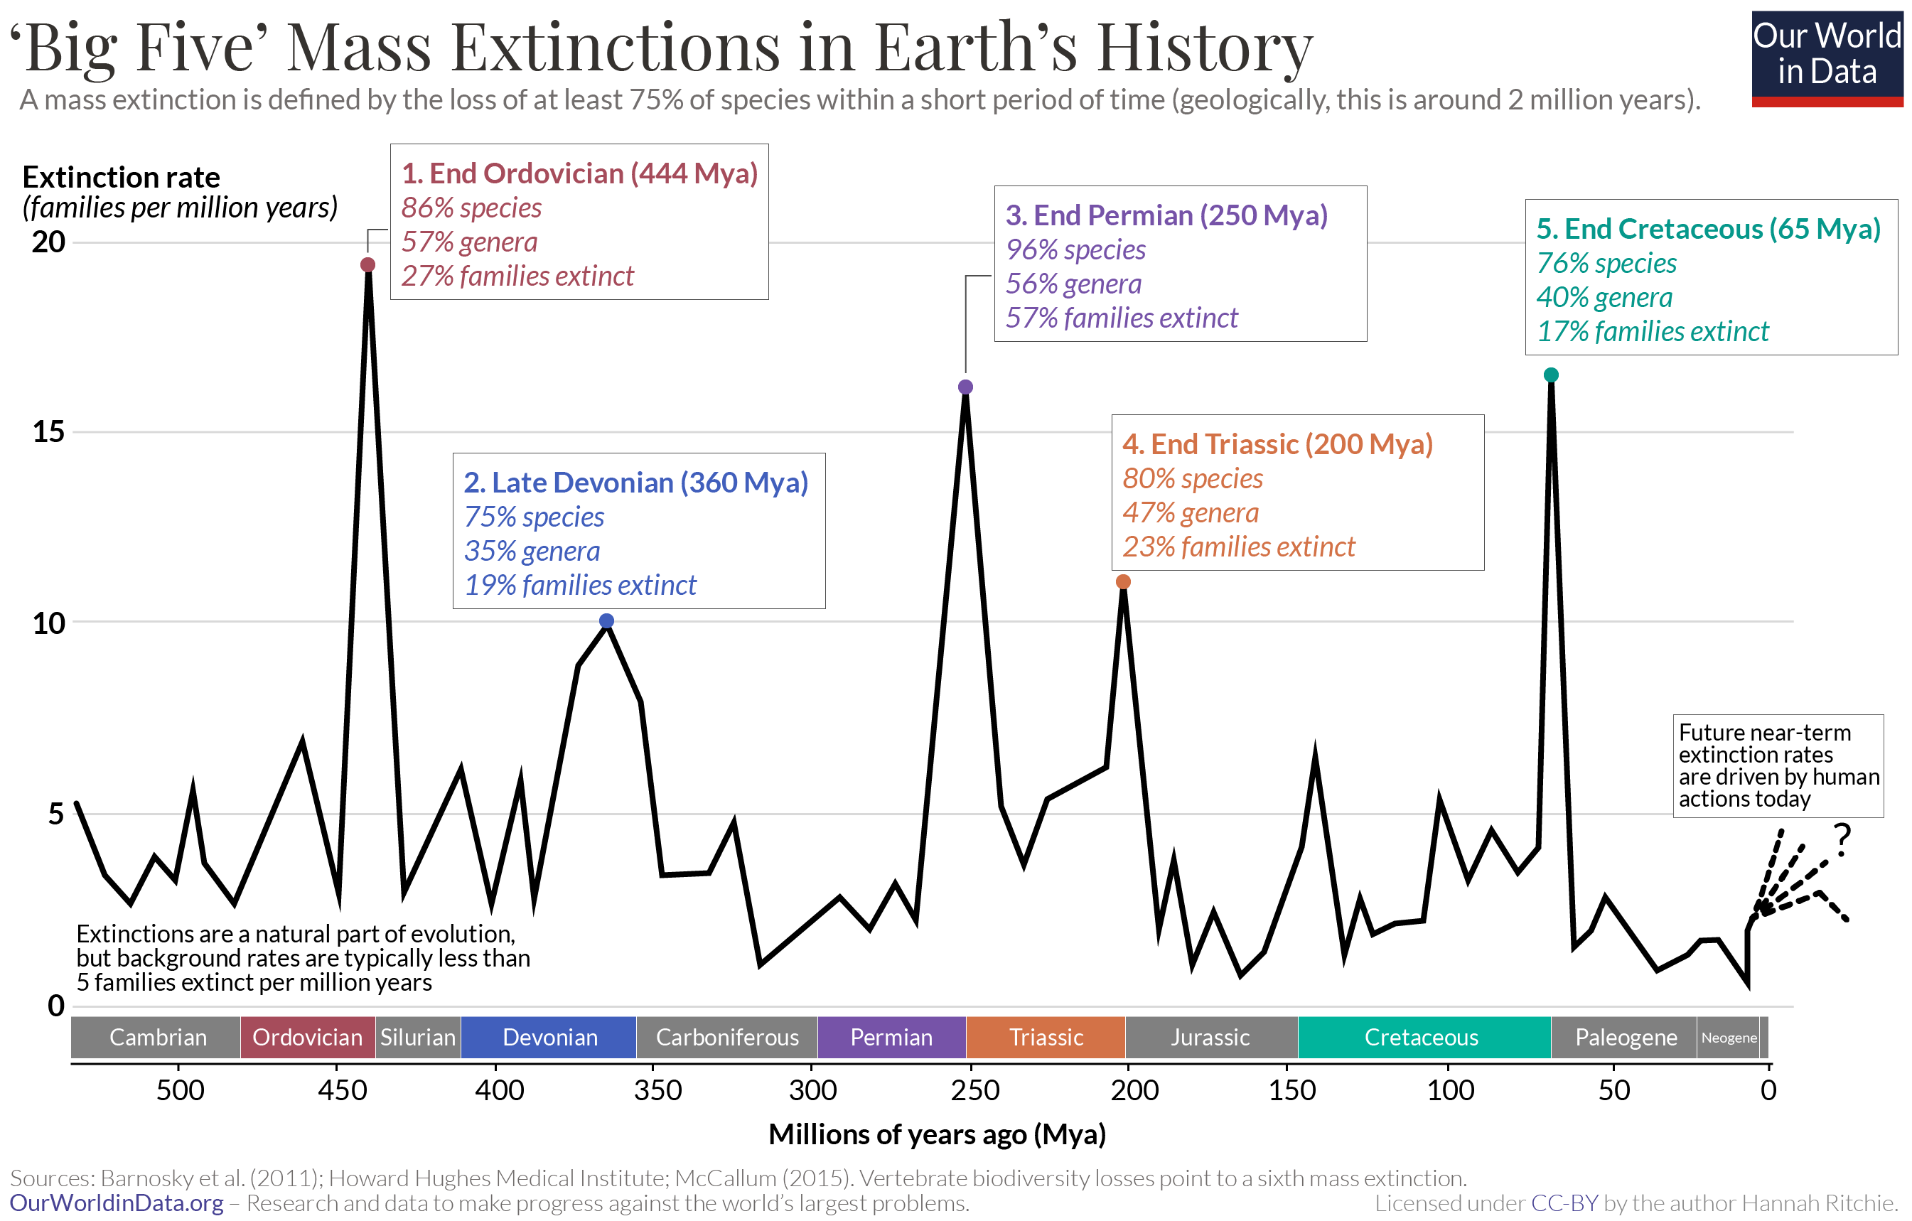

Slide 7
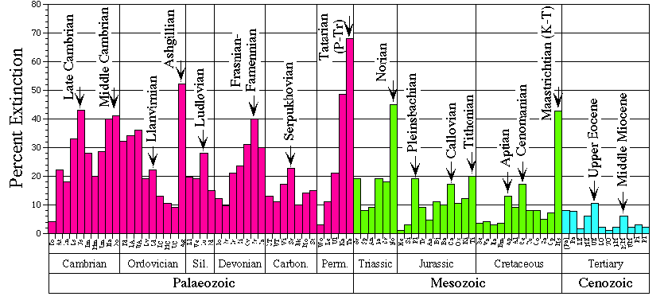
Major Extinctions
There are 12 “major” extinctions recognized in the fossil record.
The extinction intensity was higher than normal during these stages, although extinctions were not always widespread.

Slide 8
It appears that extinction events actually get less intense through the Phanerozoic.
The pattern may be a bias but could also be real.

Slide 9
If the pattern is real, the implications are profound, including:
Living taxa might be less prone to extinction than ancient taxa
The Earth may have become more stable for life over time
Major perturbations may just become less common over time

Slide 10
Suggested Causes of Extinctions
Terrestrial (causes are on Earth)
Bioevolutionary factors (burial of carbon and ecological change)
Climate/atmospheric change (Global warming/cooling)
Ocean chemistry shifts (nutrient loading, anoxia)
Habitat availability (sea level changes)
Volcanic activity
Extraterrestrial (Causes external to Earth)
Asteroids/comets hitting Earth
Solar irregularity?
Nearby cosmic events (e.g., Gamma Ray Bursts)?
Anthropogenic (Human-Induced)

Slide 11
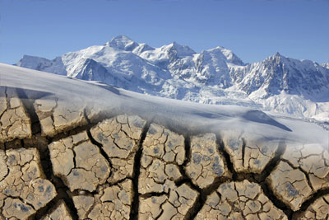
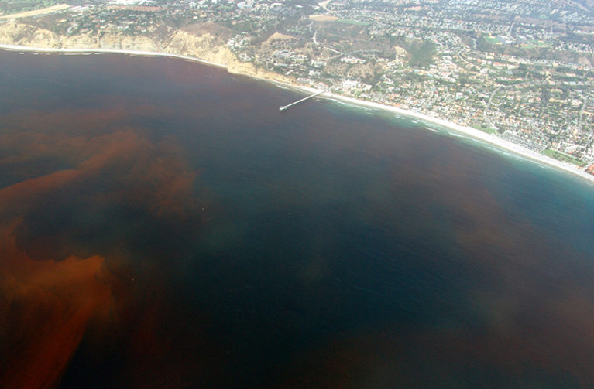
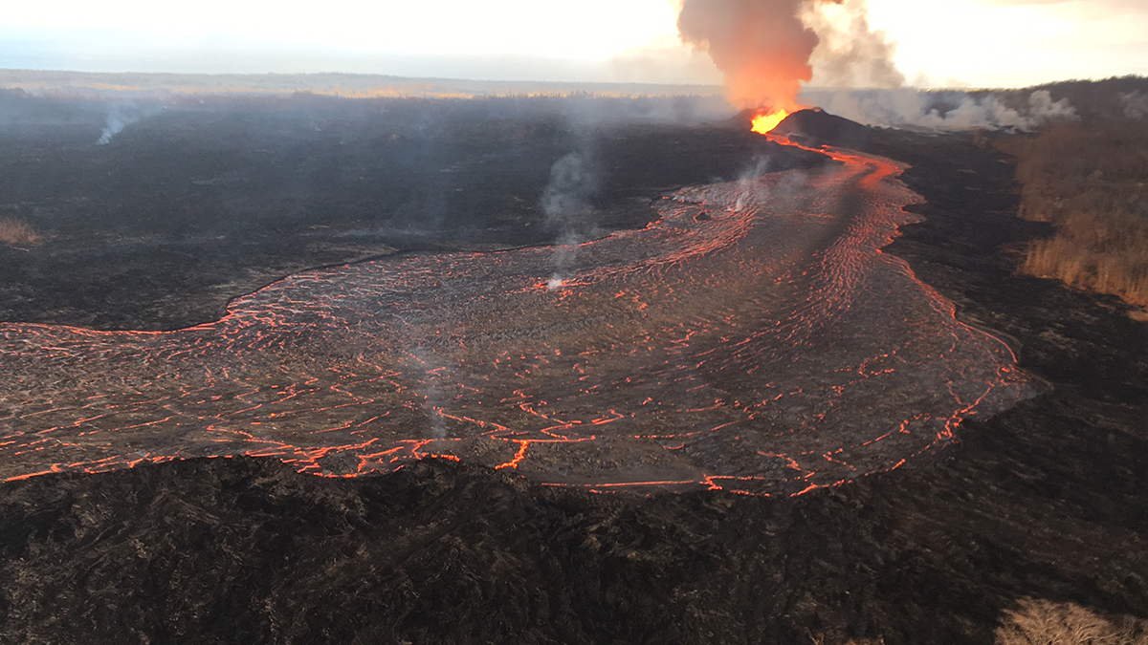
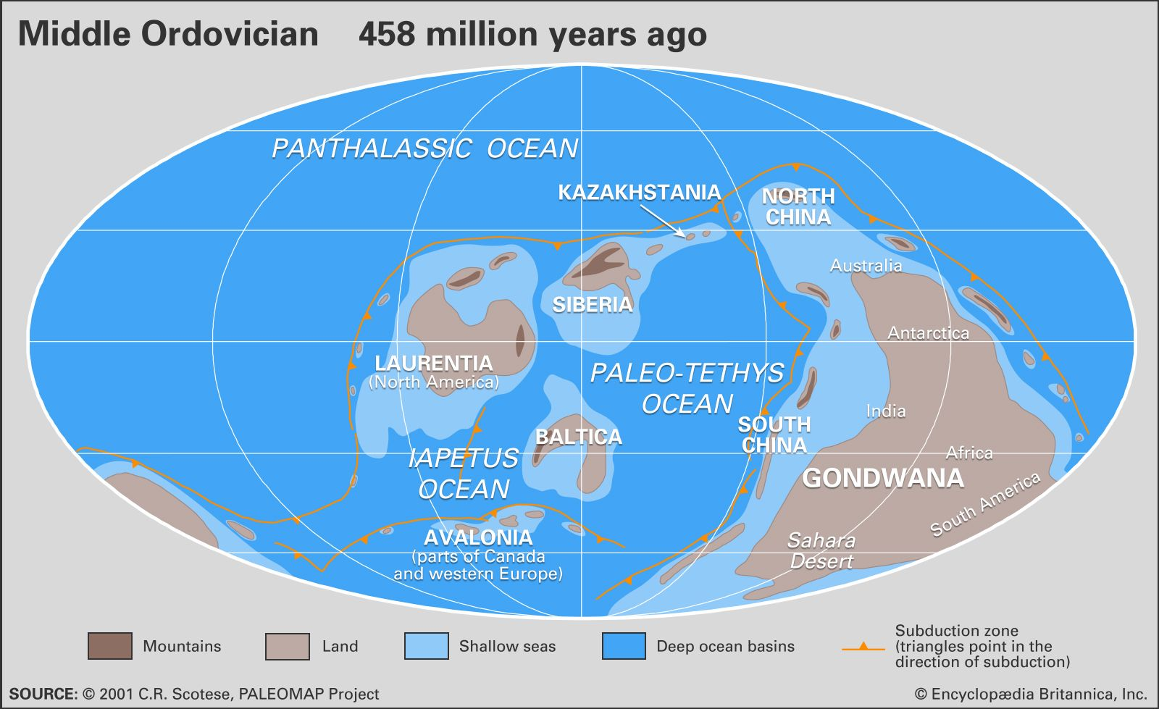
Terrestrial Causes of Extinction
Climate Changes
Changes to Ocean Chemistry
Flood Basalt Volcanism
Changes to Sea Level

Slide 12
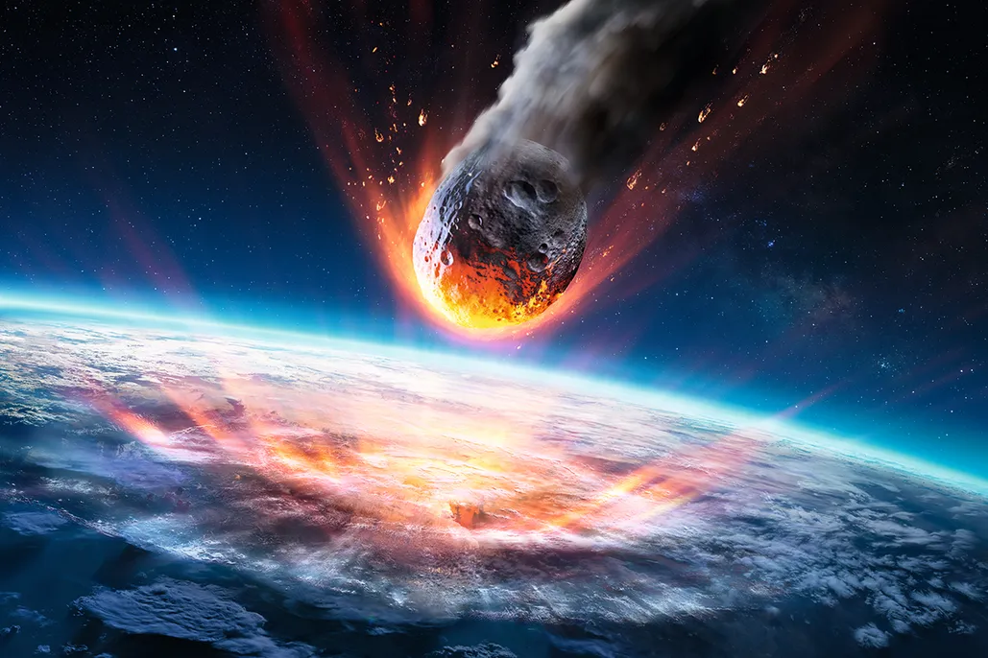
Extraterrestrial Causes of Extinction
Asteroid Impact
Effects: Megatsunami, dust in atmosphere, possible earthquakes,
water vapor in atmosphere, increased rainfall, mudslides,
thermal radiation and fires, global cooling, ecological collapse
(Titus et al., 2002 A review of common natural disasters as analogs for asteroid impact effects and cascading hazards.
Natural Hazards 116: 1355-1402)

Slide 13
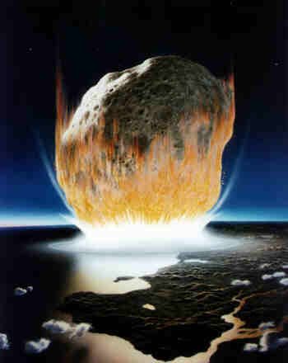
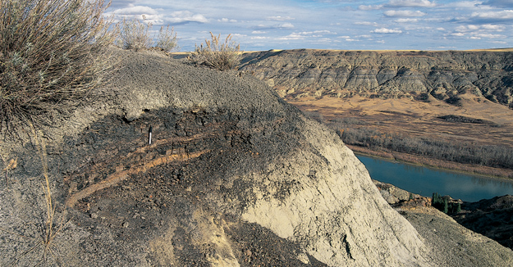
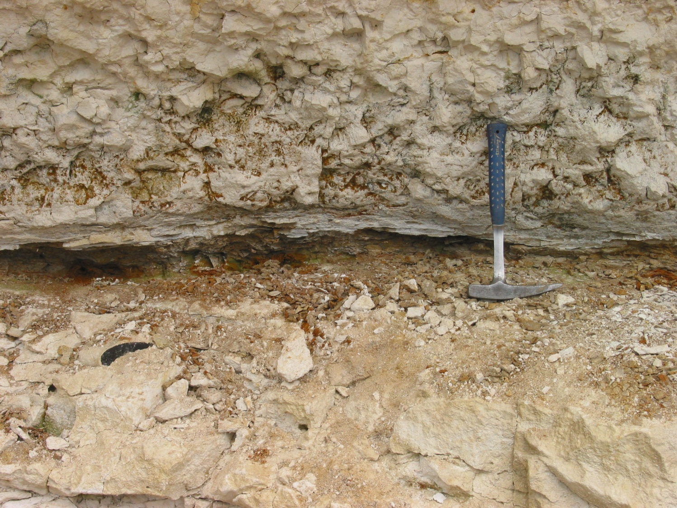
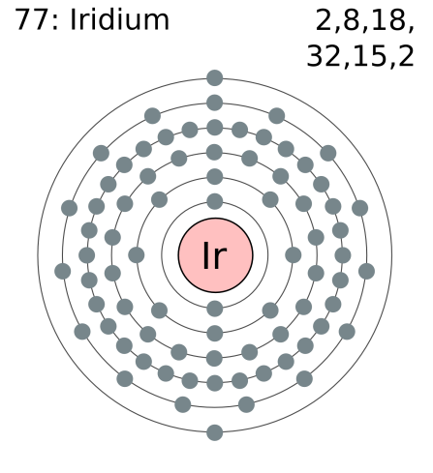
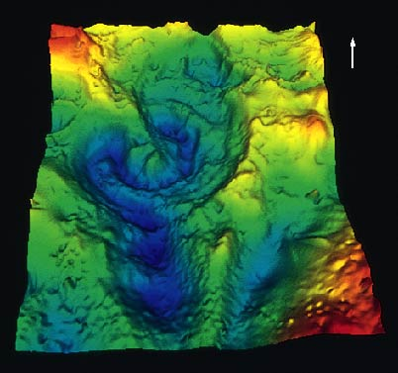
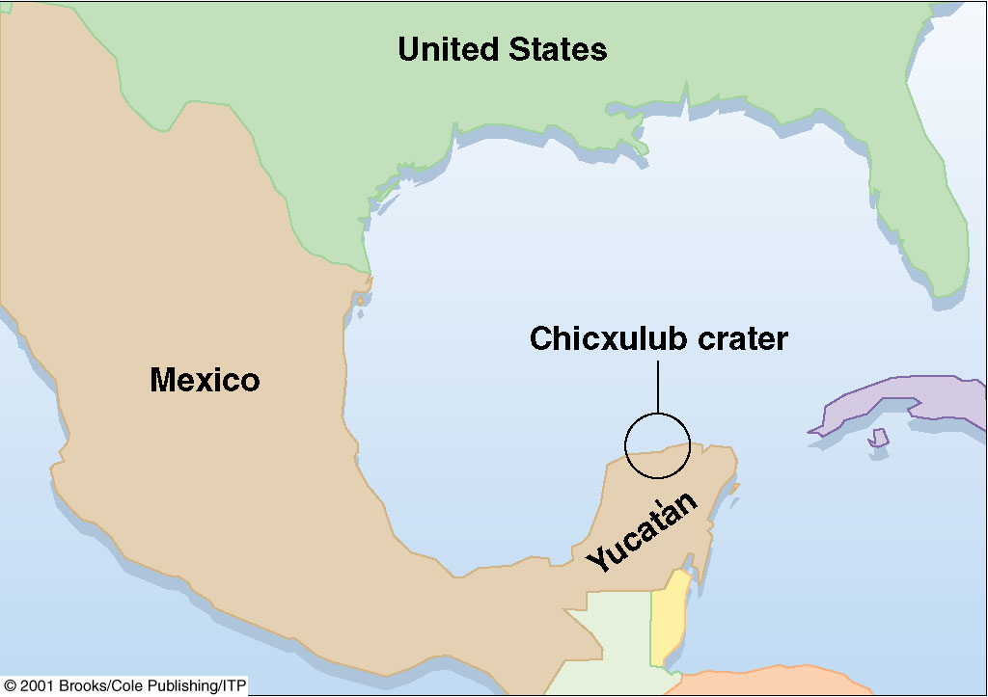
K/T Extinction Event: Evidence of the Impact
Global Cretaceous iridium anomaly
Drumheller, near Alberta, Canada

Slide 14
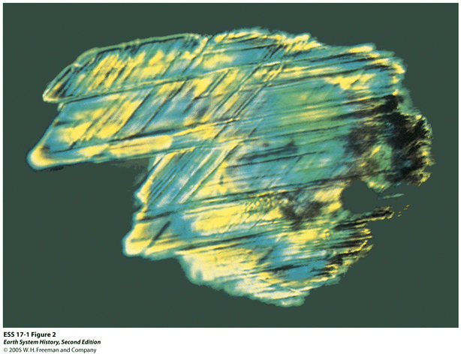
Evidence of The Impact
Shocked quartz grains
Montana
Sets of parallel welded fractures that result from exposure to extremely high pressures
Microspherules
Wyoming
Nearly spherical grains resembling window glass in its molecular structure
Largely uncrystallized

Slide 15
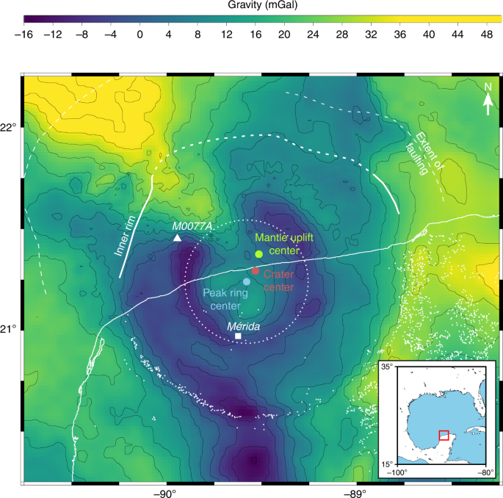
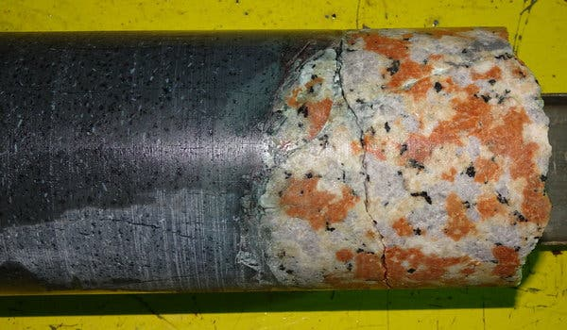
Drilling into the Chixulub Crater
Scientists drilled into the crater and extracted over 829 meters of sediment and rock (Morgan et al., 2016)
Discovered that the rocks became
porous and fractured in impact
Granite was found deep in the core,
Suggesting crust “basement” rock normally
miles below the surfacewas brought closer
to surface
Rocks behaved like a fluid immediately
following impact!
(Collins et al., 2020 after Gulick et al., 2013)

Slide 16
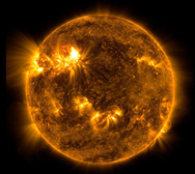
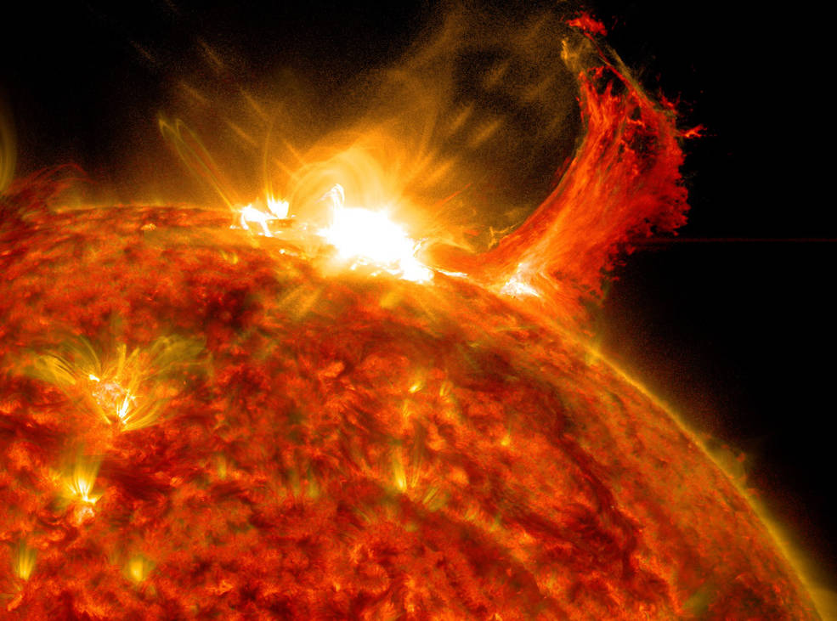
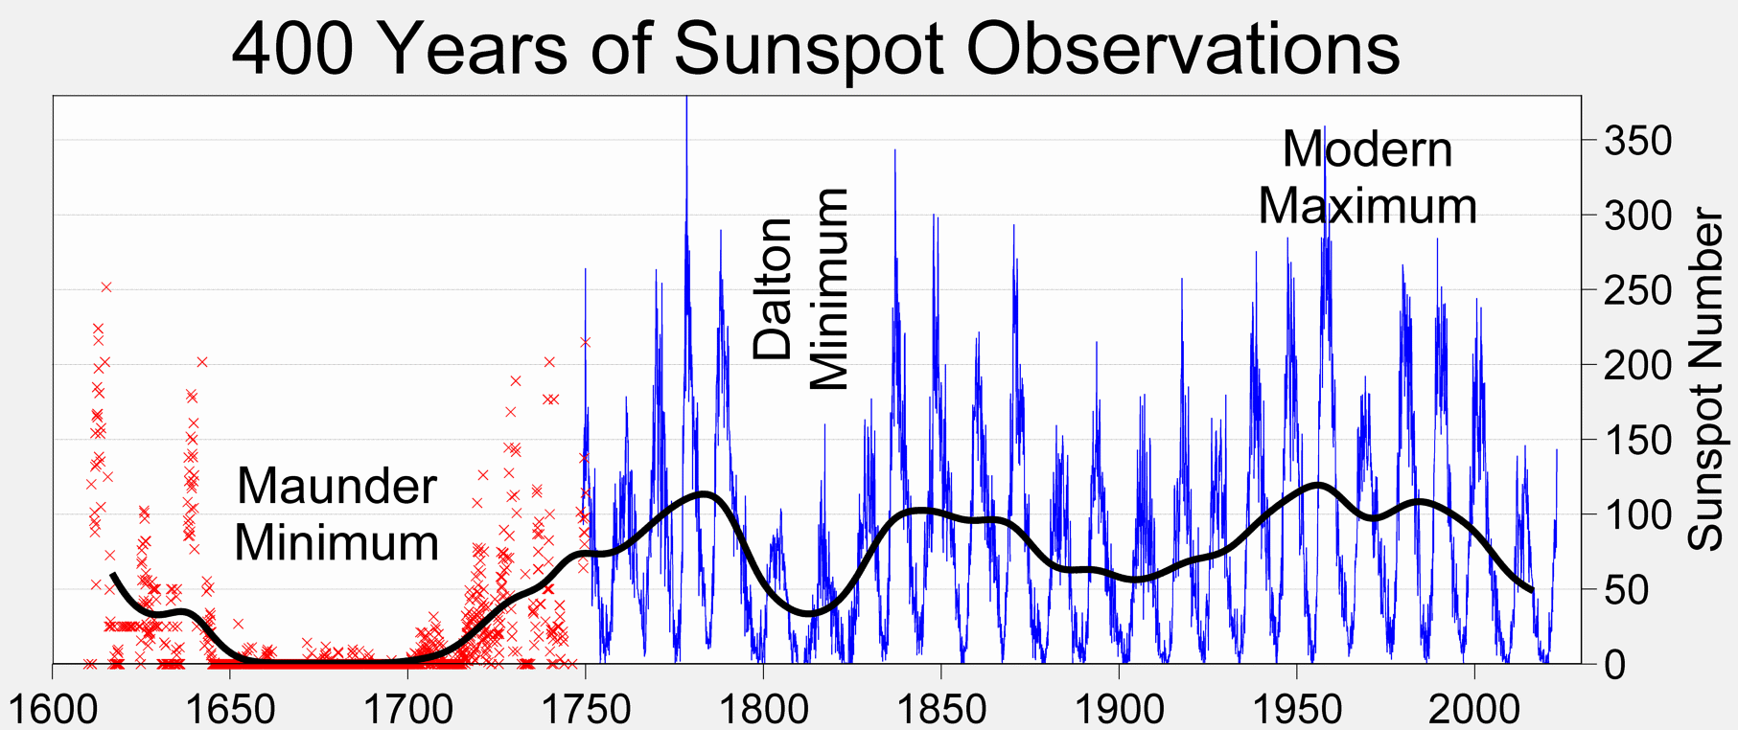
Extraterrestrial Causes of Extinction
Solar Irregularity/Solar Flares
(Speculative)
(Image credit: SDO/NASA)
(Image credit: SDO/NASA)

Slide 17
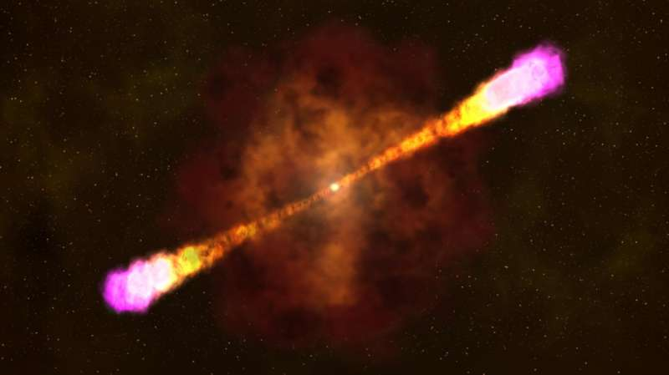
Extraterrestrial Causes of Extinction
Gamma Ray Burst/Supernova Explosions
(Speculative)
Huge supernova explosions emitting gamma ray radiation
Collapse into a neutron star or a black hole
In less than a minute could release more than the amount to energy
released by the sun over its entire lifespan
The problem: very interesting idea, but no evidence for extinction caused by GRB
Credit: NASA's Goddard Space Flight Center

Slide 18
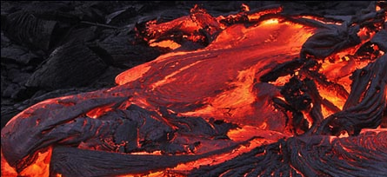
Dominant Cause: Flood Basalts
Asteroids: Dozens of them, most do not correspond to major extinctions.
One out of 17 major/mass extinctions is closely associated with an impact event.
Flood Basalts: 91% correspond to major extinction
There is a flood basalt event for all 10 major extinctions since the Permian. There is not a lot of reliable flood basalt data for before the Permian.
Sea level change: associated with approximately 50% of major extinctions

Slide 19
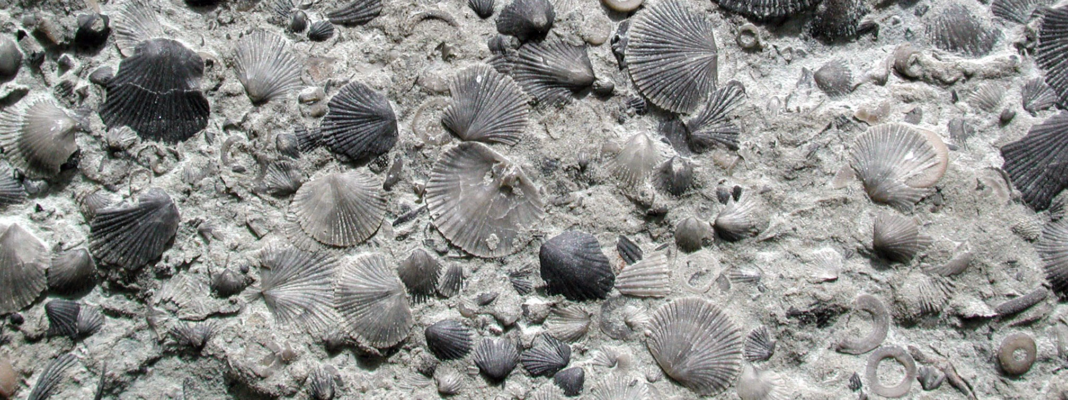
Dominant Cause: Bioevolutionary Triggers
Examples:
Organisms sequestering carbon in the form of limestone
Sequestration of carbon to eventually become coal/oil
Plants colonizing land and creating soil for the first time
Introduction of predators, competition of new species

Slide 20
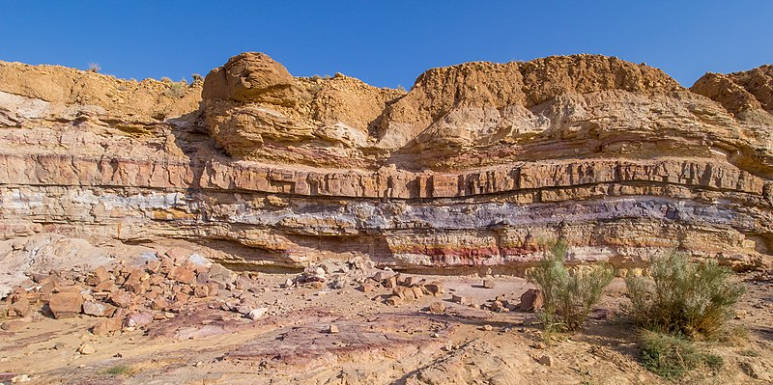
A Bit About Earth History and the Fossil Record
Origin of Earth
Today

Slide 21
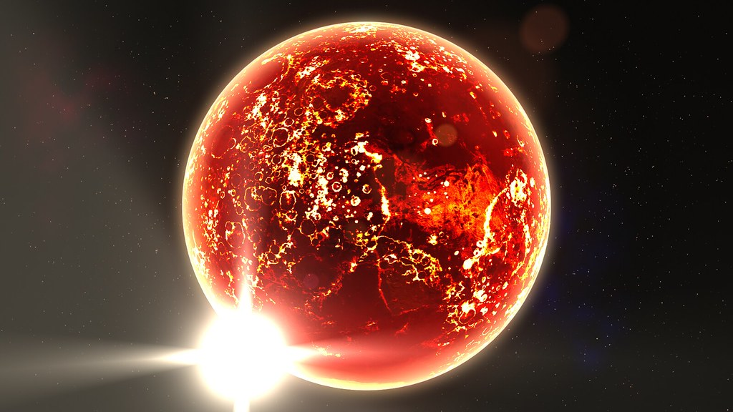
The Hadean
Origin of Earth
"Hot Planet" by Kevin M. Gill is licensed under CC BY 2.0.
Today

Slide 22
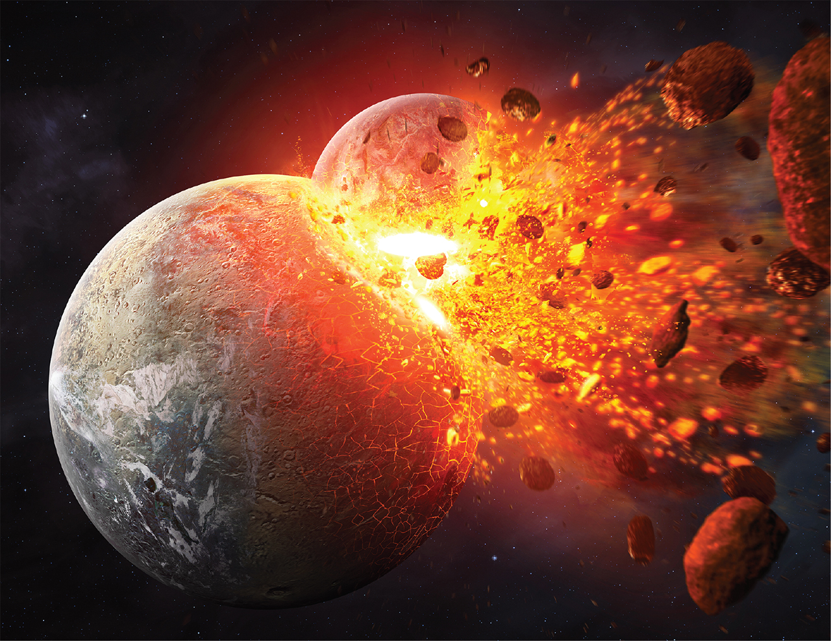
The Hadean: formation of our moon
Origin of Earth
IMAGE: TOBIAS ROETSCH/ALL ABOUT SPACE MAGAZINE/GETTY IMAGES
Today

Slide 23
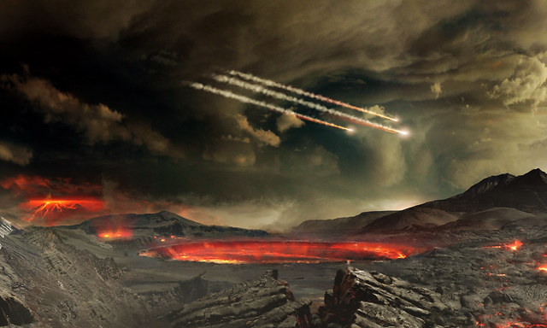
Origin of Earth
Today

Slide 24
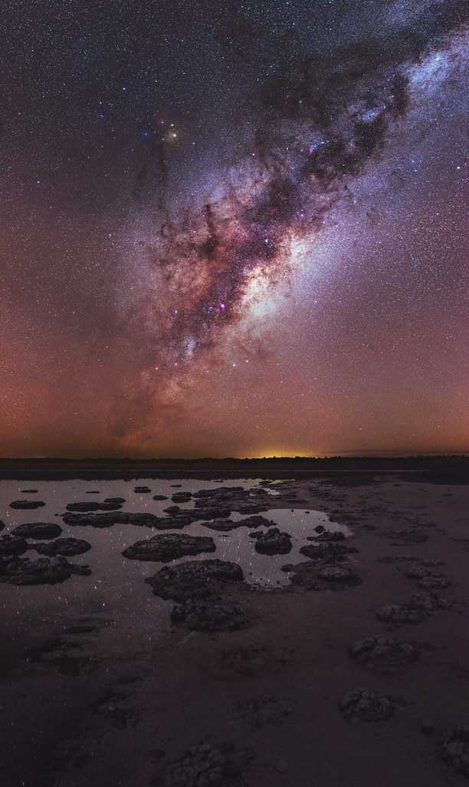
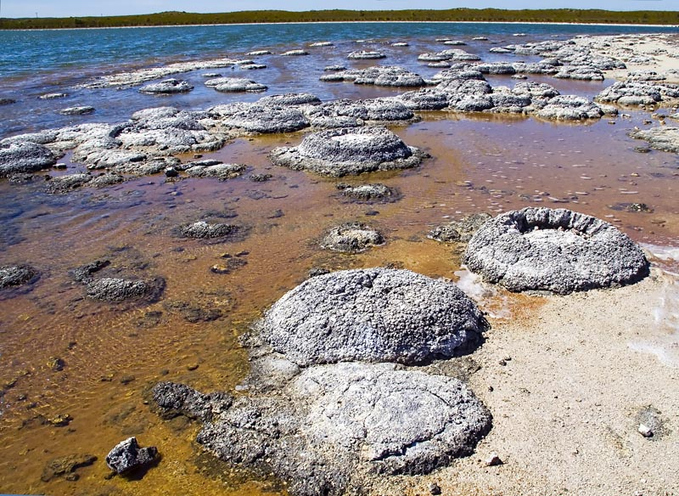
First Fossils ~3.5 Billion Years Ago
https://www.flickr.com/photos/nashworld/7067976071
"Lake Thetis-Stromatolites-LaRuth" by Ruth Ellison is licensed under CC BY 2.0.
Origin of Earth
https://www.flickr.com/photos/trevor_dobson_inefekt69/43538638932
Today

Slide 25
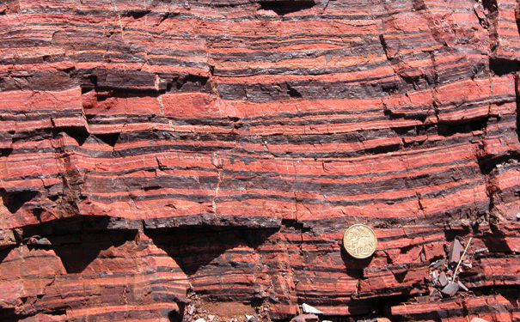
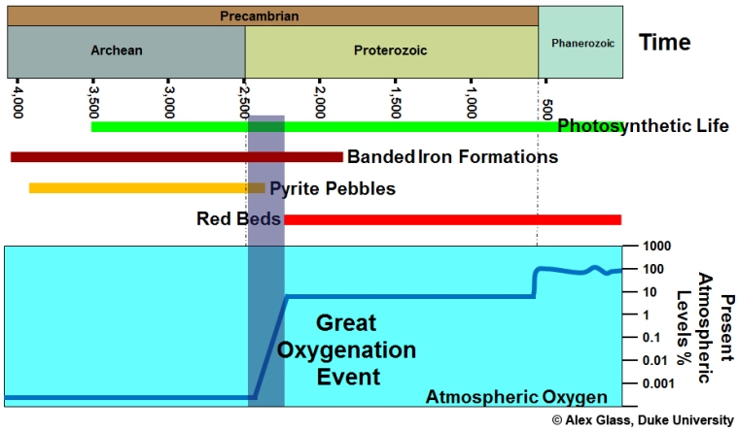
The rise of oxygen: the great oxygenation event
Banded Iron
Image: Mark Barley
Origin of Earth
Today

Slide 26
First multicellular fossils?
Recent study—published July 28, 2021
890 million years old
Turner, E.C. Possible poriferan body fossils in early Neoproterozoic microbial reefs. Nature 596, 87–91 (2021)
Origin of Earth
Today

Slide 27
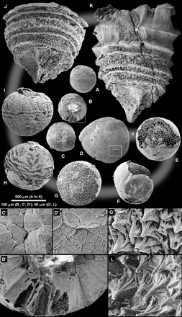
First multicellular embryos?
Doushantuo Formation (~600mya)
Metazoan embryos at different stages of development
These fossils form a growth series from several hundred cell ball to a several thousand cell embryo with a distinct spiral structure.
Origin of Earth
Bengston and Zhao 1997
Today

Slide 28
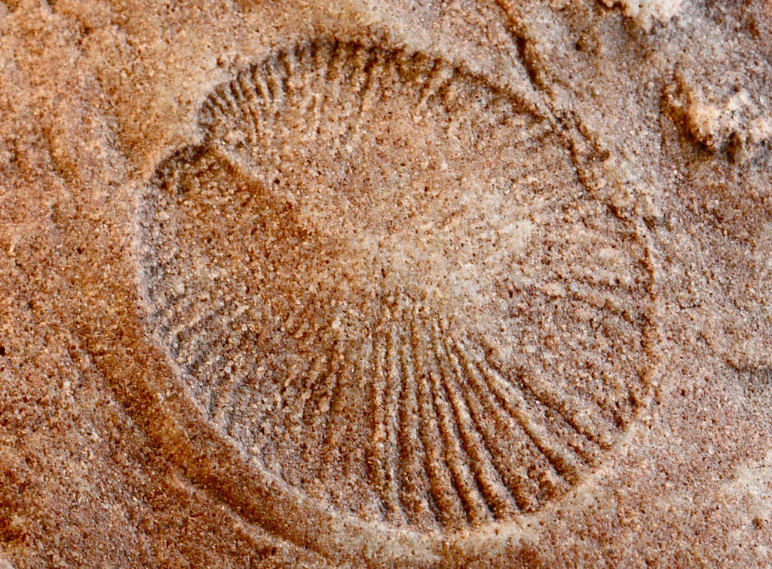
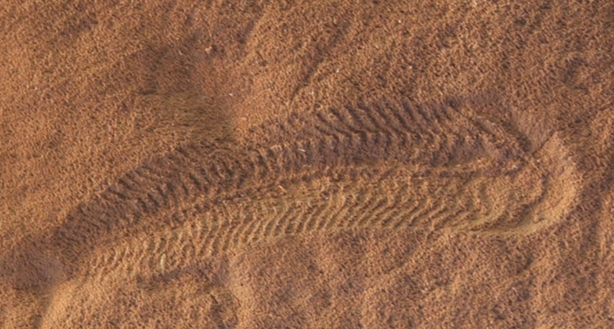
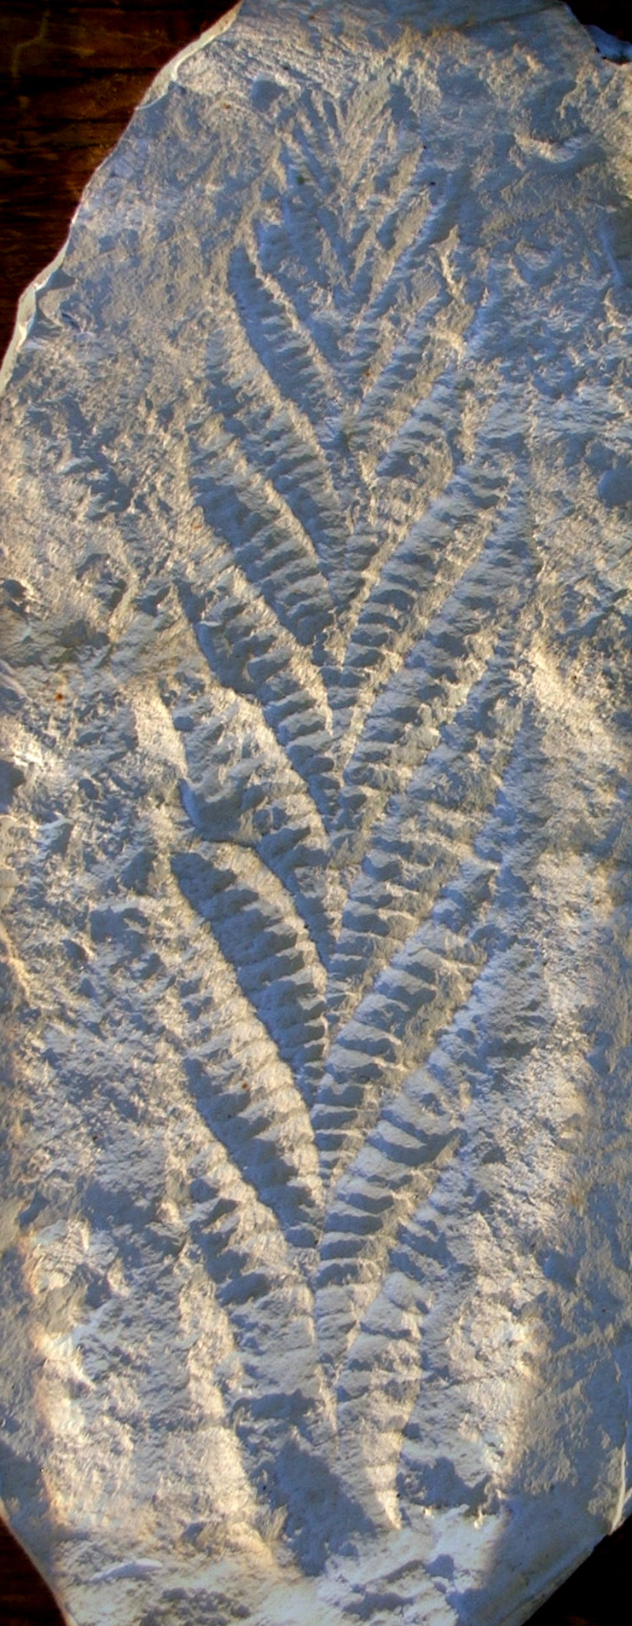
Ediacaran Fauna
Origin of Earth
Today

Slide 29
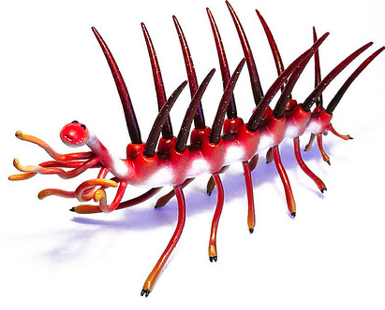
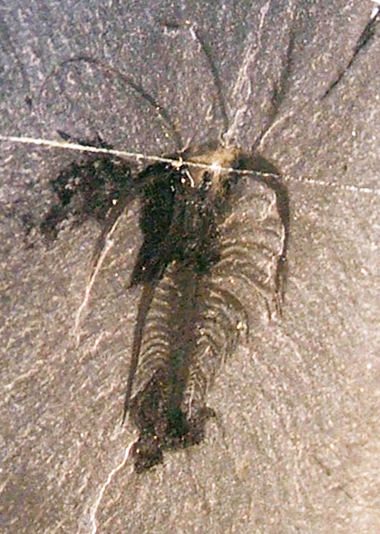
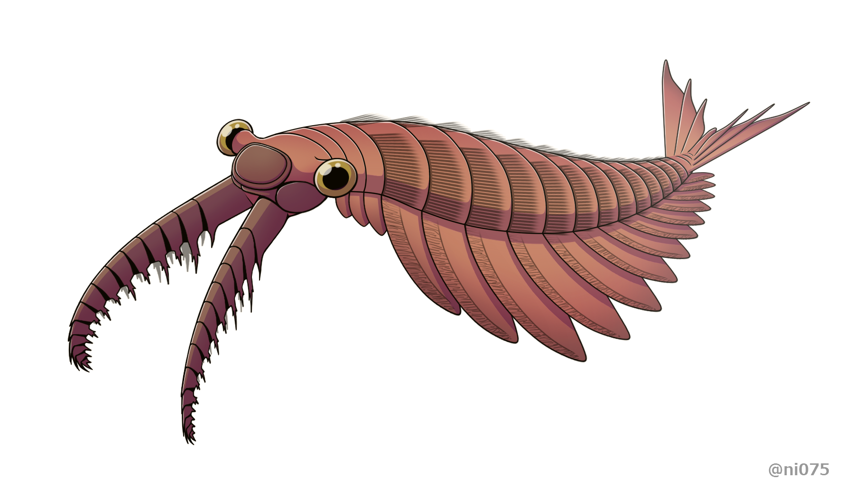
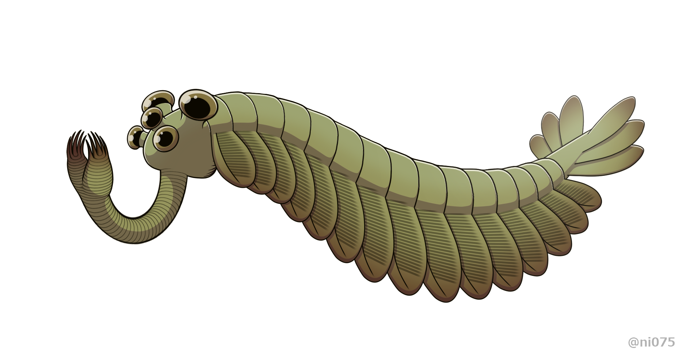
The Cambrian “Explosion”
Origin of Earth
Today

Slide 30
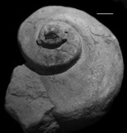
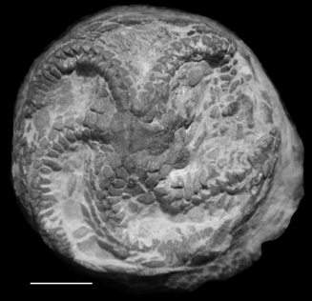
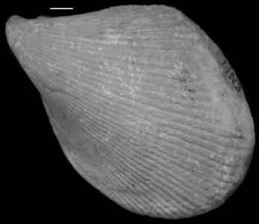
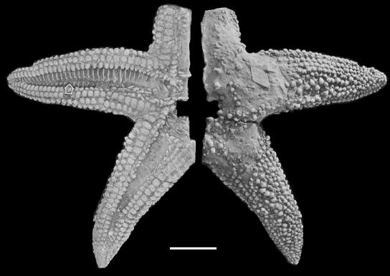
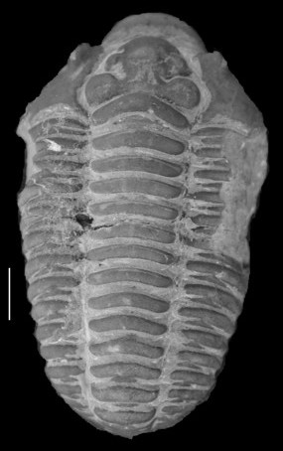
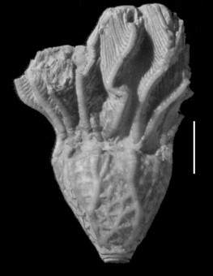
http://stratigrafia.org/cincy/index.html
The Great Ordovician Biodiversification Event
Origin of Earth
Today

Slide 31
Big Five #1: The Ordovician Mass Extinction
Credit MARK P. WITTON / SCIENCE PHOTO LIBRARY
Origin of Earth
Today

Slide 32
Silurian and Devonian Ecosystem Changes
https://samnoblemuseum.ou.edu/common-fossils-of-oklahoma/paleocommunities/terrestrial-communities/silurian-early-devonian/
Steve White
Zina Deretsky, National Science Foundation
Origin of Earth
Today

Slide 33
Big Five #2:
The Devonian Extinction
Léonard Dupond
Origin of Earth
https://mudstone.sitehost.iu.edu/field-photos-1.htm
Today

Slide 34
The Giant “Bugs” and Coal Swamps
of the Carboniferous
John Weinstein
dinopedia.fandom.com
Origin of Earth
Today

Slide 35
Big Five #3:
The Permian Extinction: The “Great Dying”
Origin of Earth
https://newcastlemuseum.com.au/NewcastleMuseum/media/Museum/Images/Exhibitions/PM_PermianExtinction.jpg
Today

Slide 36
Big Five #4: The Triassic Extinction
https://www.dkfindout.com/us/dinosaurs-and-prehistoric-life/dinosaurs/coelophysis/
© AMNH
Image credit: Dawid Adam Iurino / PaleoFactory, Sapienza University of Rome / Jurikova et al, doi: 10.1038/s41561-020-00646-4.
Origin of Earth
Today

Slide 37
The Jurassic Period
https://www.livescience.com/24745-archaeopteryx.html
Origin of Earth
Today

Slide 38
Big Five #5: Cretaceous (K-Pg) Extinction
Illustration: Eye Risk/Alamy
Origin of Earth
Image credit: George O. Poinar, Jr. / Kenton L. Chambers.
https://www.theyucatantimes.com/2016/07/chicxulub-residents-hope-for-more-exposure-for-meteorite-crater/
Today

Slide 39
The Cenozoic
Origin of Earth
Today

Slide 40
Ice Age Extinction (Minor Extinction)

Slide 41
Origin of Earth
Today

Slide 42
The Sixth Extinction??
Climate changes
Habitat loss
Invasive species
Overexploitation
(Finn et al., 2023)

Slide 43
Questions?

