Slide 1
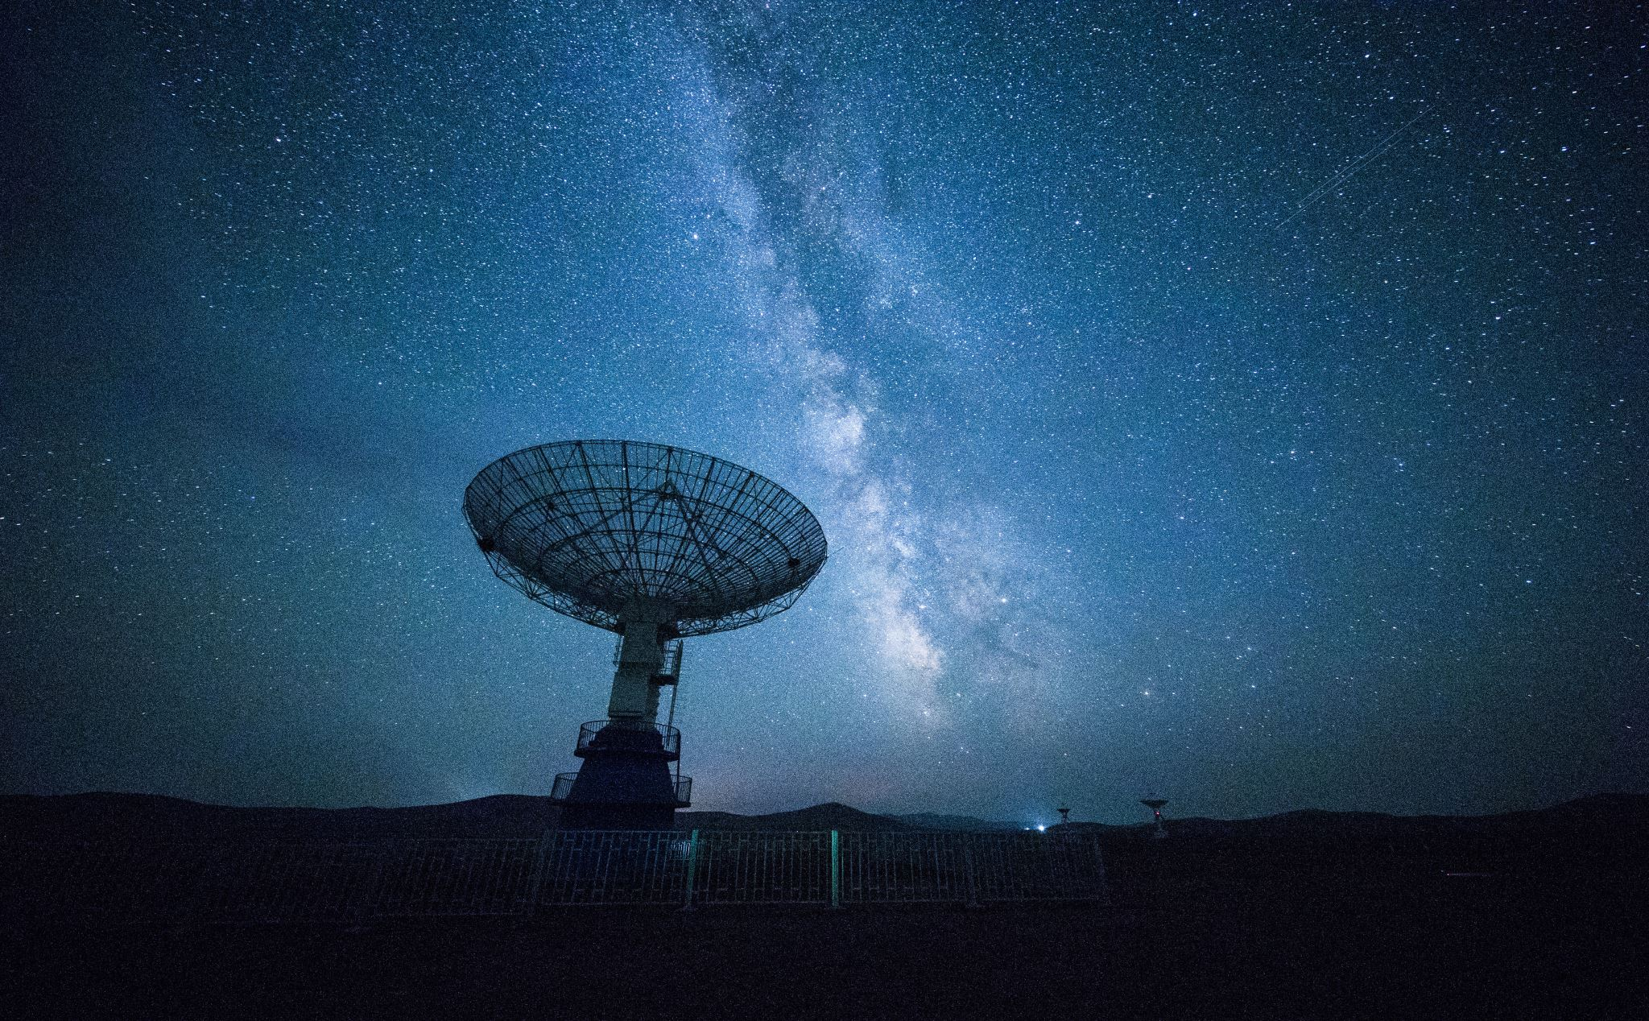
Observing in Light Polluted Skies utilizing some Astronomical League Observing Programs

Slide 2
The Louisville Astronomical Society
Founded in 1933 by Dr. Walter Lee Moore
Charter member of the Astronomical League
Over 240 members
Involved in numerous events and educational activities at libraries, schools, parks and similar public venues
Run a Library Telescope program and will add a Binocular program
Private dark site with an observatory and multipurpose building
Scout program and public nights
www.Louisville-astro.org

Slide 3
Astronomical League
It started in 1935 with the official formation in November 1941
13 charter societies including the LAS
Over 300 member societies and 23,000 members
Over 80 observing programs for all experience levels
Youth
Beginner
Intermediate
Advanced
Astrocon annual convention and awards
www.astroleague.org

Slide 4
Where do we observe?
Light polluted suburbs and cities
Mild to moderate light polluted areas
Dark skies – way far away

Slide 5
Light pollution and other factors
Bortle scale
9 level numeric scale with 1 being excellent and 9 being horrible
Here is probably a Bortle 8 sky
Fern Creek is 6 or 7 depending on sky conditions
Bortle 8 / 9 skies are very hard to observe in
Humidity
Smoke

Slide 6
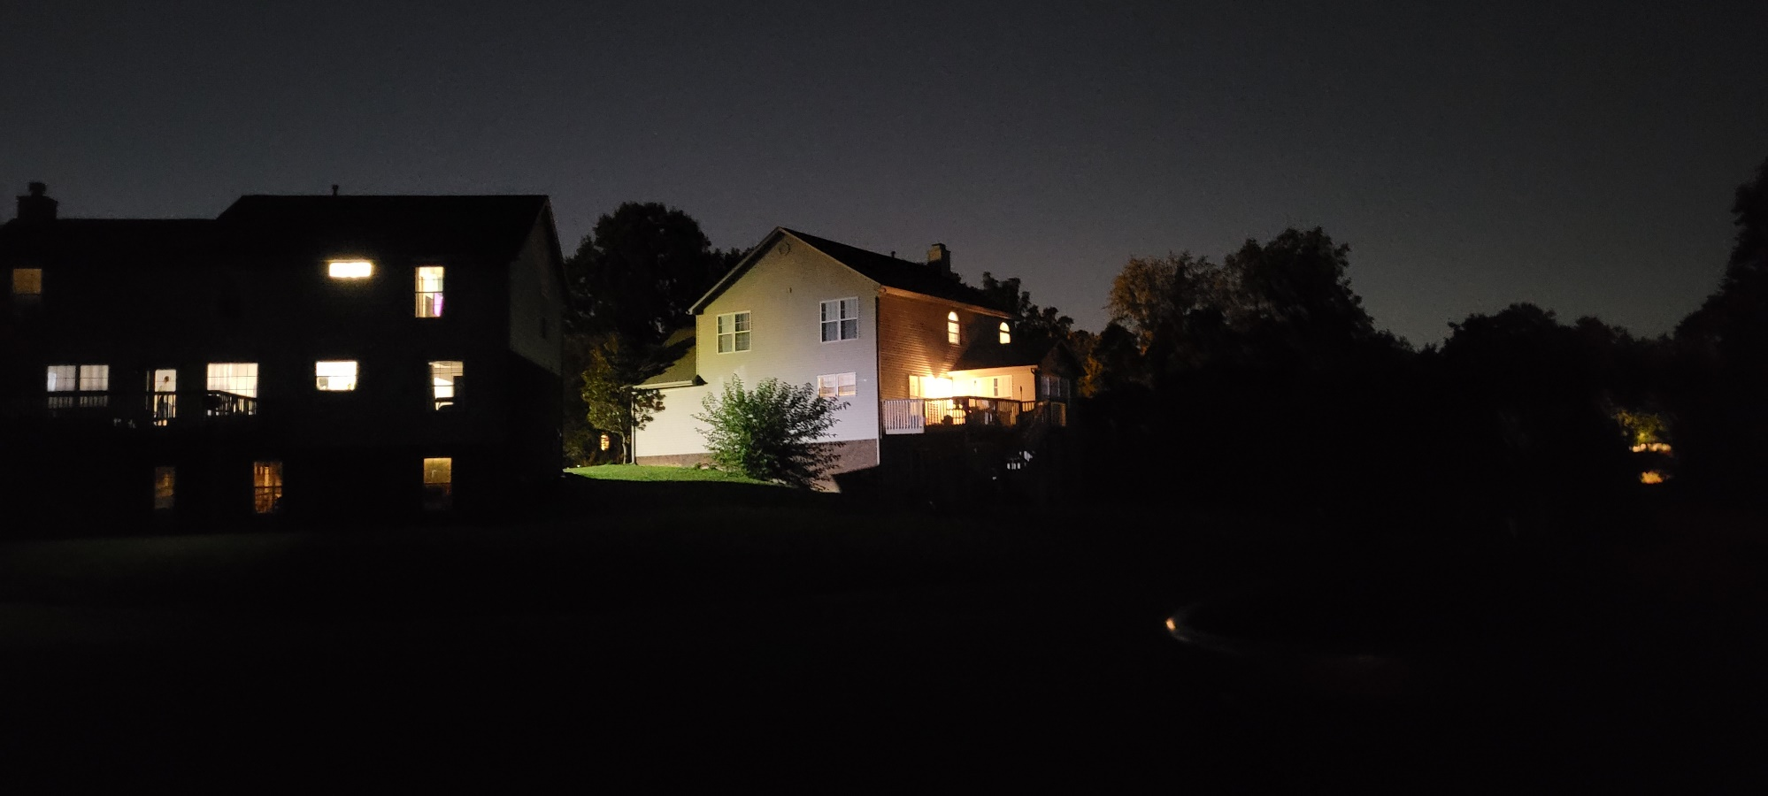
My Back Yard

Slide 7
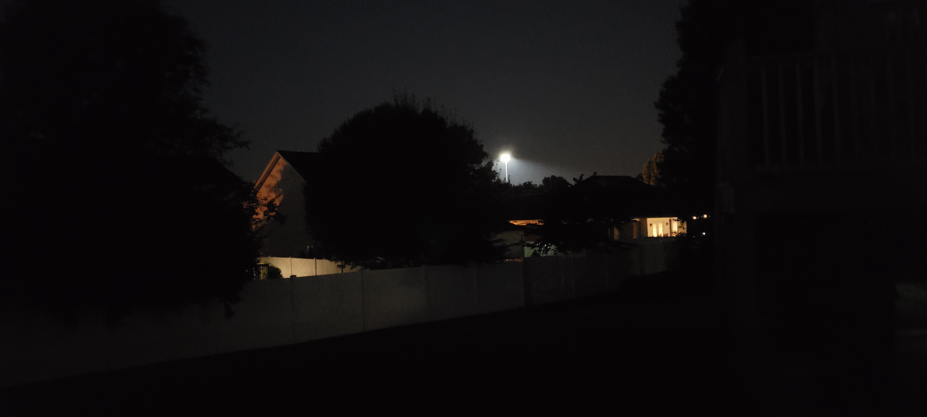
My Back Yard

Slide 8
How did I get into backyard astronomy?
Tired of driving an hour each way plus set-up time
Most good nights are during the week
Very few good new Moon weekend nights
It is easy to roll my telescope out of the garage with a 5-minute set up time

Slide 9
What equipment is needed?
10 x 50 binoculars (I use Bushnell, low cost)
Telescope 80mm and larger
Star chart or app
Patience if you don’t have GOTO or DSC
A way to record your observations

Slide 10
What equipment is needed?
Good telescope for backyards is a Newtonian reflector on a Dobsonian mount
More for the money and easy to use
8” telescope can be had for $300 or so used
Can add digital setting circles easily
GOTO mount is aways good and come in all different apertures

Slide 11
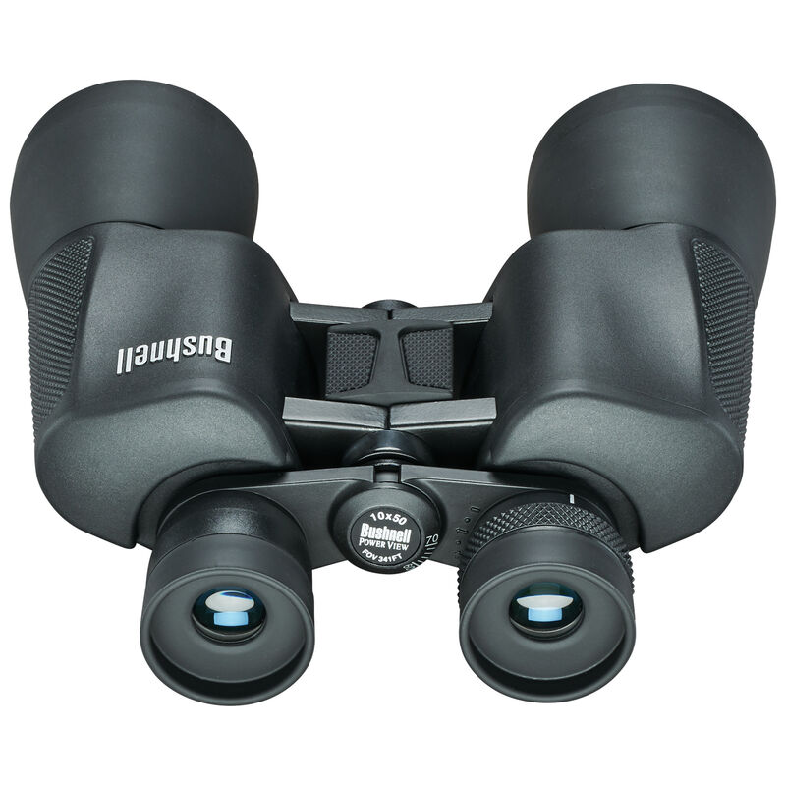
What equipment is needed?

Slide 12
What equipment is needed?
Star charts
Smartphone apps
Stellarium is excellent and free
Android and IPhone
Many others available

Slide 13
Tips and Hacks
Learn to use averted vision
If you think that you see the object but are not for sure, tap your telescope
Wait for the atmosphere to settle down
Straight up is darkest part of the sky
Use a red light to preserve night vision
https://www.astroleague.org/urban-club-tips/

Slide 14
Astronomical League observing programs
Lunar Observing programs
Double Star Observing program
Urban Observing program
Constellation Hunter Observing program
Binocular Solar System Observing program
Earth Orbiting Satellites Observing program

Slide 15
Lunar Observing Programs
Easiest object to observe
Visible most nights
Thousands of things to explore
The view changes every few hours
Very easy to keep track of its position

Slide 16
Lunar Observing Program
Naked eye observations like The Man in the Moon
Binocular and telescopic observations
Additional learning activities
100 observations in the program

Slide 17
Lunar II Observing Program
Telescopic observations are required for description of features
Sketching required for several features
Additional learning activities
100 observations in the program

Slide 18
Lunar II Observing Program

Slide 19
Lunar Observing Programs
Resources needed for this program
Lunar atlas or map
- OR -
Smartphone app (LunarMap HD)

Slide 20
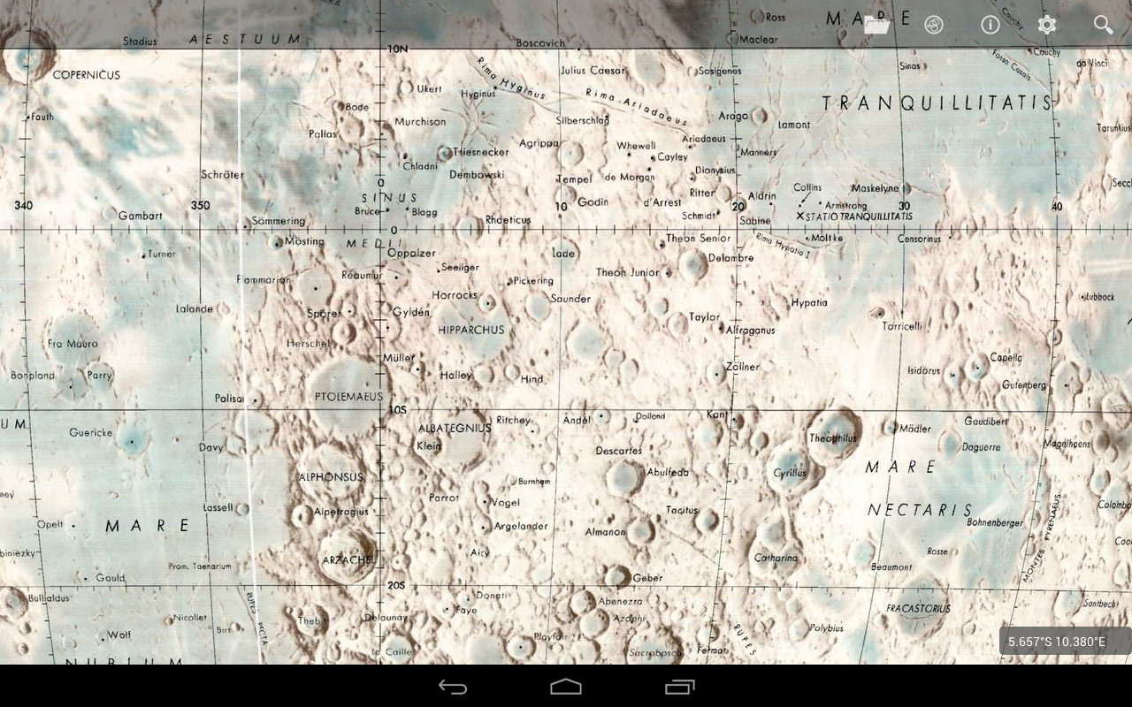
LunarMap HD
Smartphone app (LunarMap HD)

Slide 21
Double Star Observing Program
Small to medium telescope
Record 100 observations
Diagram of each pair or multiple system
Determine north from stars’ motion
Optional: calculate position angle(s) of stars
A cross-hair reticle eyepiece is helpful

Slide 22
Double Star Observing Program
Determine north direction from stars’ motion
North is 90° counter-clockwise from the direction that the double star is moving

Slide 23
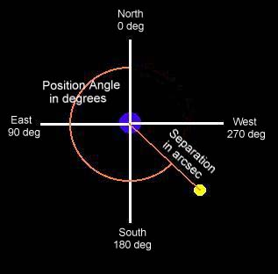
Double Star Observing Program
Calculate position angle(s) of stars

Slide 24
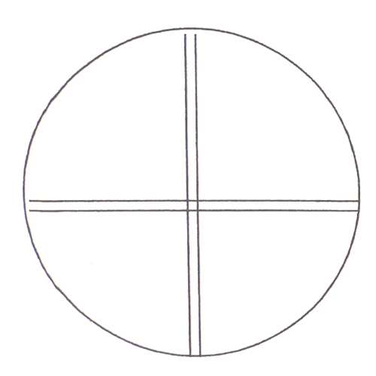
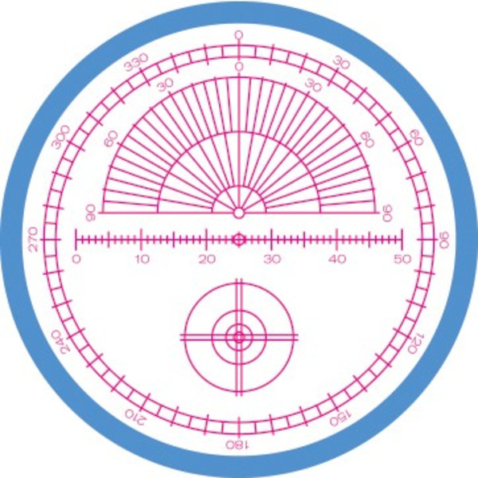
Double Star Observing Program
Reticle eyepieces

Slide 25
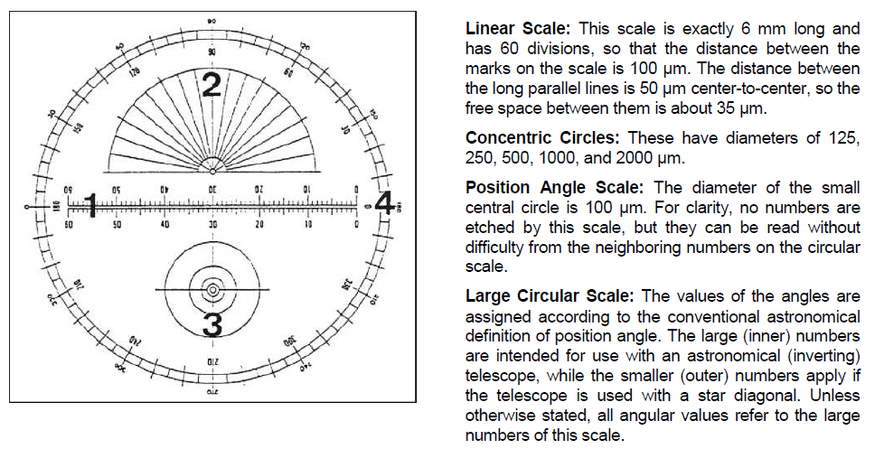
Double Star Observing Program
Reticle eyepieces

Slide 26
Double Star Observing Program
2021 | Index | Object List | Right Ascension | Declination | Magnitude | Separation | Position Angle | Last WDS Measure
[ ] | 1 | Eta Cassiopeiae | 00^{h} 49^{m}.1 | +57° 49' | 3.5, 7.4 | 13.4" | 326° | 2019
[ ] | 2 | 65 Piscium | 00^{h} 49^{m}.9 | +27° 43' | 6.3, 6.3 | 4.4" | 115° | 2020
[ ] | 3 | Psi 1 Piscium | 01^{h} 05^{m}.6 | +21° 28' | 5.3, 5.5 | 29.8" | 159° | 2018
[ ] | 4 | Zeta Piscium | 01^{h} 13^{m}.7 | +07° 35' | 5.2, 6.3 | 22.8" | 63° | 2018
[ ] | 5 | Gamma Arietis | 01^{h} 53^{m}.5 | +19° 18' | 4.5, 4.6 | 7.4" | 1° | 2020
[ ] | 6 | Lambda Arietis | 01^{h} 57^{m}.9 | +23° 36' | 4.8, 6.7 | 37.3" | 48° | 2019
[ ] | 7 | Alpha Piscium | 02^{h} 02^{m}.0 | +02° 46' | 4.1, 5.2 | 1.9" | 264° | 2019
[ ] | 8 | Gamma Andromedae | 02^{h} 03^{m}.9 | +42° 20' | 2.3, 5.0 | 9.6" | 63° | 2019

Slide 27
Urban Observing Program
100 objects in the program
Star clusters
Nebulae
Galaxies
Double and variable stars
6-inch (150mm) telescope recommended but many can be seen in an 80mm and several naked eye

Slide 28
Urban Observing Program
Object Name | Right Ascension | Declination | Mag. | Mess. # | Type | Size | Con
NGC 221 | 00^{h} 42.7^{m} | +40° 52′ | 9 | M32 | Galaxy | 7.6′ x 5.8′ | And
NGC 224 | 00^{h} 42.7^{m} | +41° 16′ | 4.4 | M31 | Galaxy | 180′ x 63′ | And
NGC 1068 | 02^{h} 42.7^{m} | -00° 01′ | 8.8 | M77 | Galaxy | 6.9′ x 5.9′ | Cet
NGC 3031 | 09^{h} 55.6^{m} | +69° 04′ | 6.8 | M81 | Galaxy | 26′ x 14′ | UMa
NGC 3034 | 09^{h} 55.8^{m} | +69° 41′ | 8.4 | M82 | Galaxy | 11′ x 4.6′ | UMa
NGC 4374 | 12^{h} 25.1^{m} | +12° 53′ | 10.1 | M84 | Galaxy | 6.5′ x 5.6′ | Vir
NGC 4406 | 12^{h} 26.2^{m} | +12° 57′ | 9.8 | M86 | Galaxy | 8.9′ x 5.8′ | Vir
NGC 4486 | 12^{h} 30.8^{m} | +12° 24′ | 8.6 | M87 | Galaxy | 7.2′ x 6.8′ | Vir
NGC 4594 | 12^{h} 40.0^{m} | -11° 37′ | 8.3 | M104 | Galaxy | 8.9′ x 4.1′ | Vir
NGC 4736 | 12^{h} 50.9^{m} | +41° 07′ | 8.1 | M94 | Galaxy | 11′ x 9.1′ | CVn

Slide 29
Constellation Hunter Observing Program
Observe and sketch all the Northern constellations
No equipment is needed but binoculars are helpful
Excellent resource is Wikipedia
39 observations

Slide 30
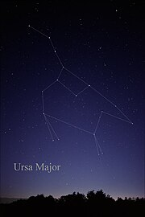
Constellation Hunter Observing Program

Slide 31
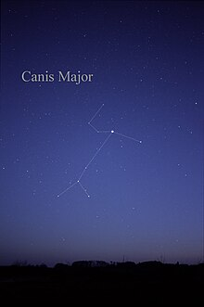
Constellation Hunter Observing Program

Slide 32
Solar System Observing Program
25 projects for binoculars and small telescopes
Sun (with proper protection) and Moon
Inner planets – Mercury, Venus and Mars
Outer planets – Jupiter, Saturn, Uranus and Neptune
Awards for both binoculars and telescopes

Slide 33
Solar System Observing Program
Projects include:
The phases of Venus
Albedo features on Mars
Jupiter’s eclipsing its Moons
Saturn’s rings
Saturn’s moons (5 are seen in a telescope)
Locating Uranus and Neptune

Slide 34
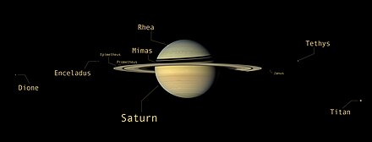
Solar System Observing Program

Slide 35
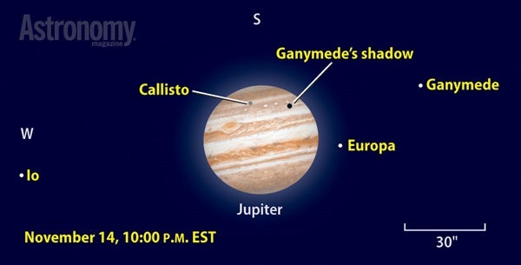
Solar System Observing Program

Slide 36
Earth Orbiting Satellite Observing Program
Eyes and/or binoculars are needed
28 observations
Observe a variety of man-made objects orbiting the Earth
To see what is coming up overhead check out Heavens Above website
This is fun for the whole family
You will learn how to spot satellites and distinguish them from airplanes

Slide 37
Keeping track of your observations
Keep observing logs
Write them down as you observe, or
Use a voice recorder
If you plan on submitting observations for an award use required format
Keep an observing journal with extra details that you find interesting like the light pollution level, neighbors’ lights, mosquitos

Slide 38
Closing comments
These programs will keep you busy for many backyard observing sessions
These programs have hundreds of things to observe
Check out some new objects that you may not know are visible in something as small as a 20mm binocular
These are great things to show friends and family in light polluted skies
Most of all – HAVE FUN!

