Slide 1
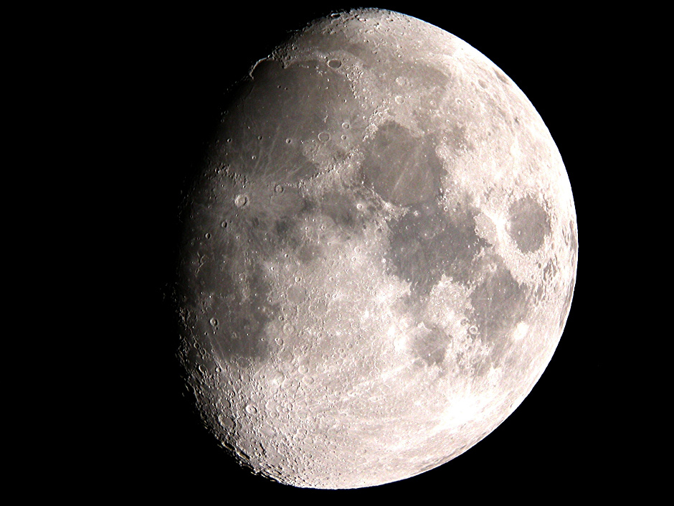
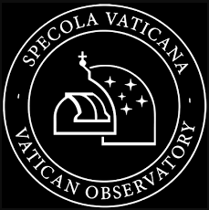
Sun, Moon, and Ascending: Astrology from the Perspective of an Astronomer.
Christopher M. Graney, Vatican Observatory
Notes:
Mention VO dates to work on the Gregorian Calendar in 16th century, J Heilbron – Catholic Church support of astronomy 600 years.

Slide 2
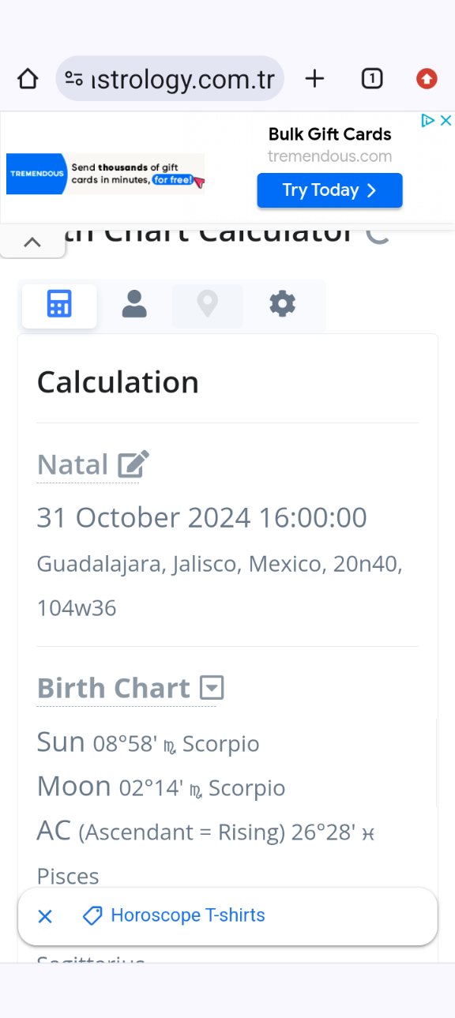

Slide 3
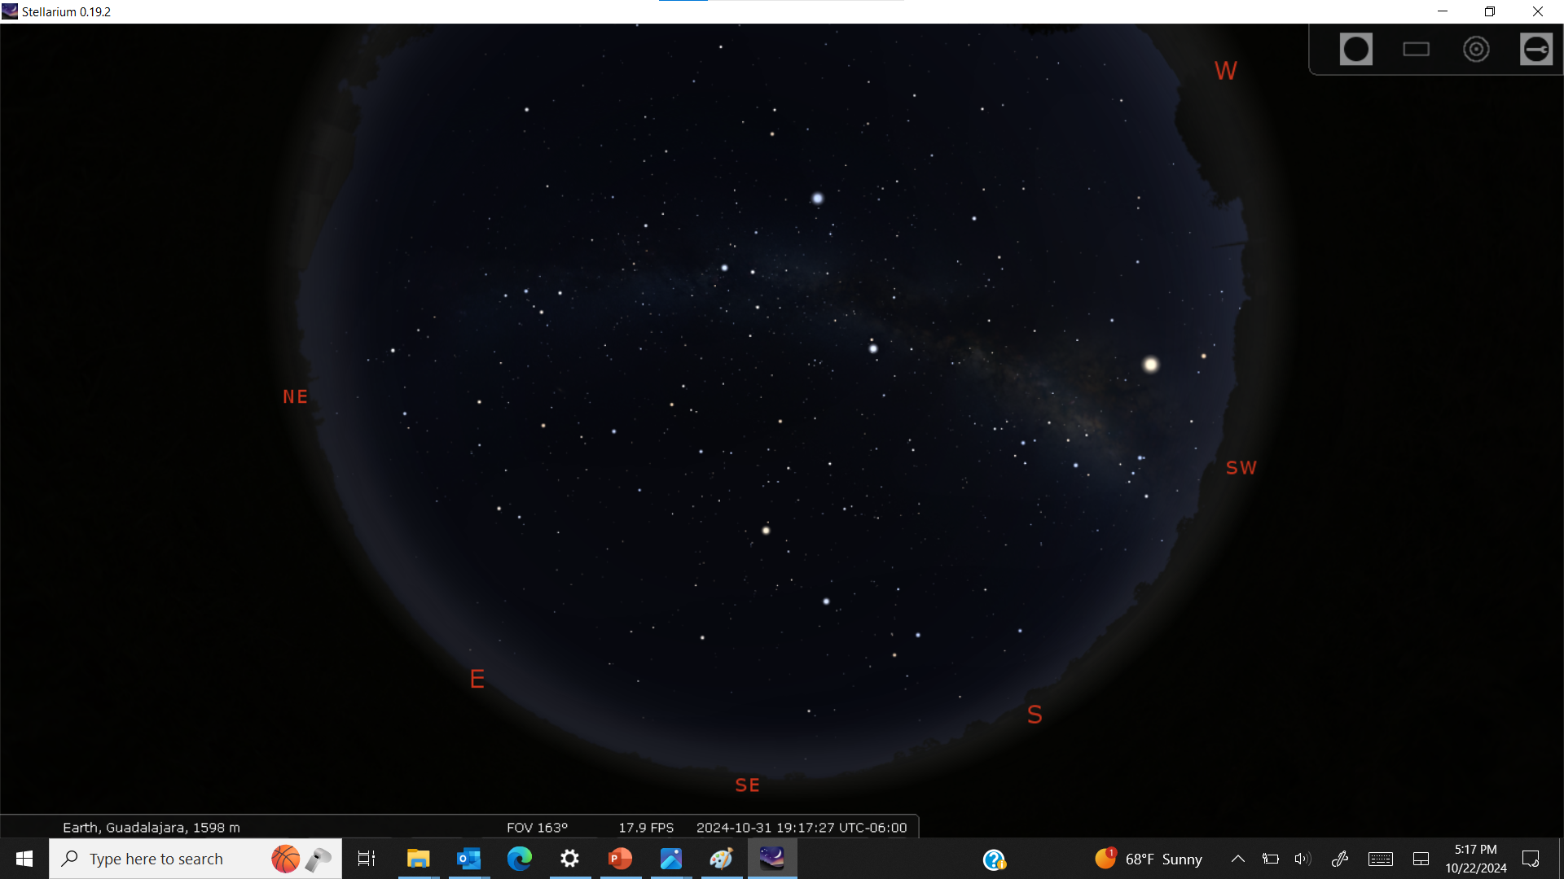

Slide 4
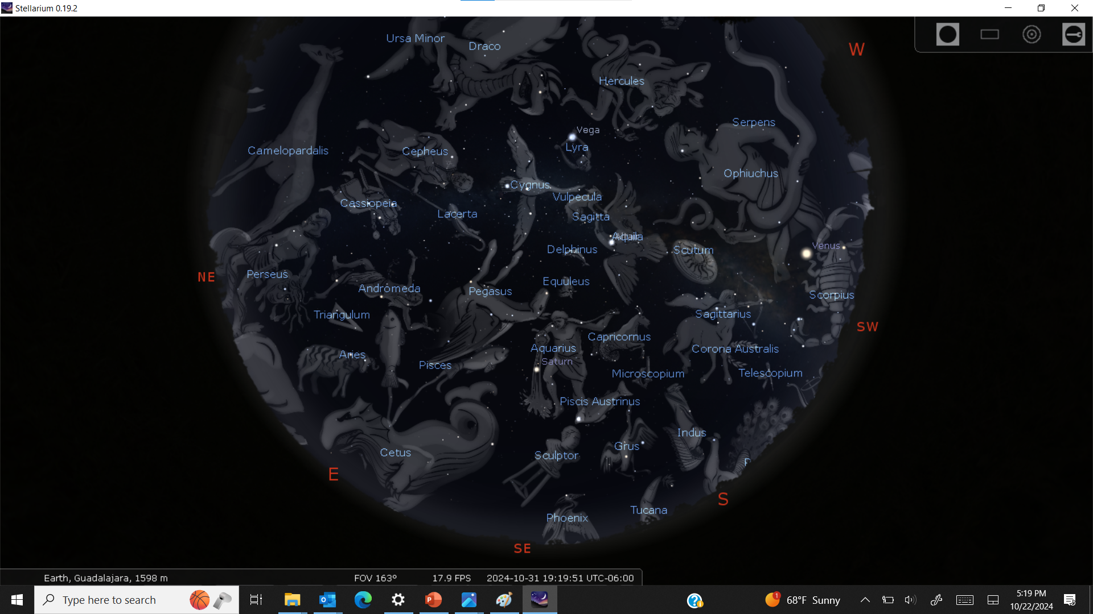

Slide 5
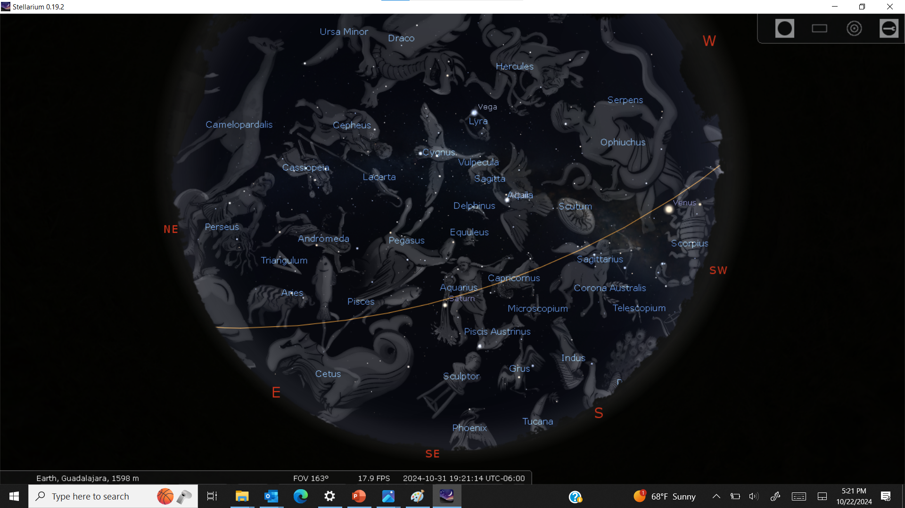

Slide 6
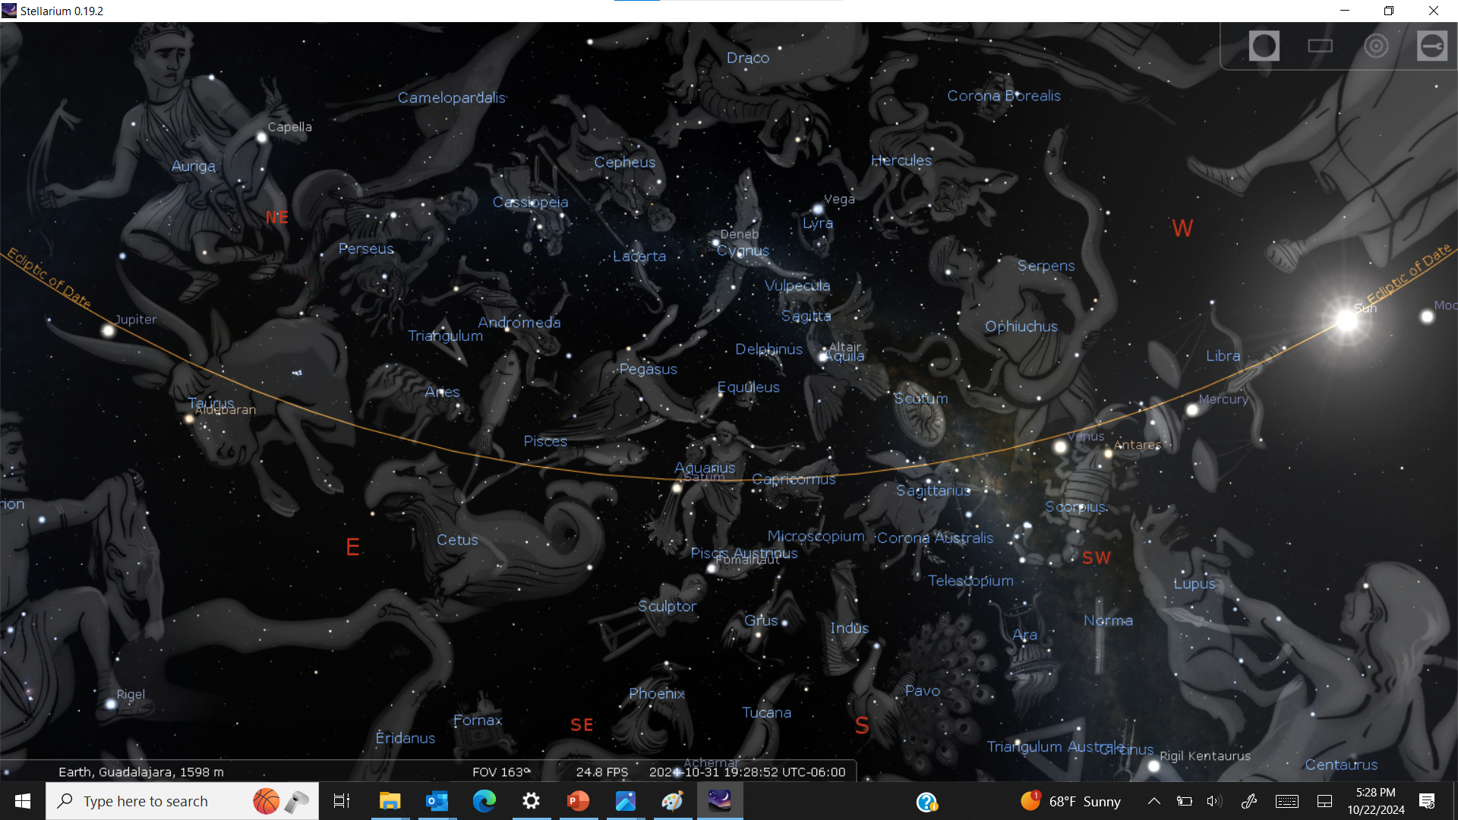

Slide 7
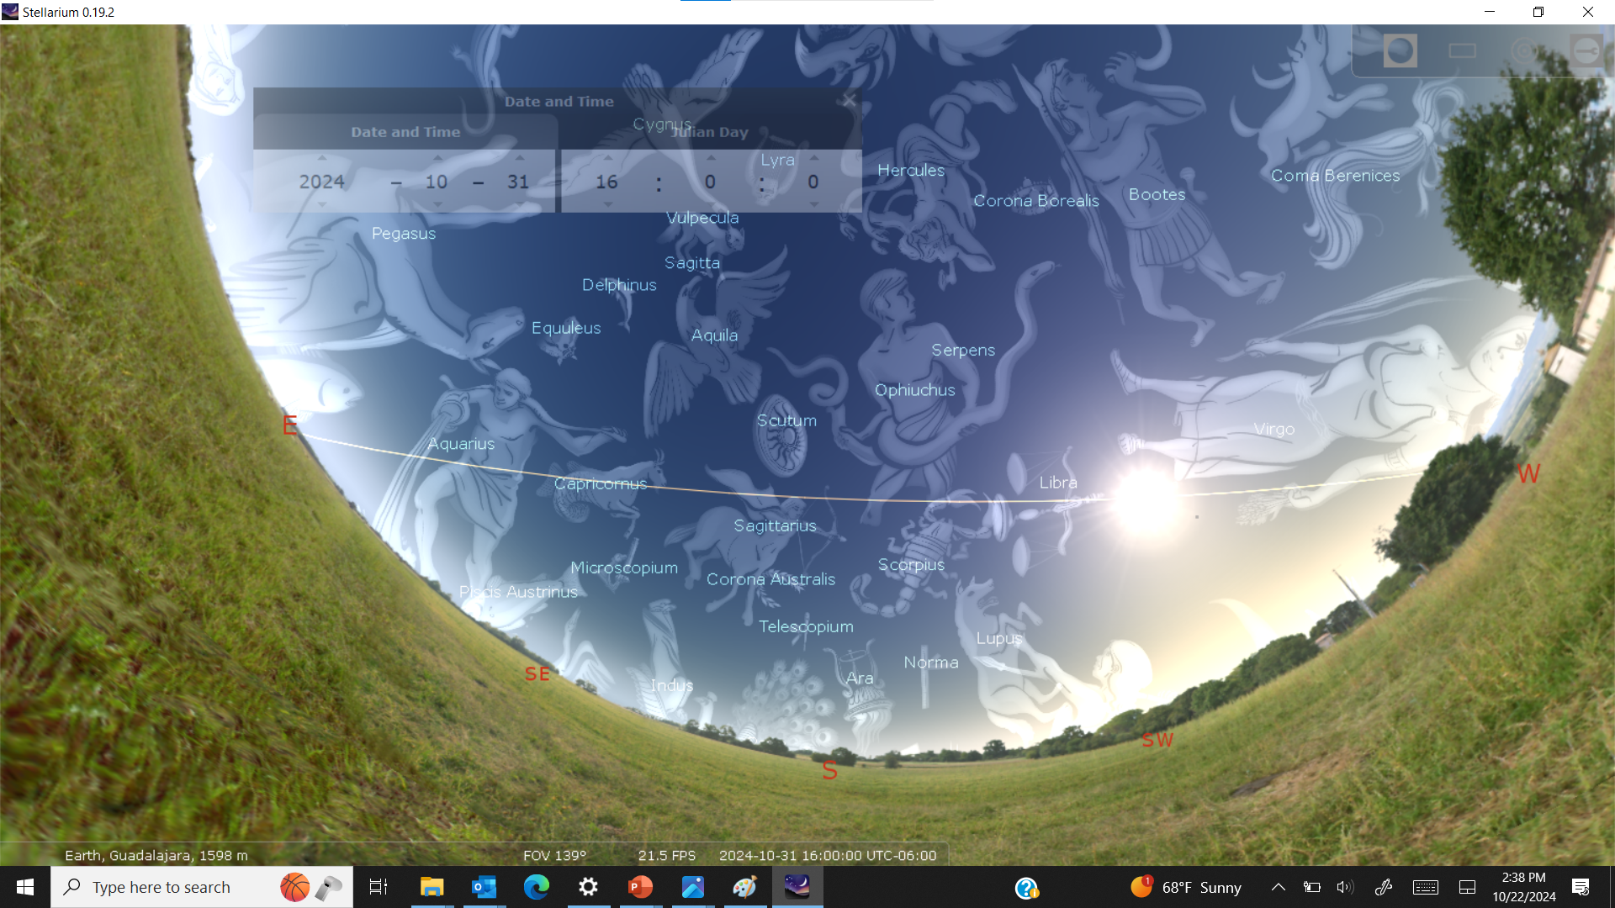

Slide 9
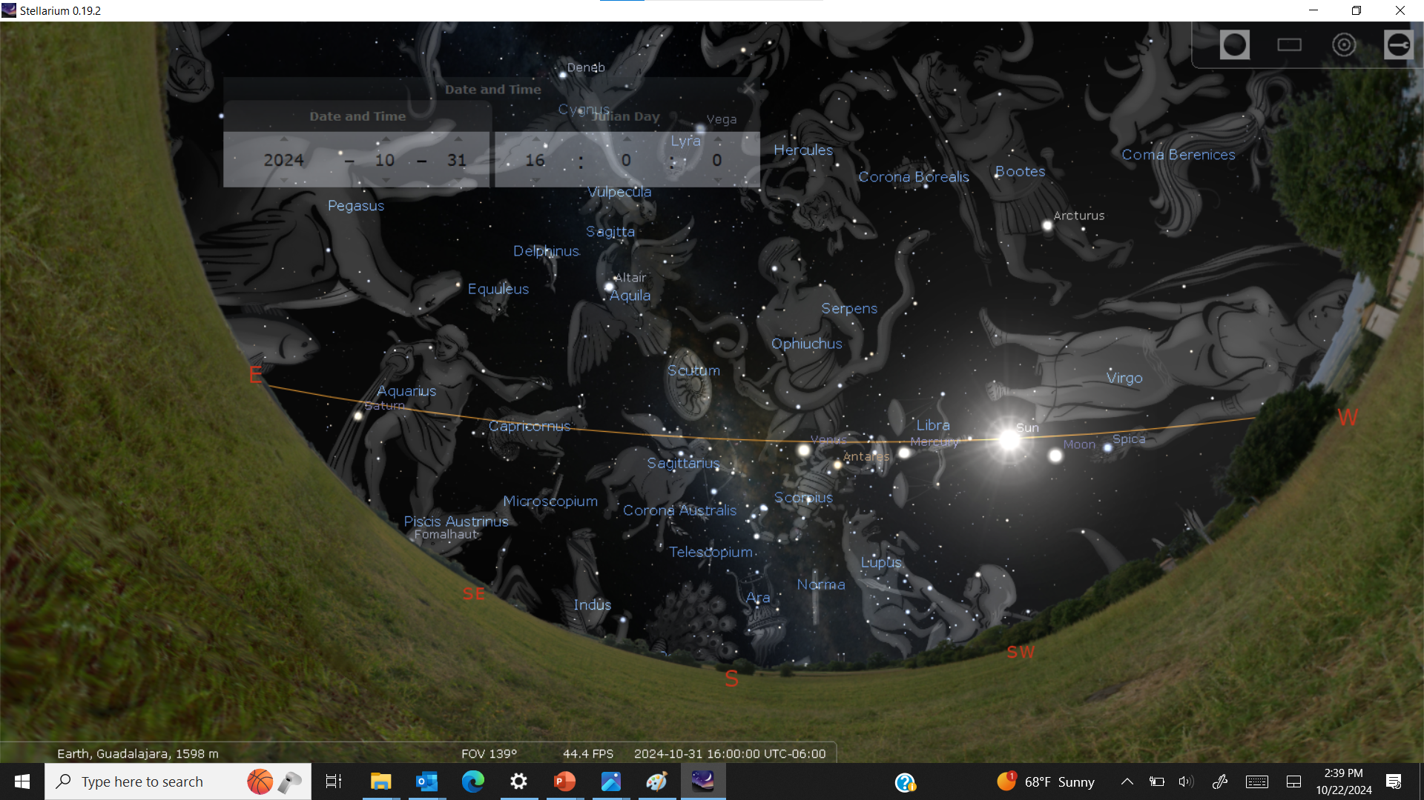

Slide 10
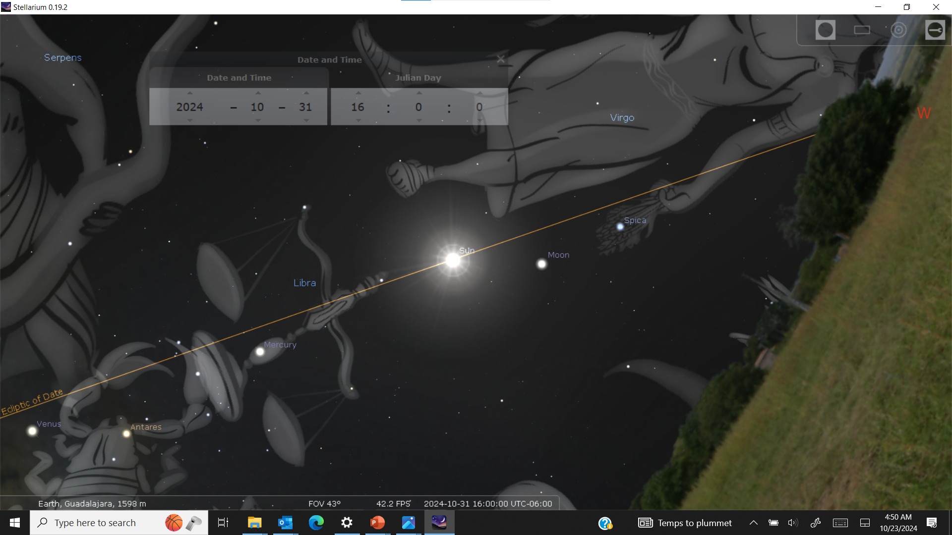

Slide 12
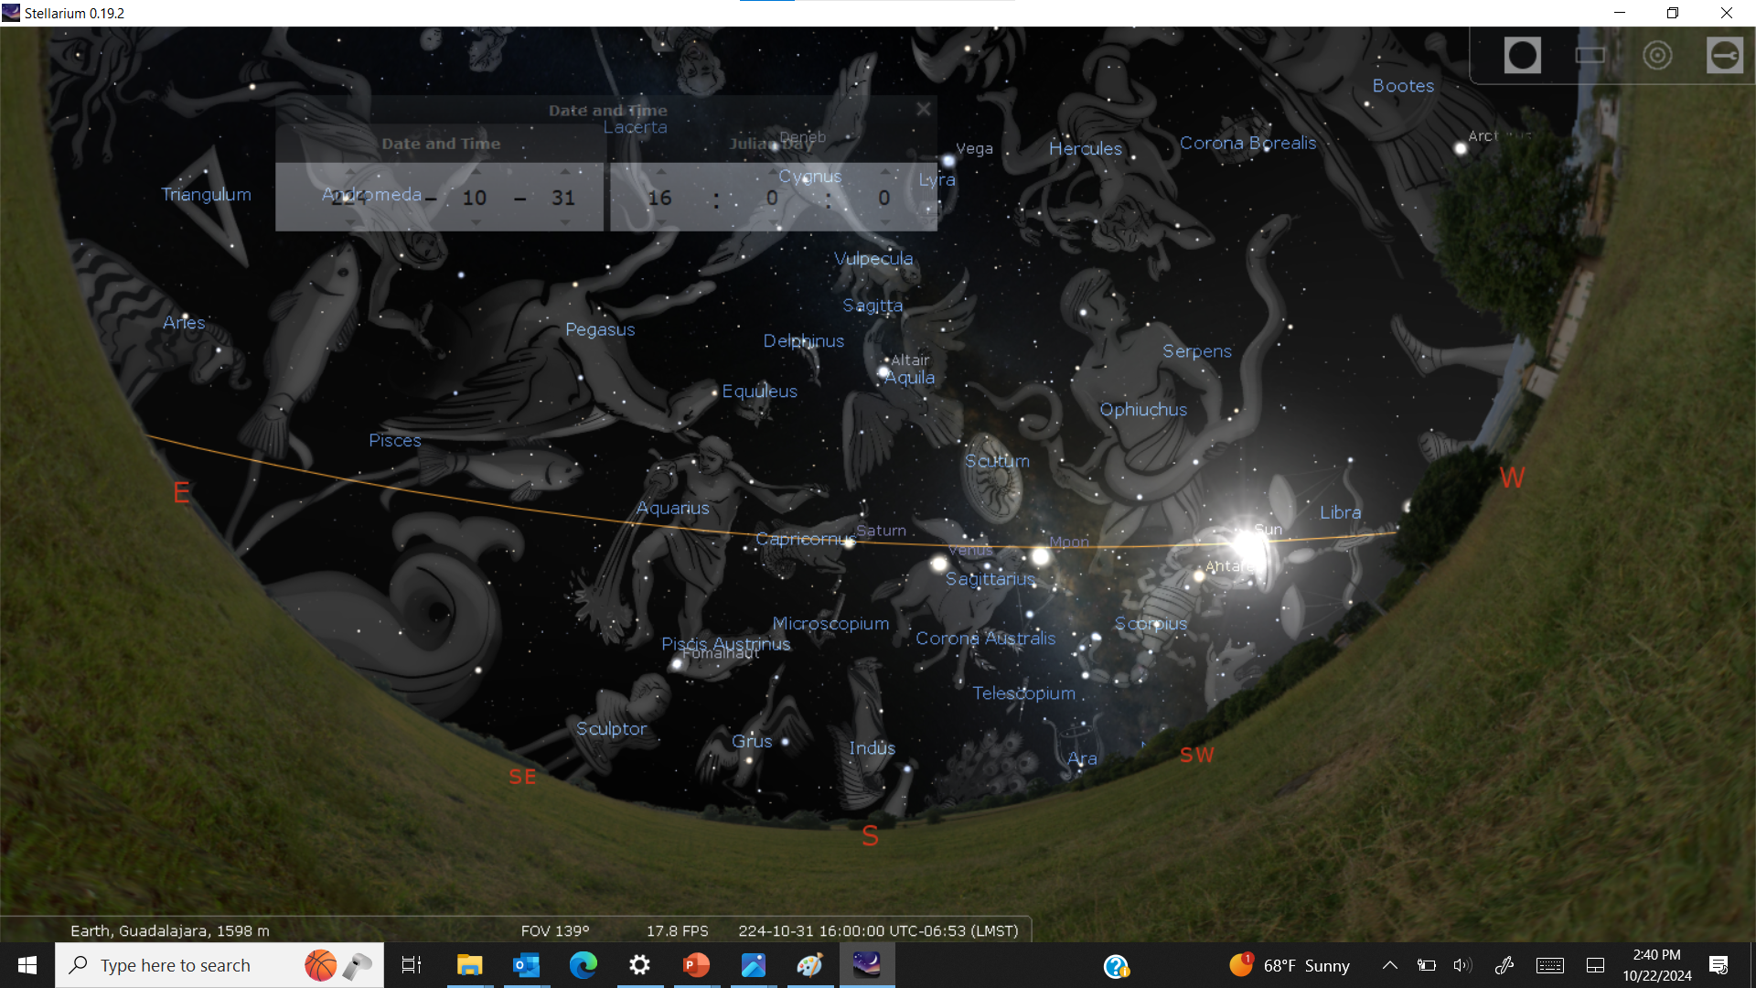

Slide 13
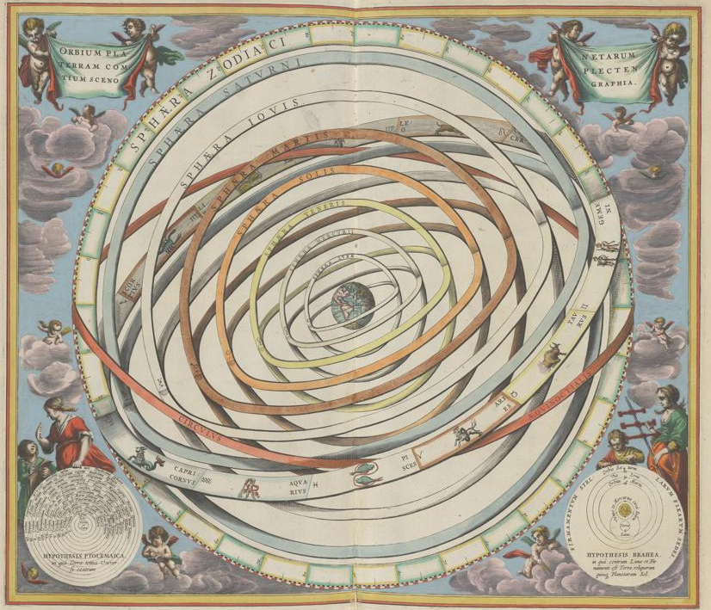
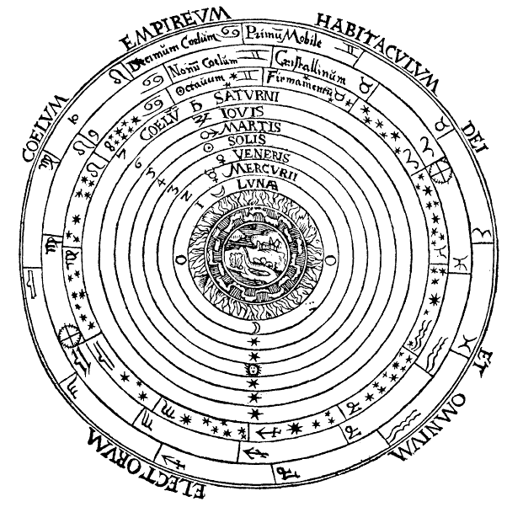
The Universe in the year 224: Earth is the center, made of 4 elements; heavens are “ethereal” (5th element)

Slide 14
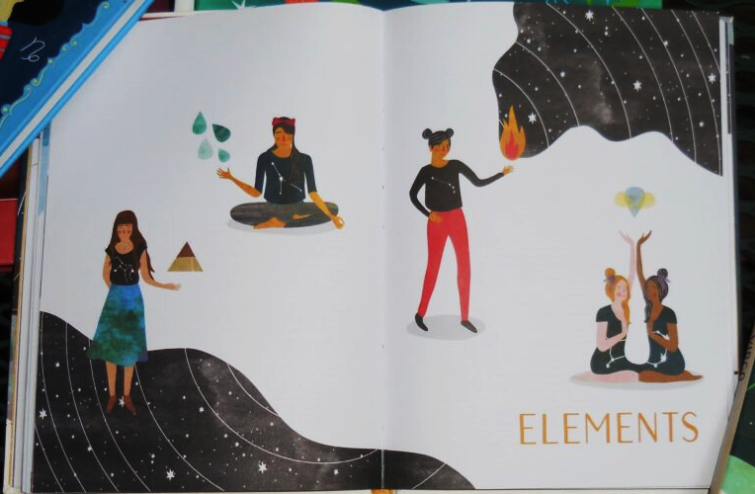
WATER
FIRE
AIR
EARTH

Slide 15
The Universe in the year 224:
Planets & stars are ethereal lights, centered on Earth. They can convey ethereal information (from the gods, or the universe, or whatever) to Earth.

Slide 16
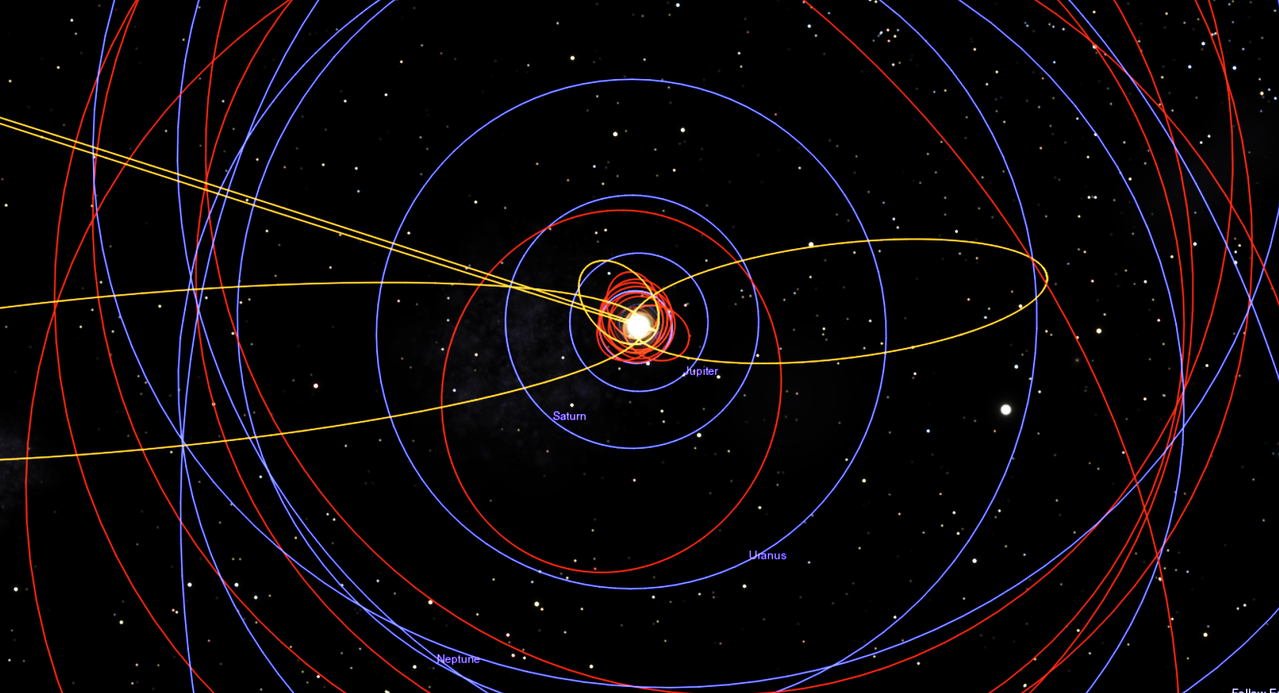
The Universe Solar System in the year 2024: Where is Earth? All bodies made of same elements (H, C, O, N, Fe, Si, etc.)

Slide 17
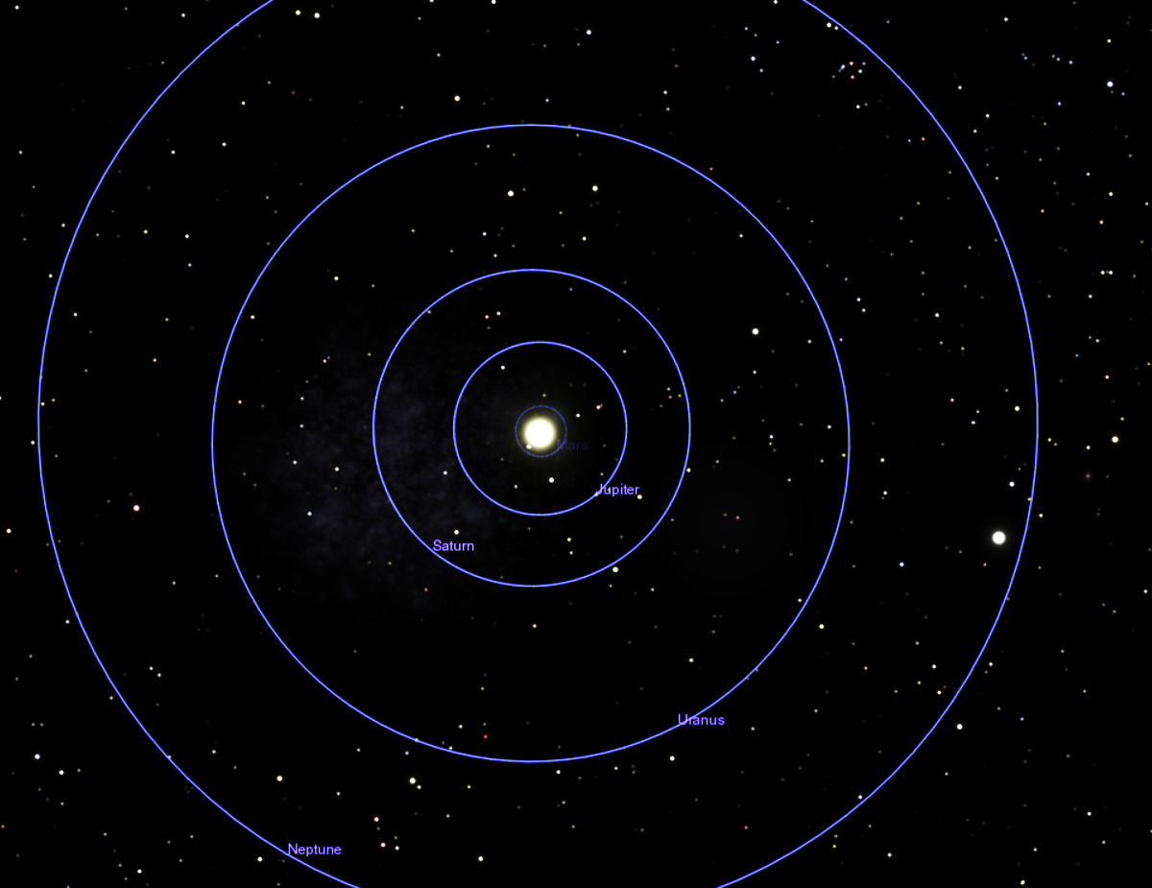
Where is Earth? All bodies made of same elements (H, C, O, N, Fe, Si, etc.) All obey same laws of physics & chemistry.

Slide 18
The Universe in the year 2024:
Planets & stars are not centered on Earth, not ethereal. Just material like us.
No ether. No 4 elements.

Slide 19
“we are all connected”
“you are part of the universe around you, and by studying the stars, it’s possible to learn more about yourself”

Slide 20
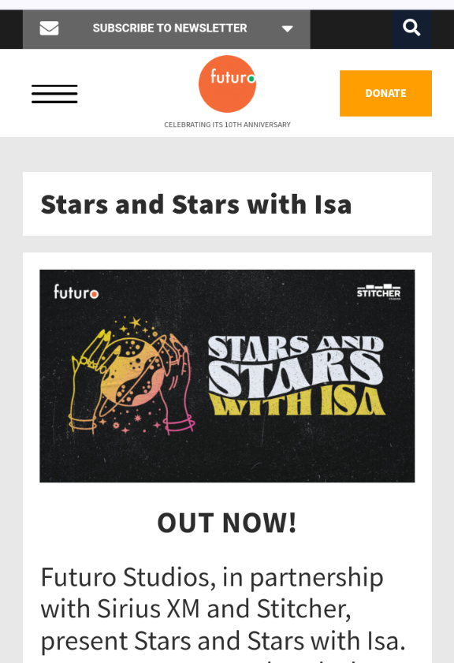
Maria Hinojosa (award-winning journalist) & Isa Nakazawa (astrologer)
They say (citing Carl Sagan) that we are all made of “star stuff”, so we are connected to the stars, we are “part of something bigger” and we “don’t walk alone”.

Slide 21
BUT...
Why would the H, C, O, N, Fe, Si in far-away bodies affect us so much more than the same elements right here?
The “ascendant” can make a big difference in, for example, a “Leo”:
The stars of Virgo “Ascendant” on the eastern horizon at a Leo’s birth will affect her in one way (so as to “temper Leo’s love of drama”, and causing her to perhaps “come across as less fun-loving than you really are” and be prone to getting “caught up in making things perfect”). The stars of Sagittarius ascendant will affect her in a dramatically different way (giving her a “sunny character” to match her “bright and breezy personality”, so she “makes friends with ease”, is a “natural leader”, full of “optimism and love of learning” with a “Sagittarius free spirit” that is “complemented by Leo’s staying power”). HUGE DIFFERENCE!

Slide 22
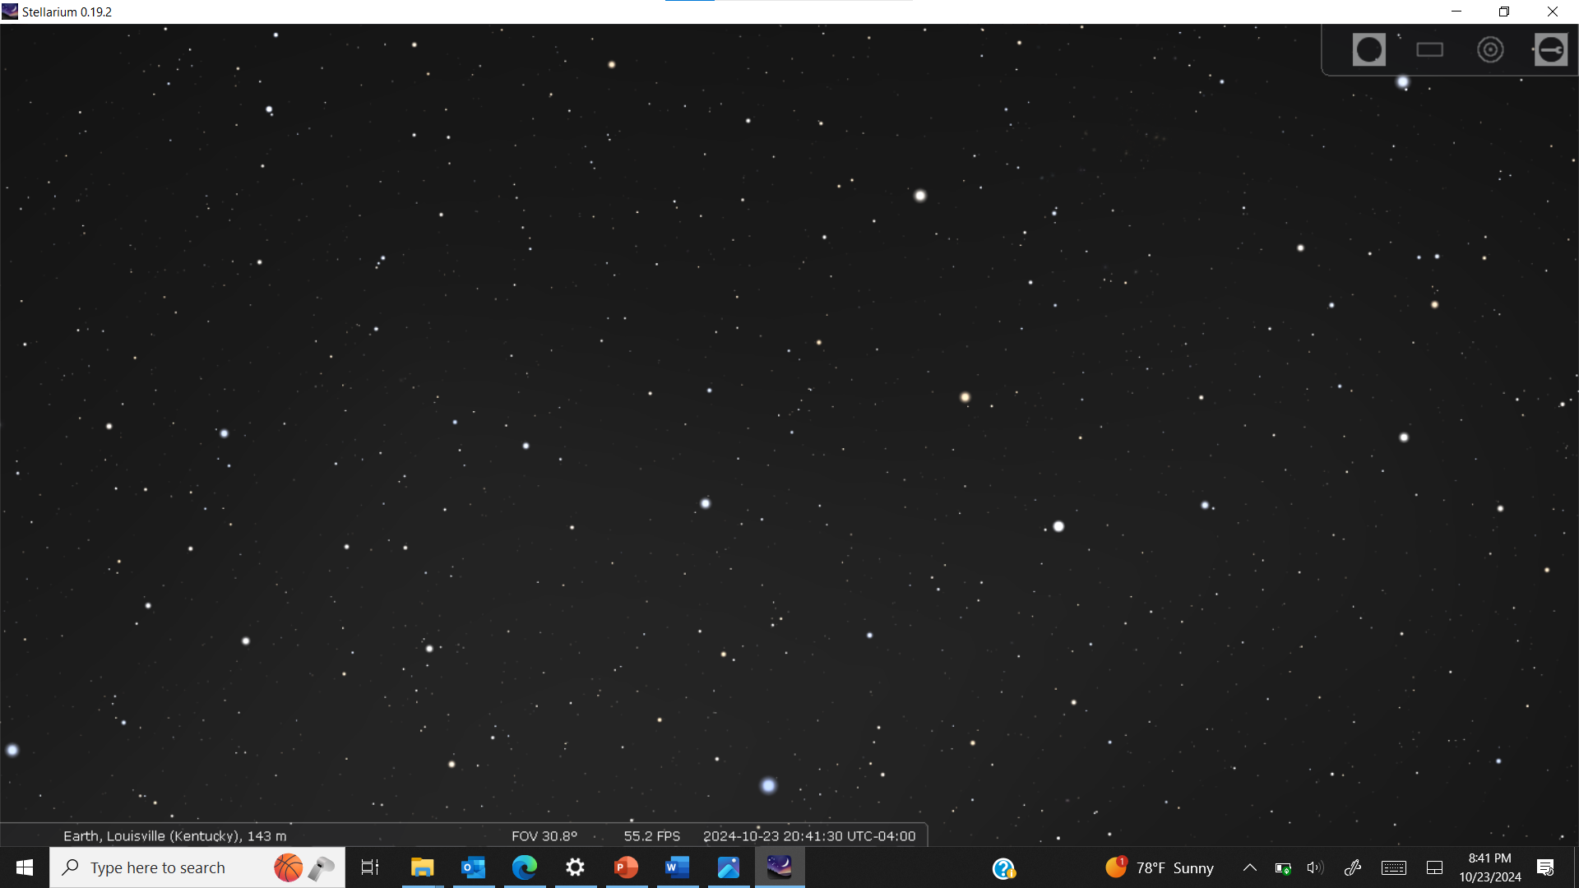

Slide 23
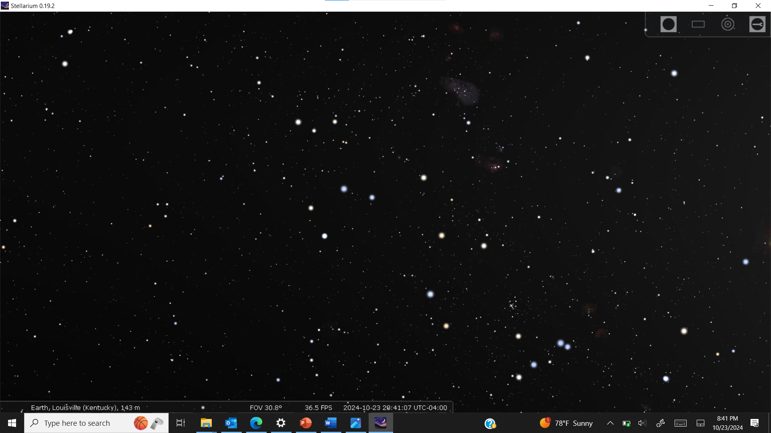

Slide 24
“less fun-loving than you really are” and be prone to getting “caught up in making things perfect”

Slide 25
a “sunny character” to match her “bright and breezy personality”, so she “makes friends with ease”, is a “natural leader”, full of “optimism and love of learning” with a “Sagittarius free spirit” that is “complemented by Leo’s staying power”

Slide 26
But in fact, the effect those so-distant stars could have on a child’s at birth is dwarfed by the effect of every object in the room where she was born. The gravitational pull at Earth of a star like the sun located 10 light-years away is less than that of a mass of just ¼ gram at a distance of 1 meter. In other words, each bead of sweat on the head of the child’s father as he encouraged her mother through the delivery would have had as much effect as the stars of her Rising sign.

Slide 27
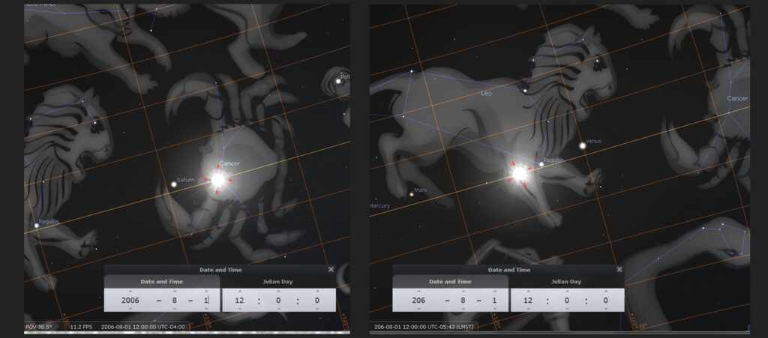
Astrology is almost 2000 years out of date.
Signs are wrong because calculations are out of date (Born 2006-8-1? you are not a Leo, you are a Cancer!). Go see the sky for yourself!
Earth is not the center of the universe
Stars & planets are not ethereal
They have same effect as all other matter and are too far away to do anything

Slide 28
The idea that anything about you are determined by the stars lacks any scientific basis.
Astrology is like a fragment of a religion.

Slide 29
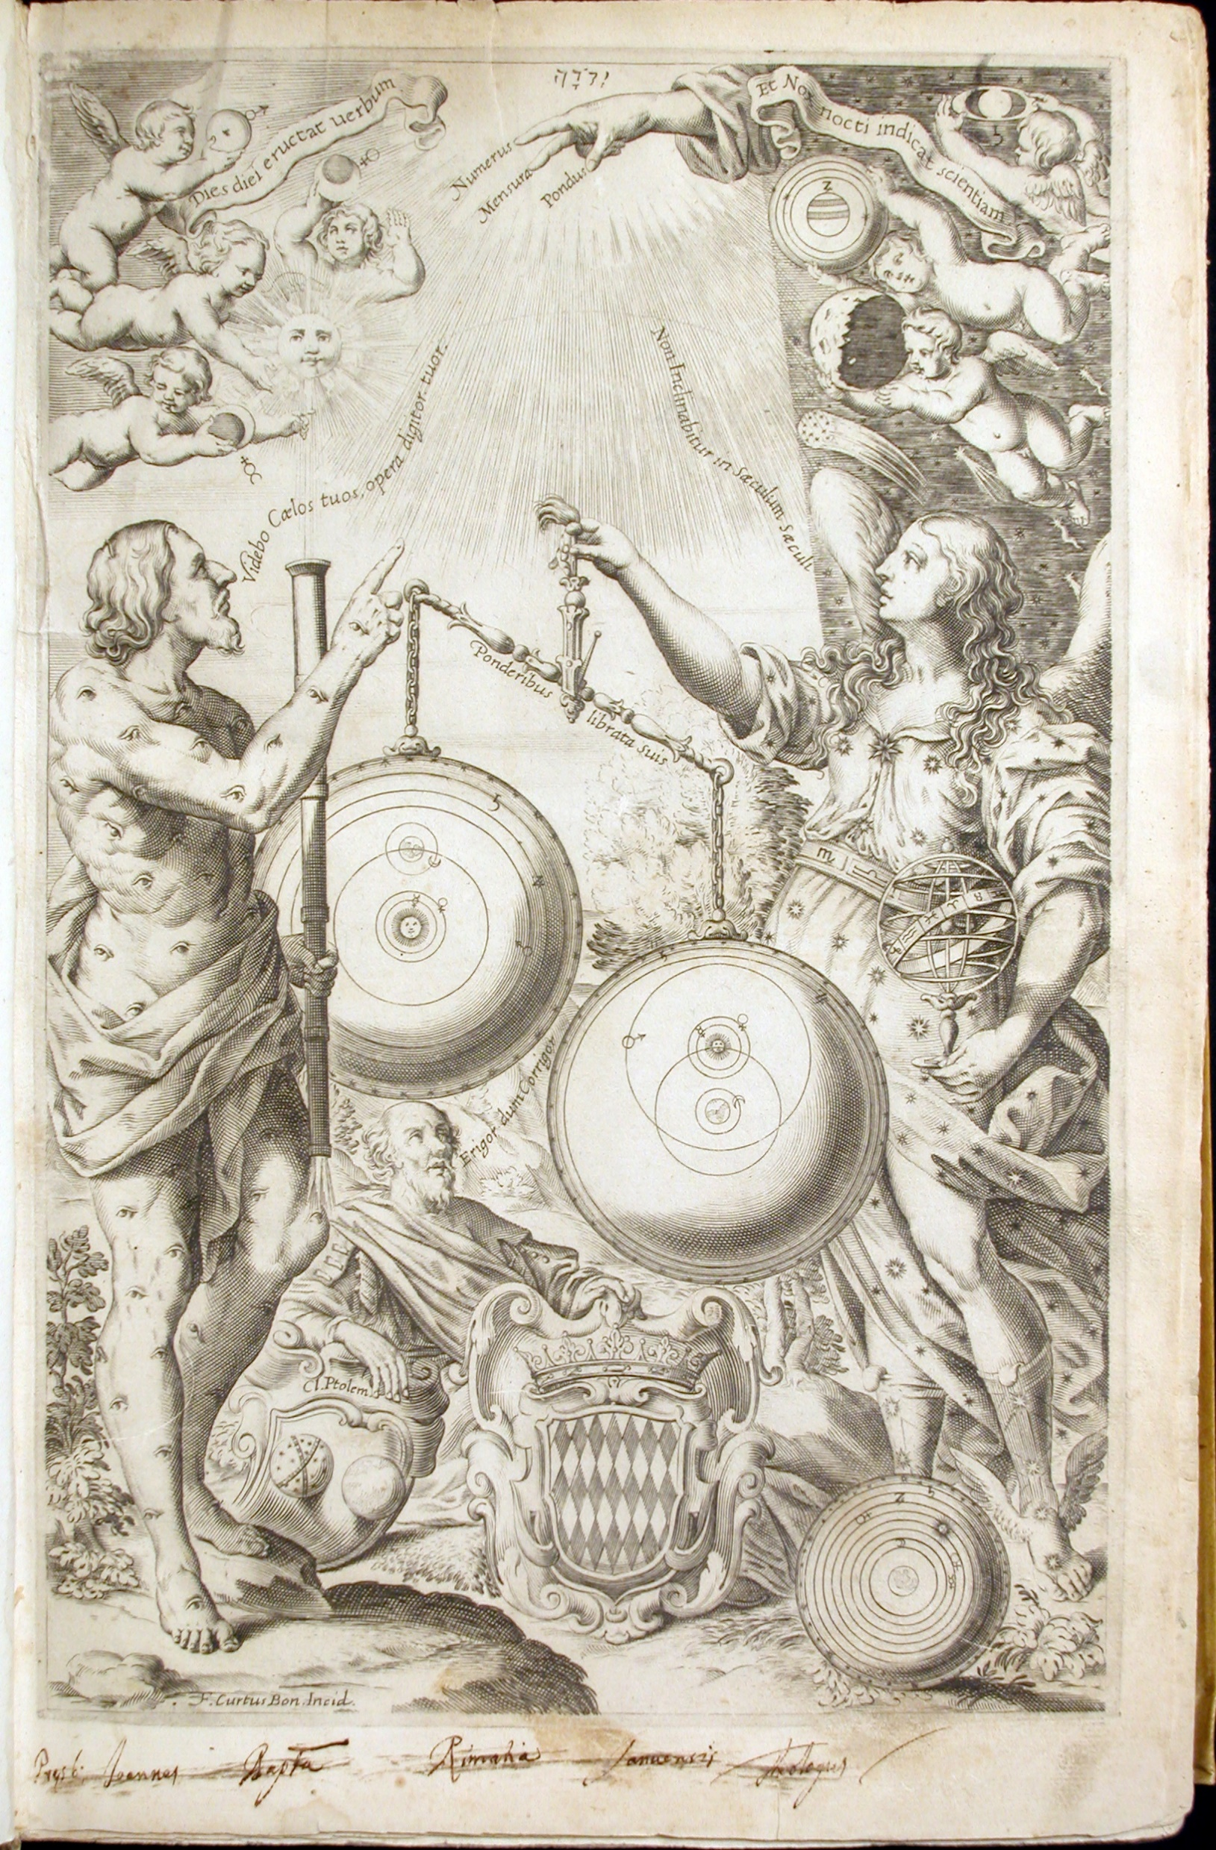
HISTORICAL PERSPICTIVE—Jesuit astronomer Fr. Giovanni Battista Riccioli (1651), citing Isaiah 47:13-14 (among other things):
“Let them come forward now and save you, these who analyse the heavens, who study the stars and announce month by month what will happen to you next. Oh, they will be like wisps of straw and the fire will burn them.”
Artwork from Riccioli’s 1651 New Almagest THE BIG book on astronomy of the 17th century

Slide 30
Riccioli goes on to complain about:
“the error of astrologers who, based on the position of the stars, not only predicted inclinations towards certain types of behaviour or lifestyles based on the natural temperament of the humours, but also ventured to predict future events and outcomes that were dependent solely on the free will of one or more individuals.
This type of men, as Tacitus says in his Annals, will “always be sought after and retained in the city”, or rather one could say throughout the world. Even though astrologers may be wrong a thousand times and deceive many, they earn more fame from one instance of reckless success than infamy from so many blatant lies.”
Artwork from Riccioli’s 1651 New Almagest THE BIG book on astronomy of the 17th century

Slide 31
Riccioli goes on to complain about:
“Astronomy is the most excellent part of Mathematics, and they perverted it to Judicial Astrology to predict fortuitous events, ranging from the certain prediction of Eclipses, to claiming equal certainty in other matters.”
In other words, Riccioli is saying that yes, you can use the stars to predict things like eclipses, and even weather in a simple sense (when the Sun is in the scorpion the weather will be colder! when the Sun is in the crab, the weather will be cooler!)—but it is absurd to think you can use it to predict what your day will be like or what your life will be like or who your friends should be.
Artwork from Riccioli’s 1651 New Almagest THE BIG book on astronomy of the 17th century

Slide 32
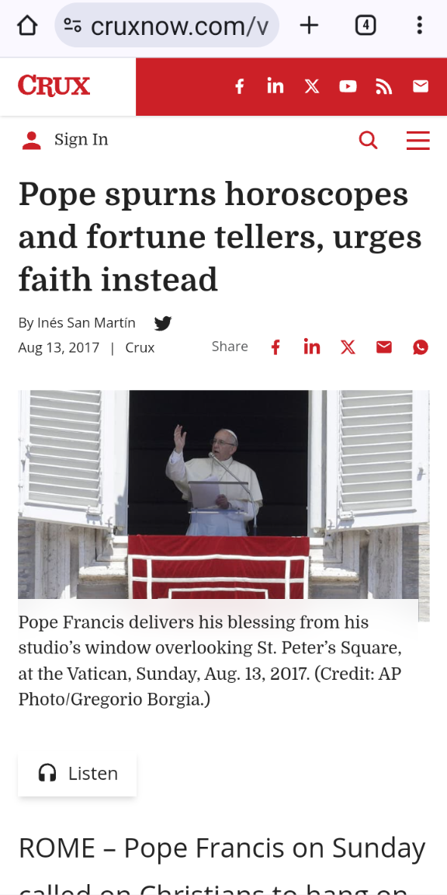
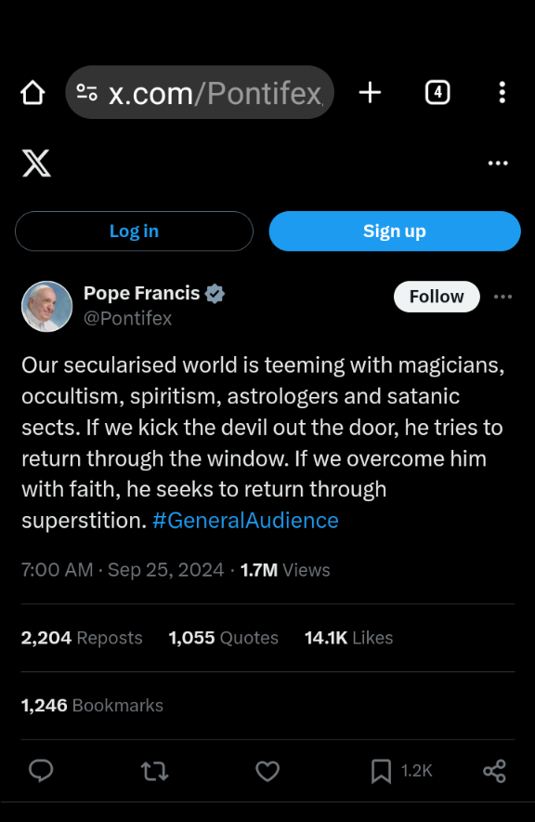
Another Jesuit (not an astronomer—a chemistry tech!), Pope Francis.

Slide 33
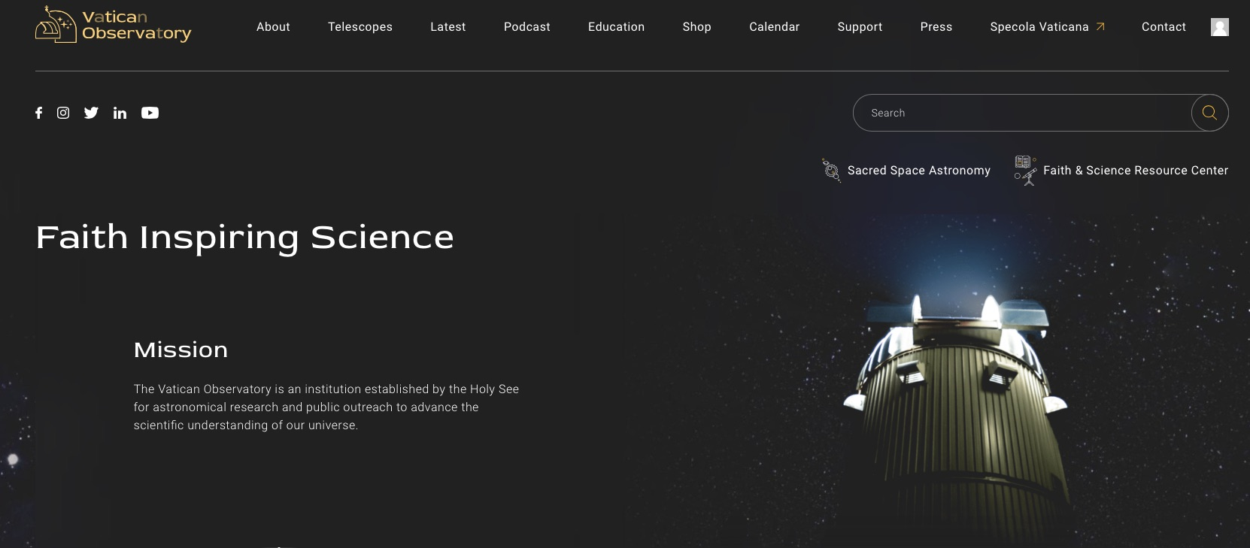
Learn more about
the Vatican Observatory at
www.VaticanObservatory.org

Slide 34
We’re exploring the farthest reaches of creation – the galaxies, stars and planets. But doing that takes money. Your USA tax-deductible gift to the Vatican Observatory Foundation promotes scientific study while helping us reveal God’s unlimited majesty.
There’s a whole universe out there.
Let’s explore it together.
Please consider a donation today.
Learn more about
the Vatican Observatory at
www.VaticanObservatory.org

